Slide 1
Students as Change Agents for School
Transformation
Carlton Cummiskey, Winter Haberle, Kaia Levey, Mason Berry, Eva Hynes, Maddy Cheney, Katie Rush, Liam Poulin, Hadley Kielich
Harwood Union High School
June 4, 2019
Notes:
lili

Slide 2
Hello Everyone!
Our Agenda
What we are doing at Harwood to transform teaching and learning using Student Agency and the Harkness Pedagogy
What is it like to learn in a Harkness classroom?
Our Reflections…….
Notes:
Winter

Slide 3
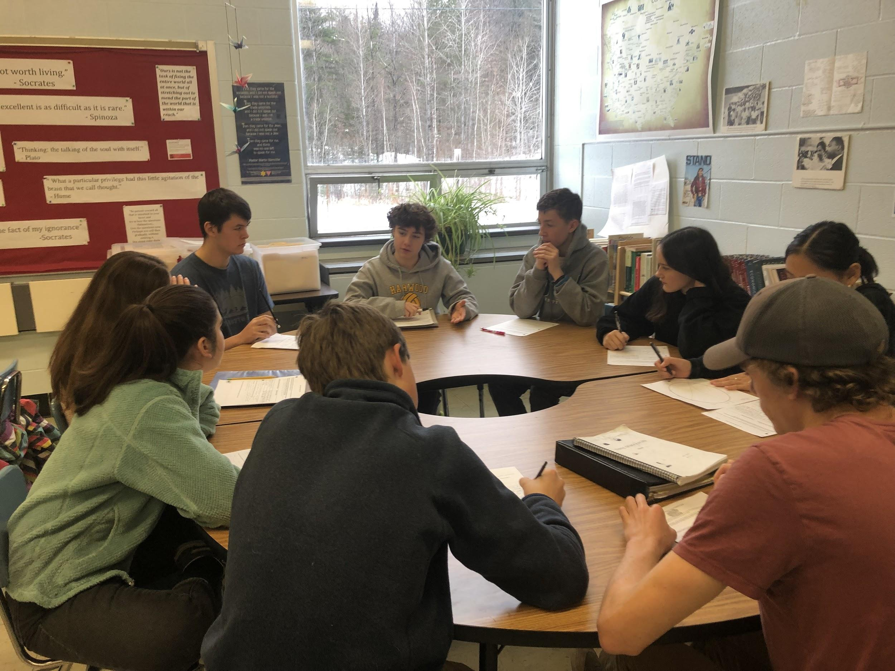
Who are We and What Have We Been Doing at HUHS?
Notes:
Liam
Who? We are the people of Harkness and we are teaching a pedagogie that makes the students do the work.
We are changing harwood because we feel like this is the new way of teaching and if we did not think this could work we would not be here right know talking to you.

Slide 4
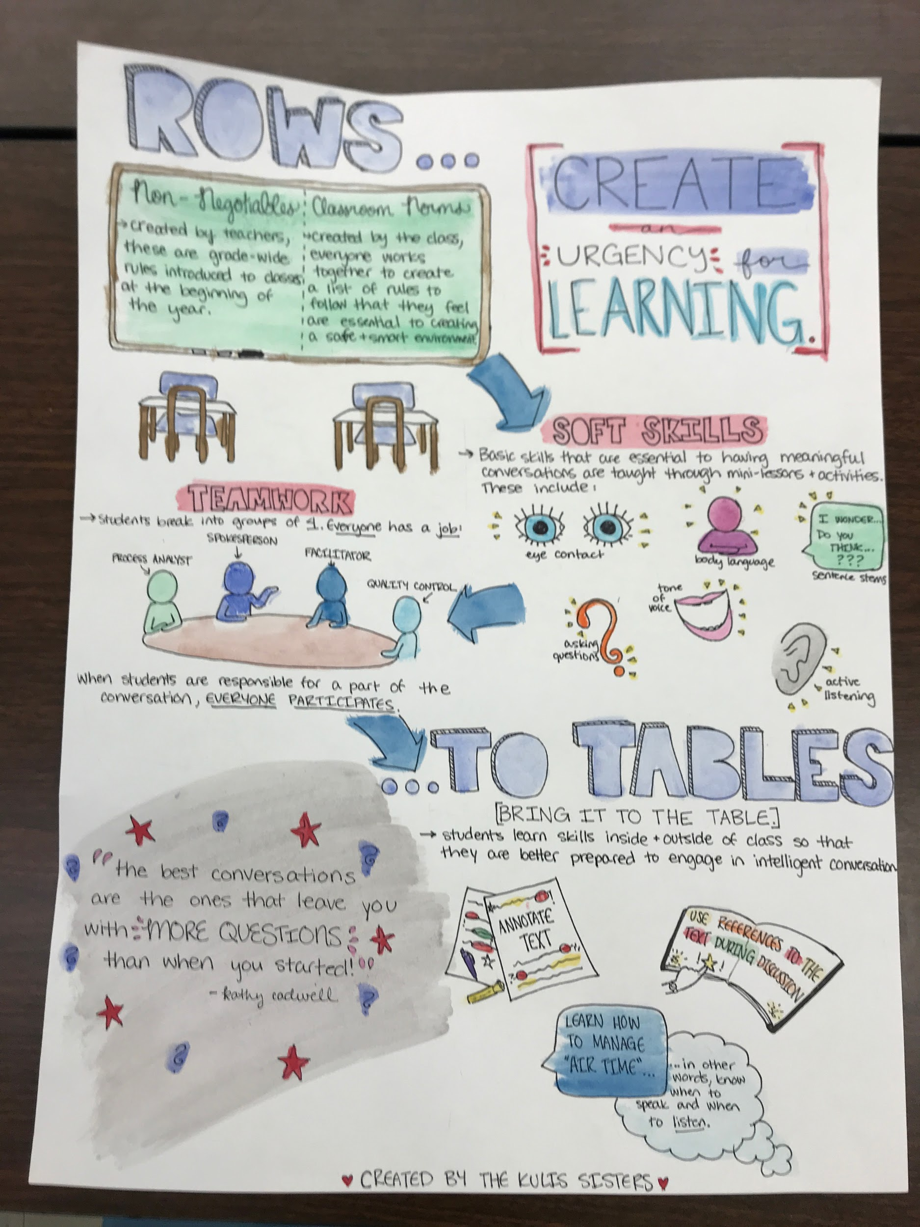
We are Working to Create Student-Driven Classrooms That Promote Equity, Diversity and Inclusion
Going
From ROWS….
To TABLES
*
Notes:
Carlton The idea the core is Harkness is a different way of teaching. Where the students do learning and the teacher does the listening. Many of you are wondering what is he talking about. Harkness is where students are put into tables rather than rows. Where they discuss about papers,books, world events and so much more. Where the teachers aren't involved in the process

Slide 5
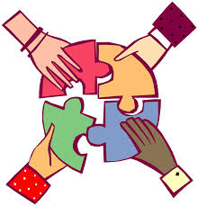
We are Working for School Transformation Using
A New Model for Student-Teacher Partnerships
Notes:
Maddy Cheney - Trying to work with teachers instead of teachers telling students what to do
Collaborate with the teachers and learn together. Comprehending on our own with teachers assistance

Slide 6
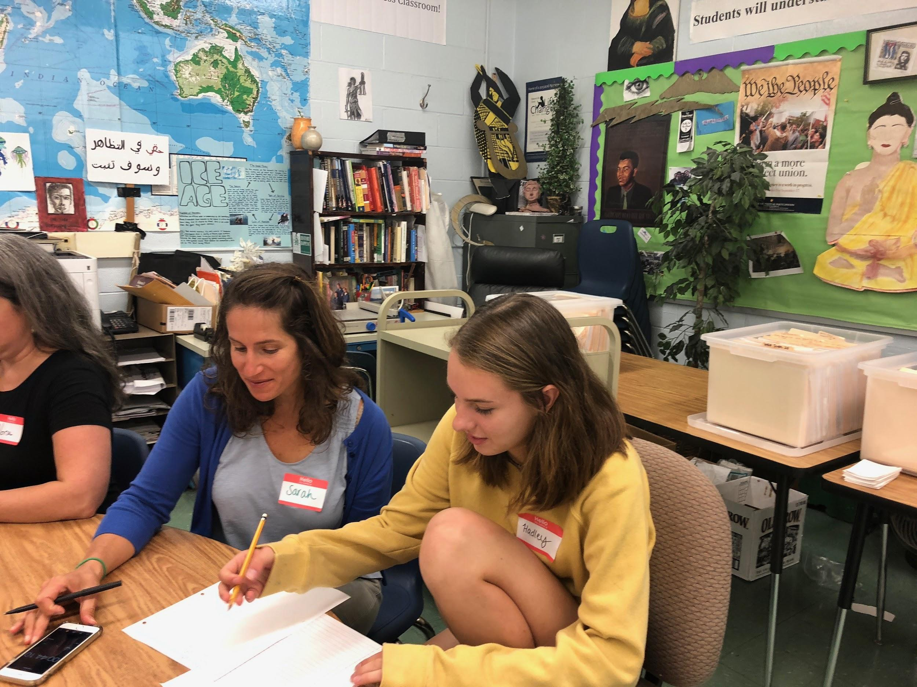
How are We Creating Change at our School?
We start with “STUDENT AGENCY”
Notes:
Winter
Student agency is in my opinion the most important institution that a school can promote. Student agency means the Students learning through topics that are relevant and interesting to them. Students helping to create their lessons. Students having a voice in how, and to a degree what, they learn.

Slide 7
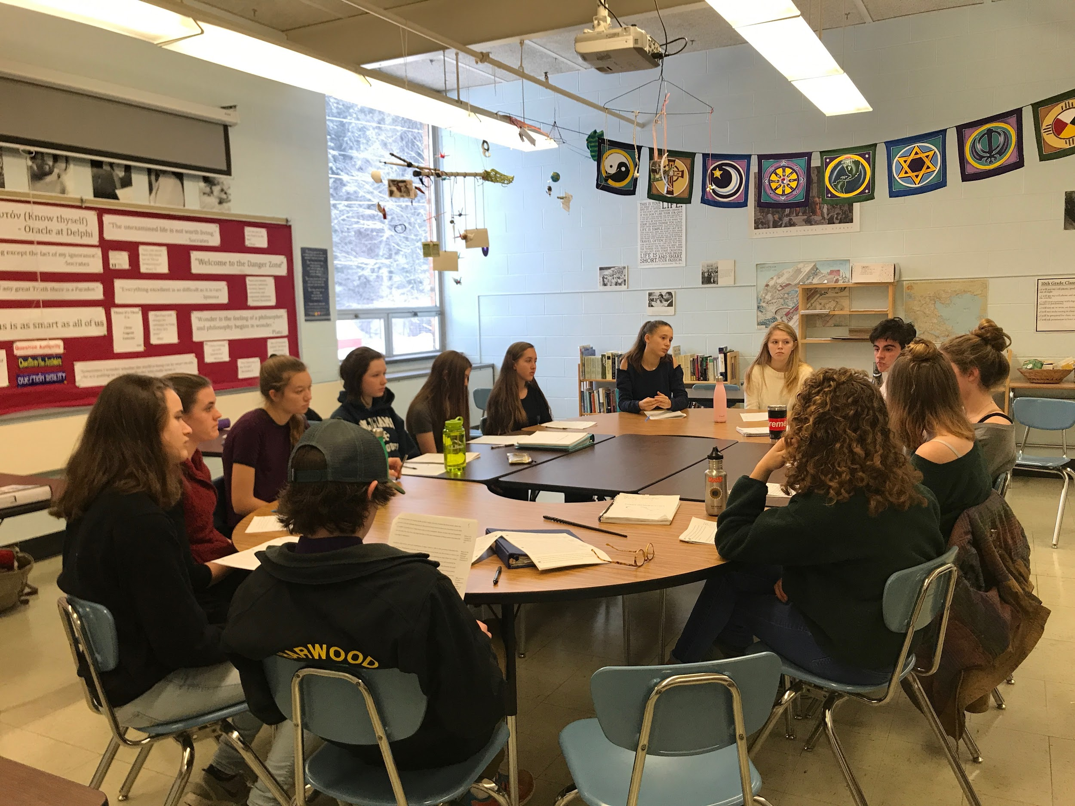
We are Partnering with Teachers to Increase Student- Driven Inquiry and Student Voice in the Classroom using Harkness Dialogue
“The One That Does the Work Does the Learning”
Notes:
Katie- move from teacher centered to student driven
The one that does the work does the learning

Slide 8
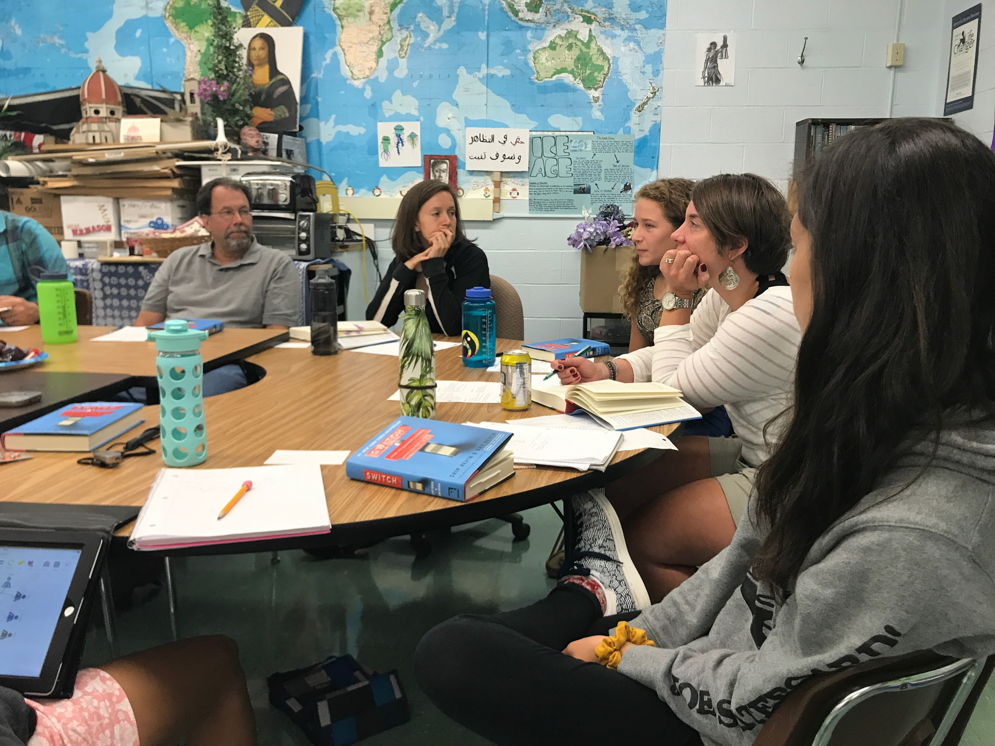
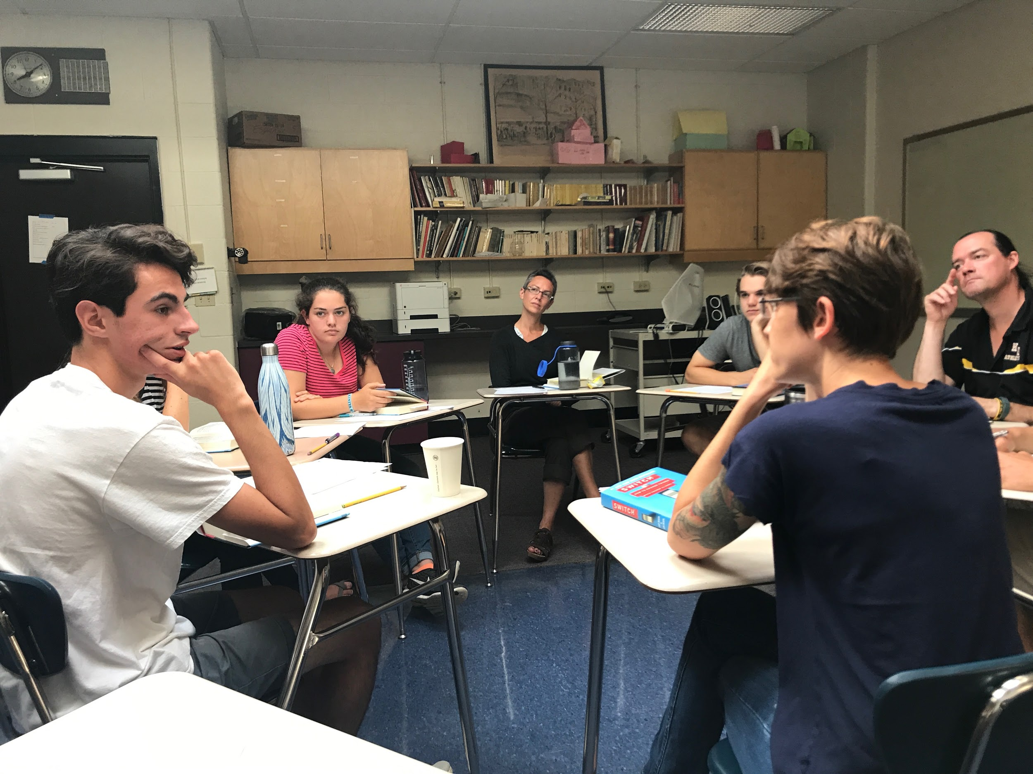
Over the Past Two Years 20 Student Leaders and 27 Teachers have been Introduced to Harkness
Next year all HUHS students will have learned Harkness skills!
Notes:
Hadley - by the middle of next year the whole school will have learned harkness skills

Slide 9
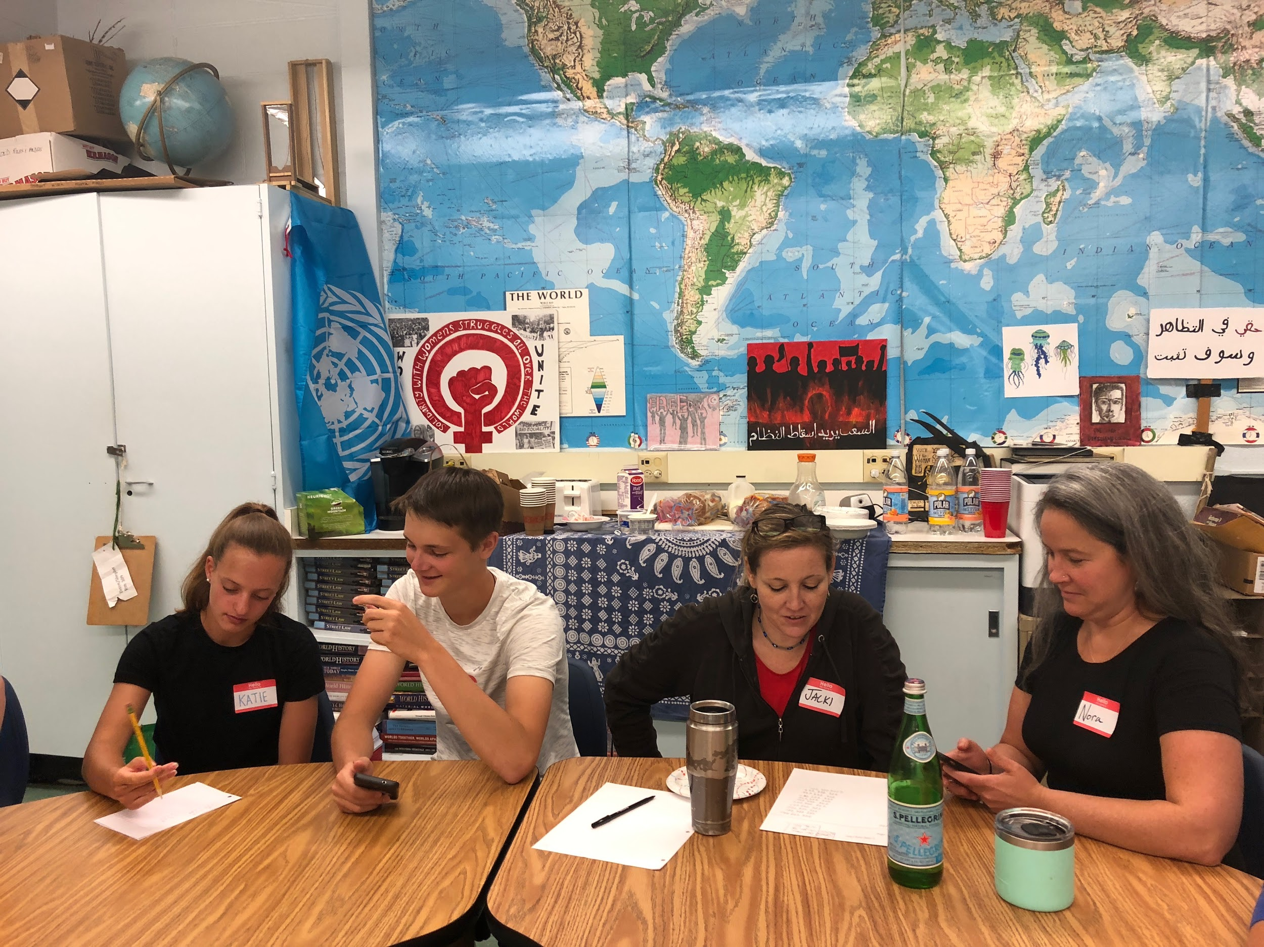
How Have We Been Working to Make Teaching and Learning More Engaging?
We Learn the Skills of Harkness Together with Teachers
Notes:
Eva - We learned soft skills alongside the teachers
Model of students working with teachers and students changing it (student voice)
We worked with teachers to make a change.

Slide 10
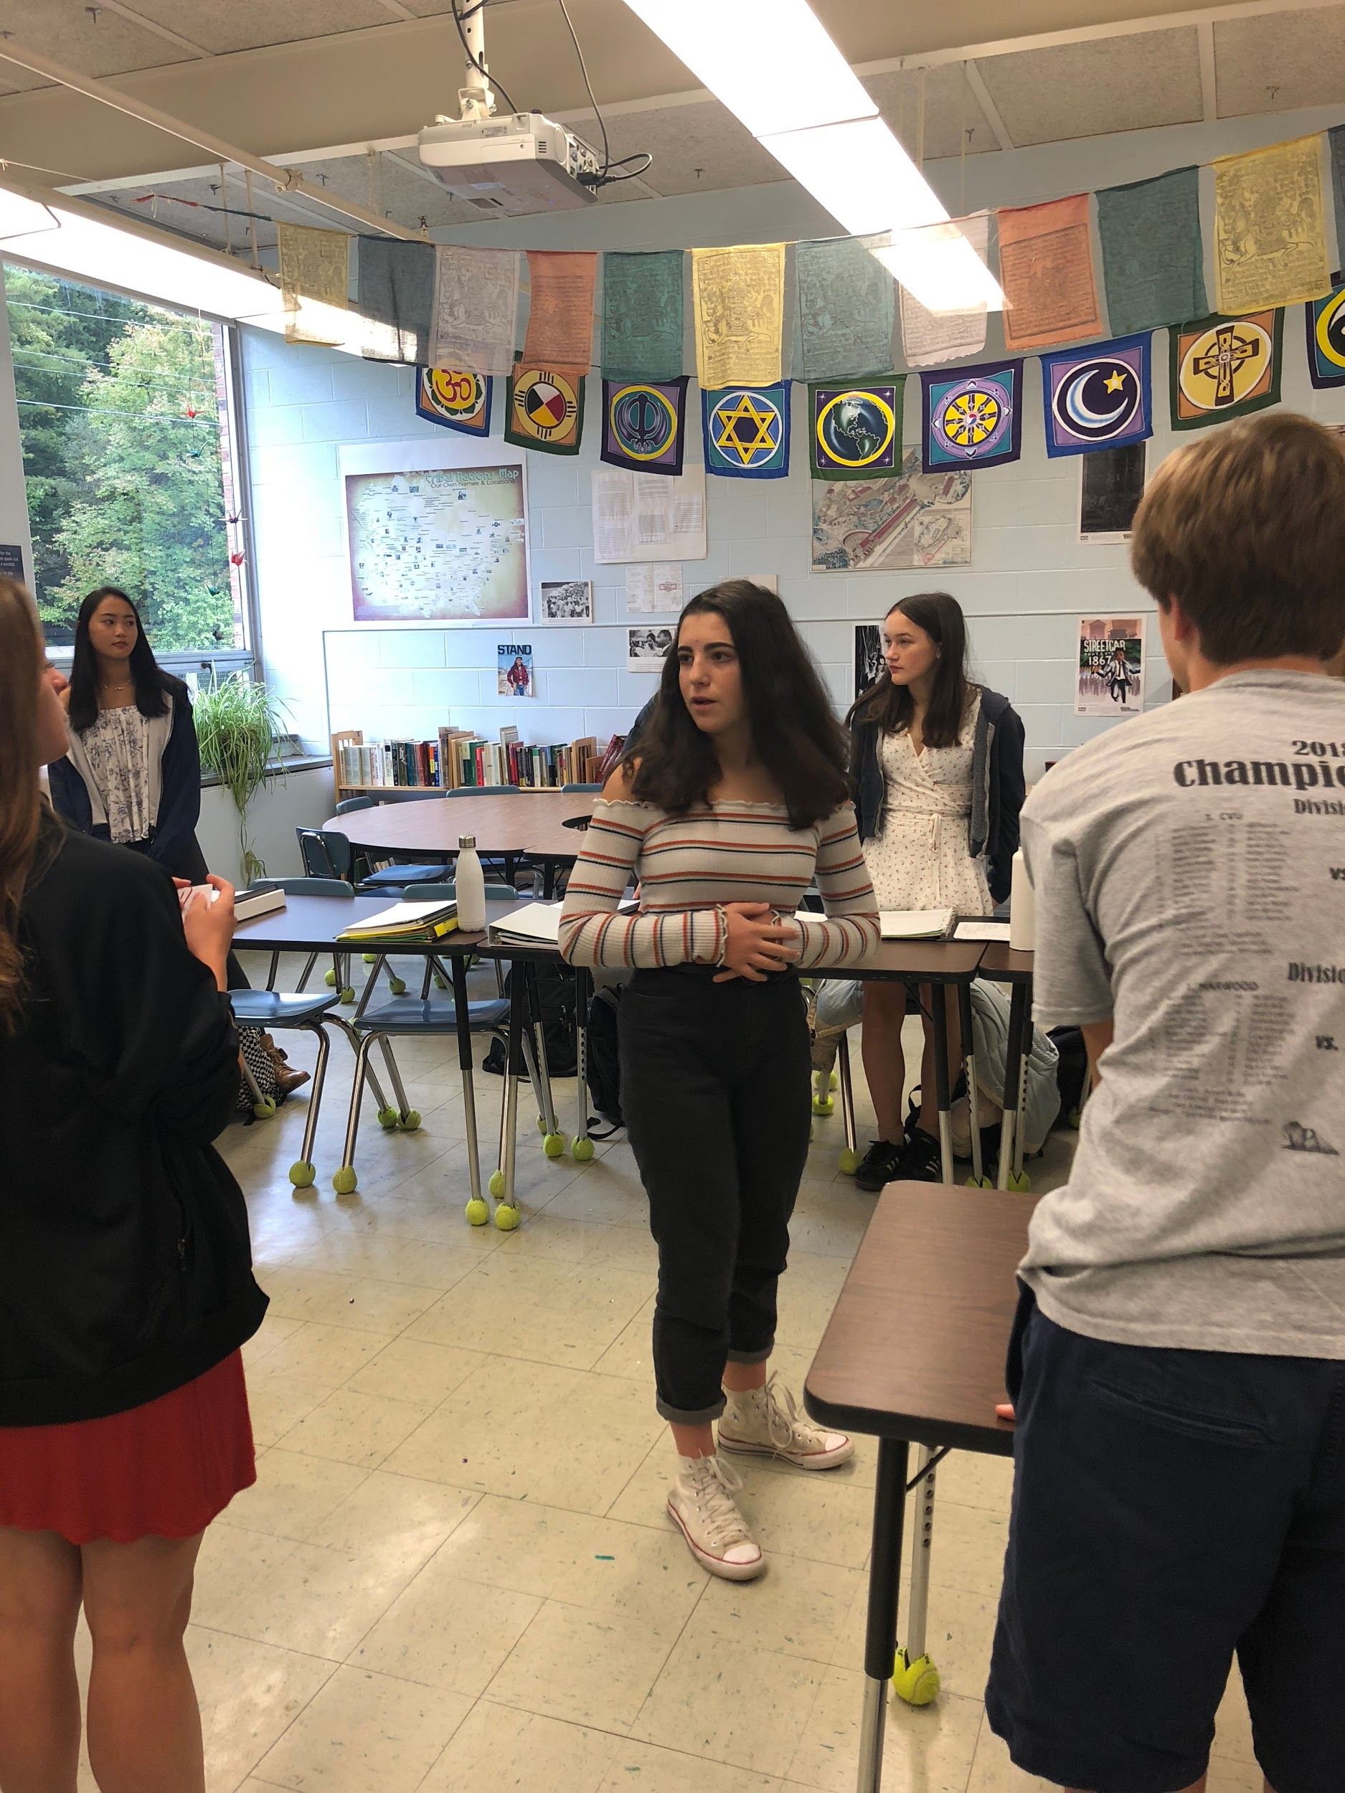
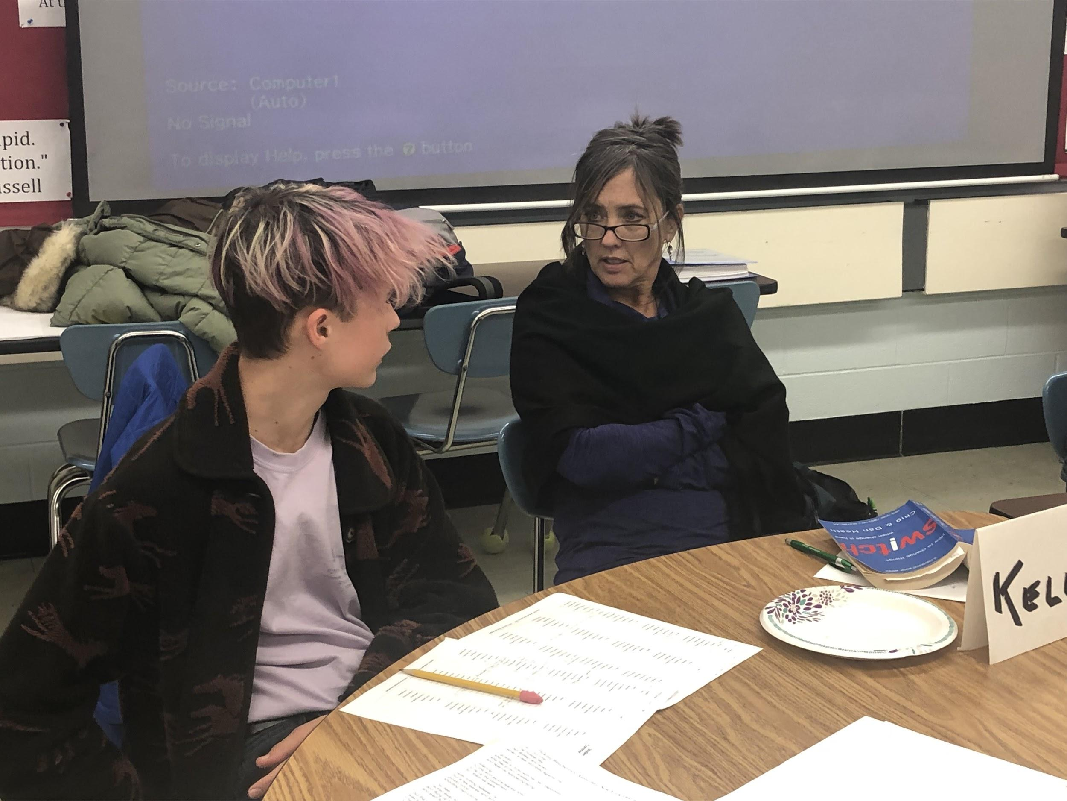
Teachers get Graduate Credit and Students get Proficiency Credit to learn about Harkness
We take on Leadership Roles in Teaching Peers and Faculty
Notes:
Kaia
This is the first class where students and teachers are learning together,
New student partnerships and teacher relationships are built
In this leadership class teachers can earn graduate credit and students can earn proficiency credit

Slide 11
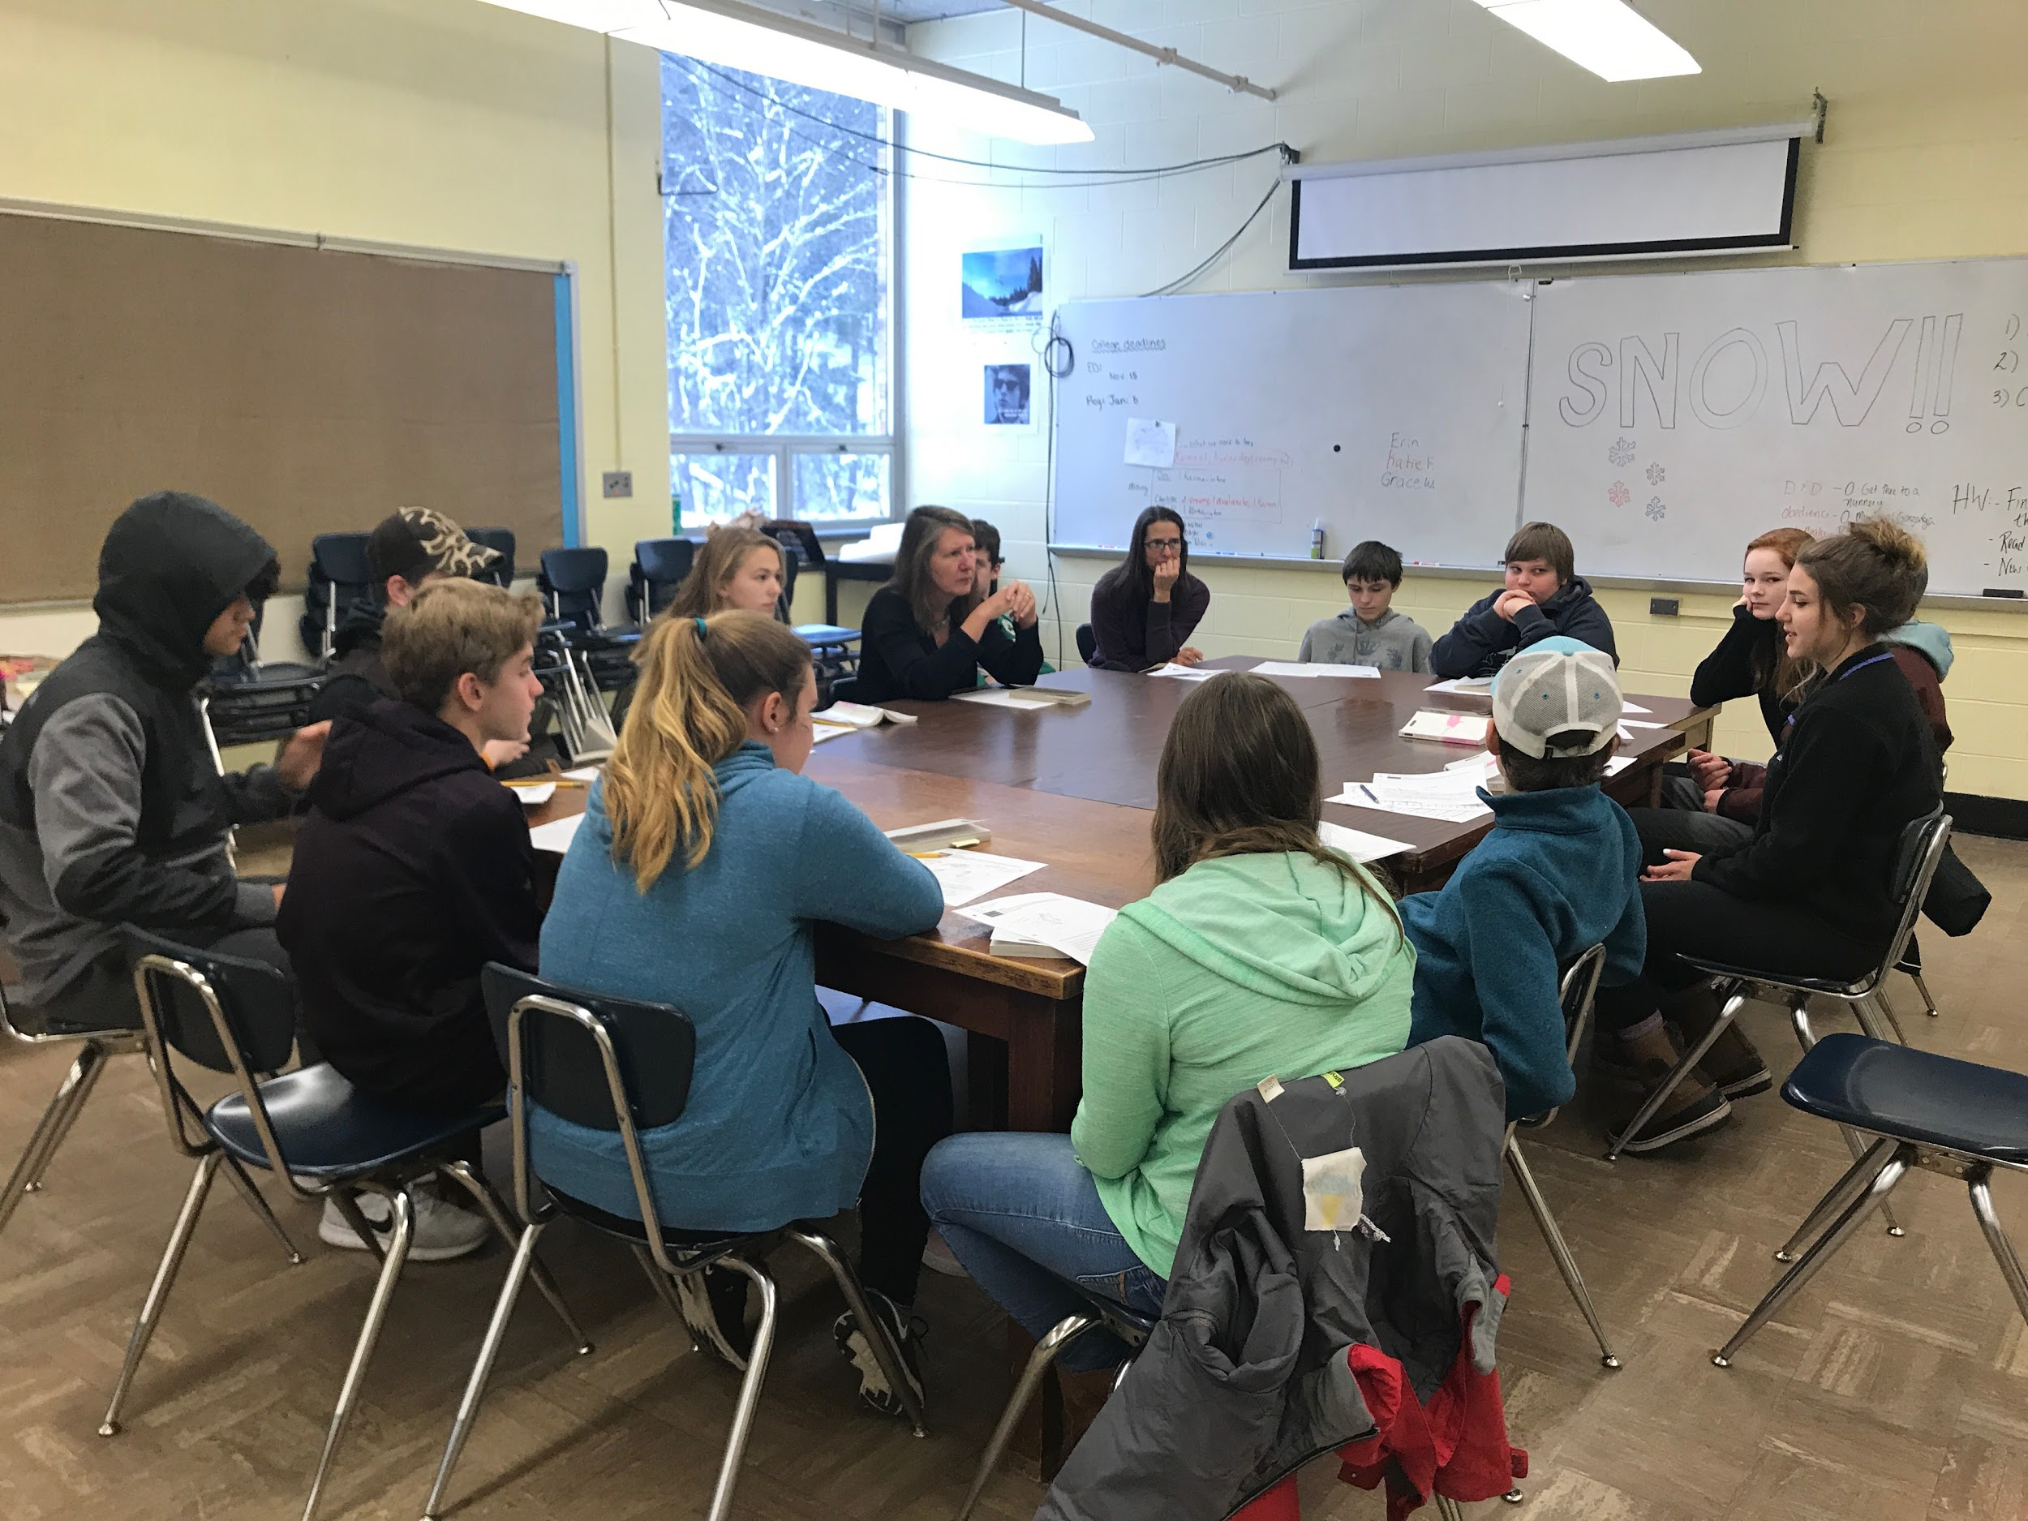
All Harwood Freshmen Learn the Skills of Harkness Discussions in Global Studies
Notes:
Mason
Recognize and thank the global studies teachers

Slide 12
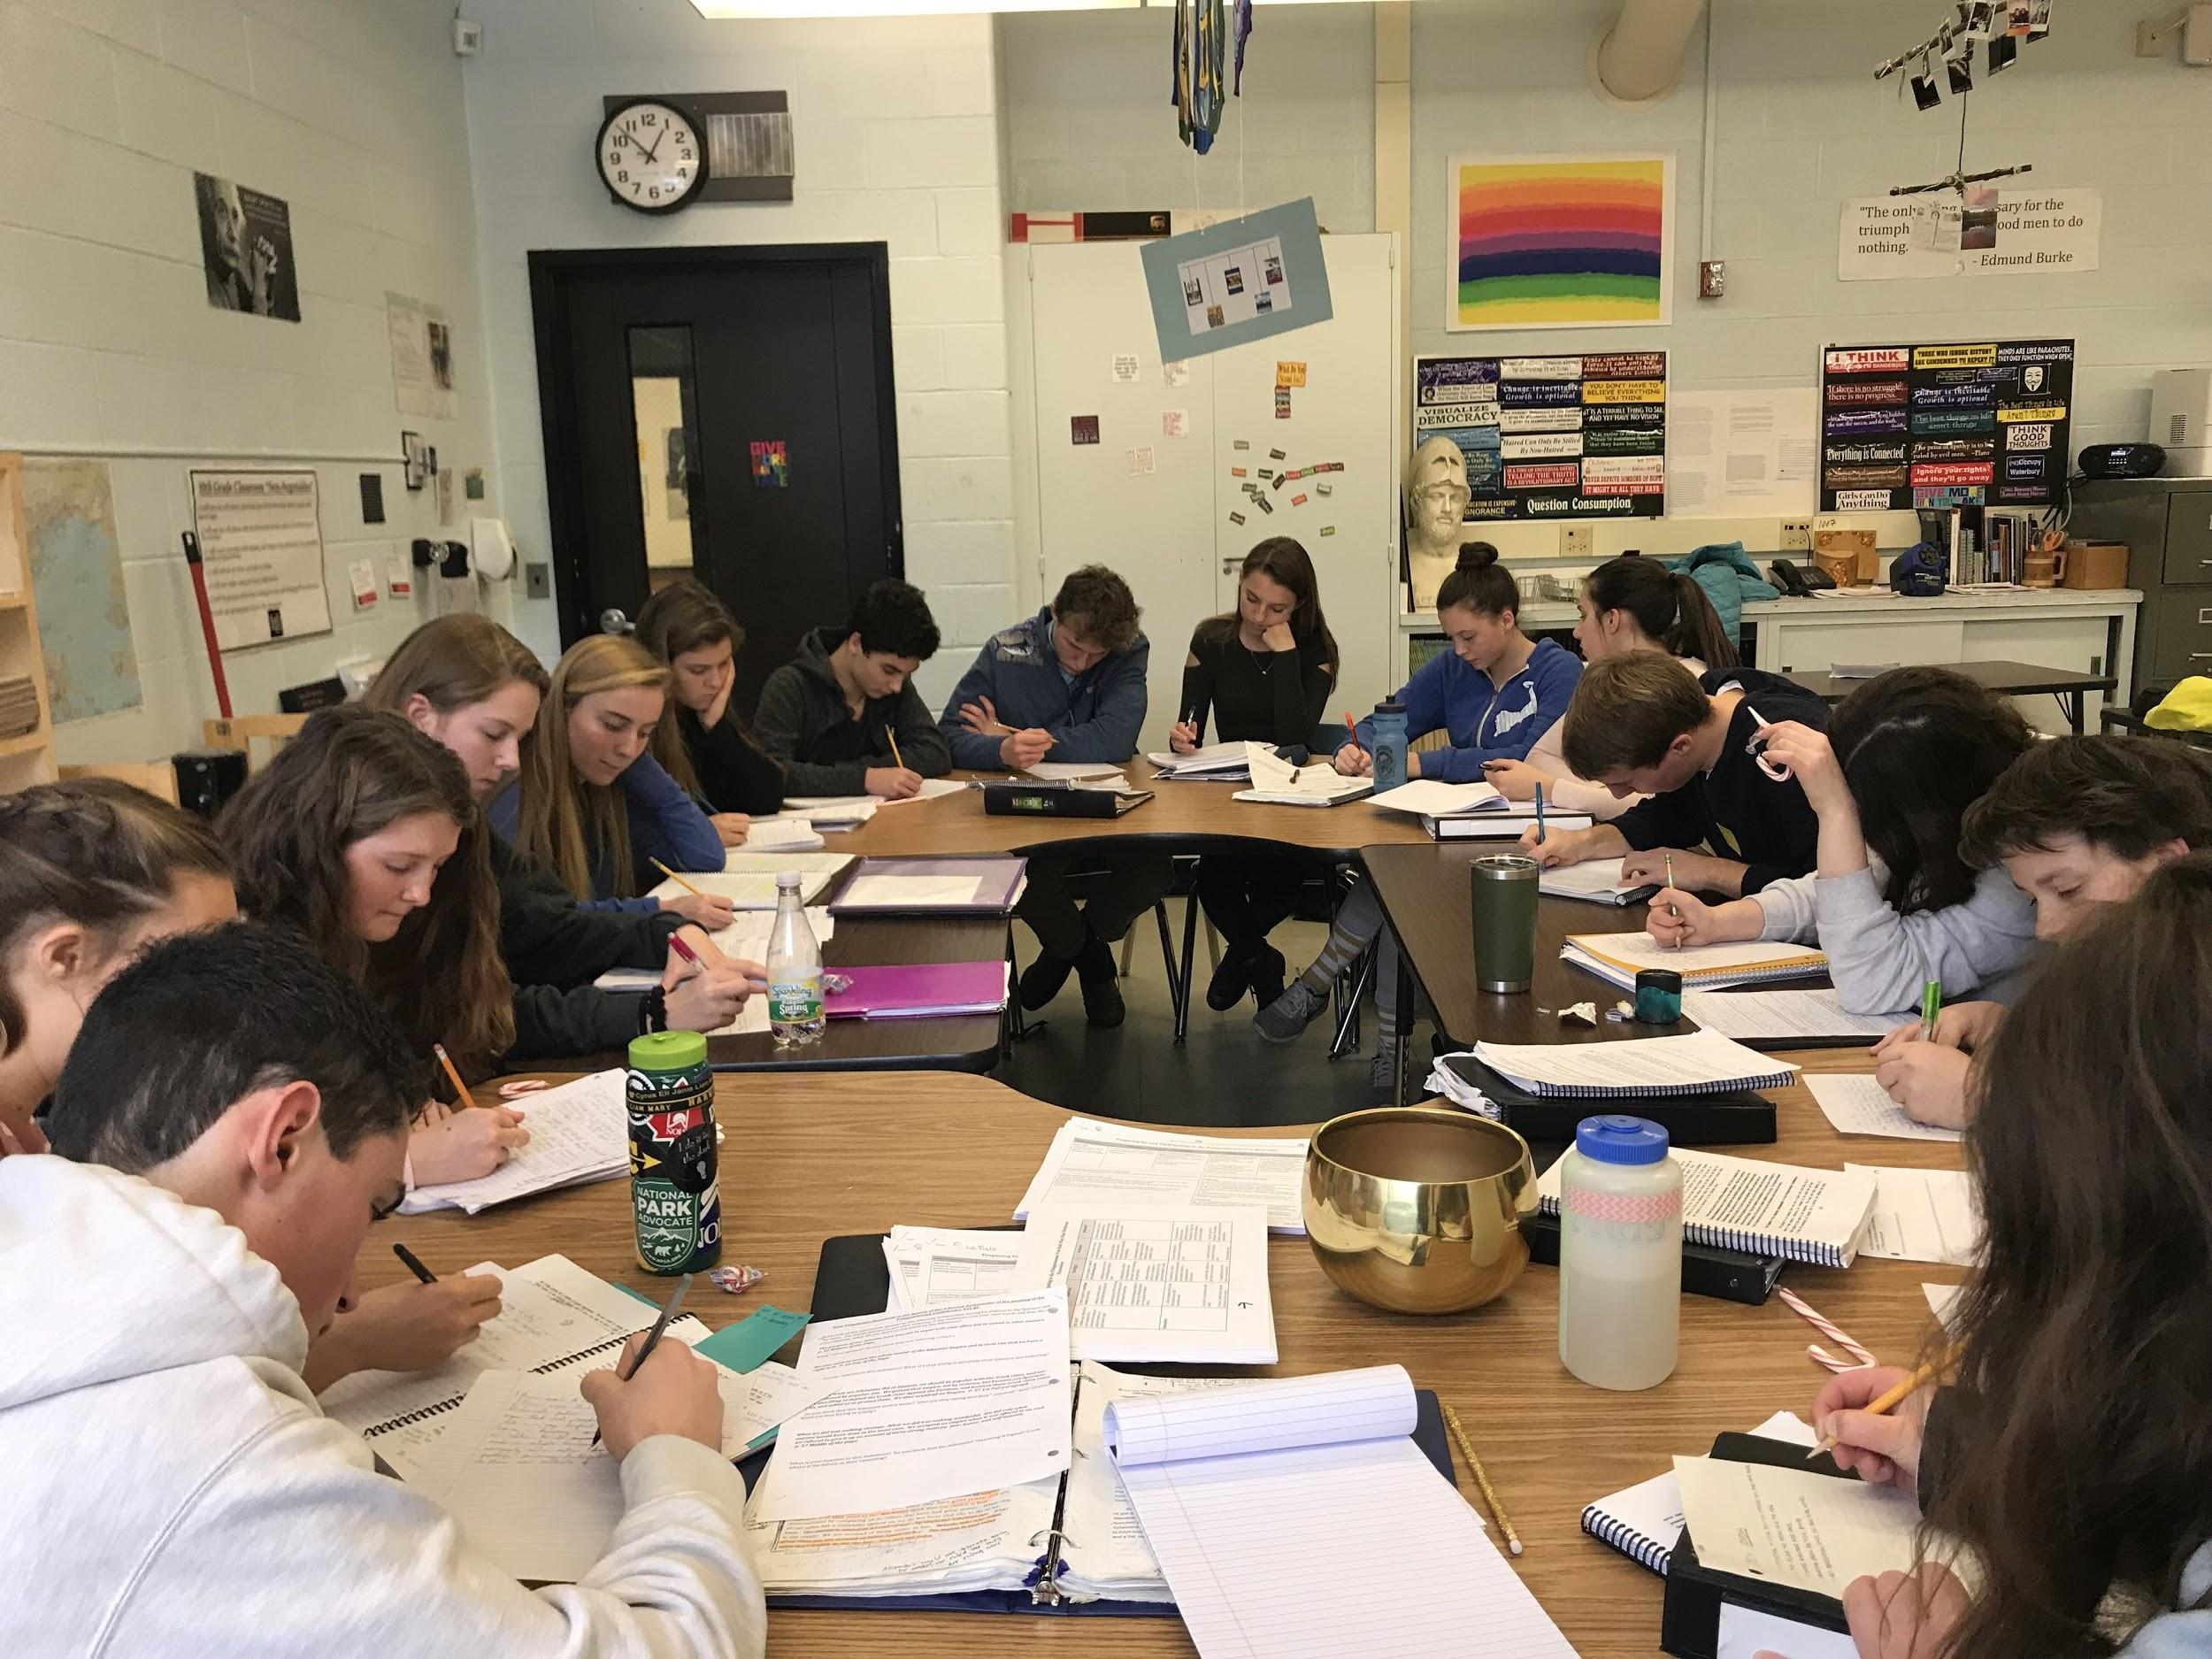
We Work with Teachers and Go Into Classrooms to Help Teach our Peers the Skills of Harkness
Notes:
Katie
Students initiate change through harkness
We have gone into 8th, 9th, and 10th grade classrooms teaching students the soft skills for a harkness discussion

Slide 13
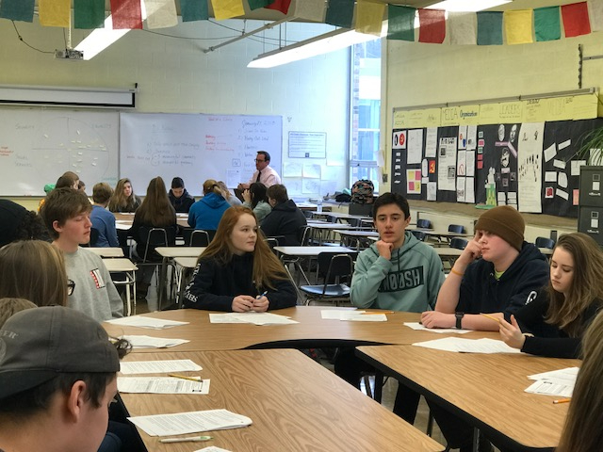
In Harkness Discussions Students Drive the Discussion and Work Collaboratively
Notes:
Hi Kaia
At the Harkness table students drive the discussion
In this global studies class (from last year) the students have their text out in front of them in order to dive deeper

Slide 14
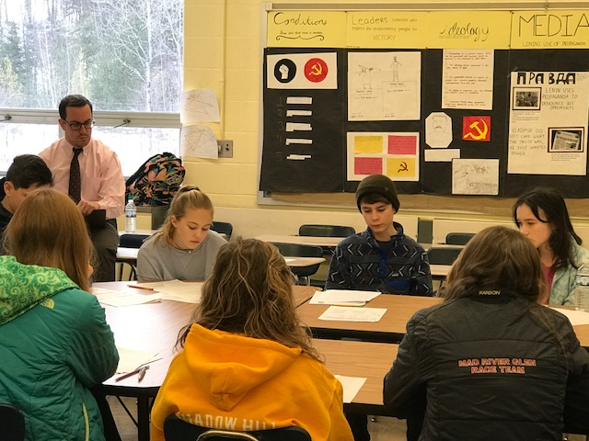
The Teacher is at the Table but Students Do the Work!
Notes:
Maddy
While doing harkness, the students drive THEIR own conversation. They are able to discuss any questions or comments they have to further their understanding of the writing or topic being discussed. In this photo Mr. McCormick is simply observing the students work.

Slide 15
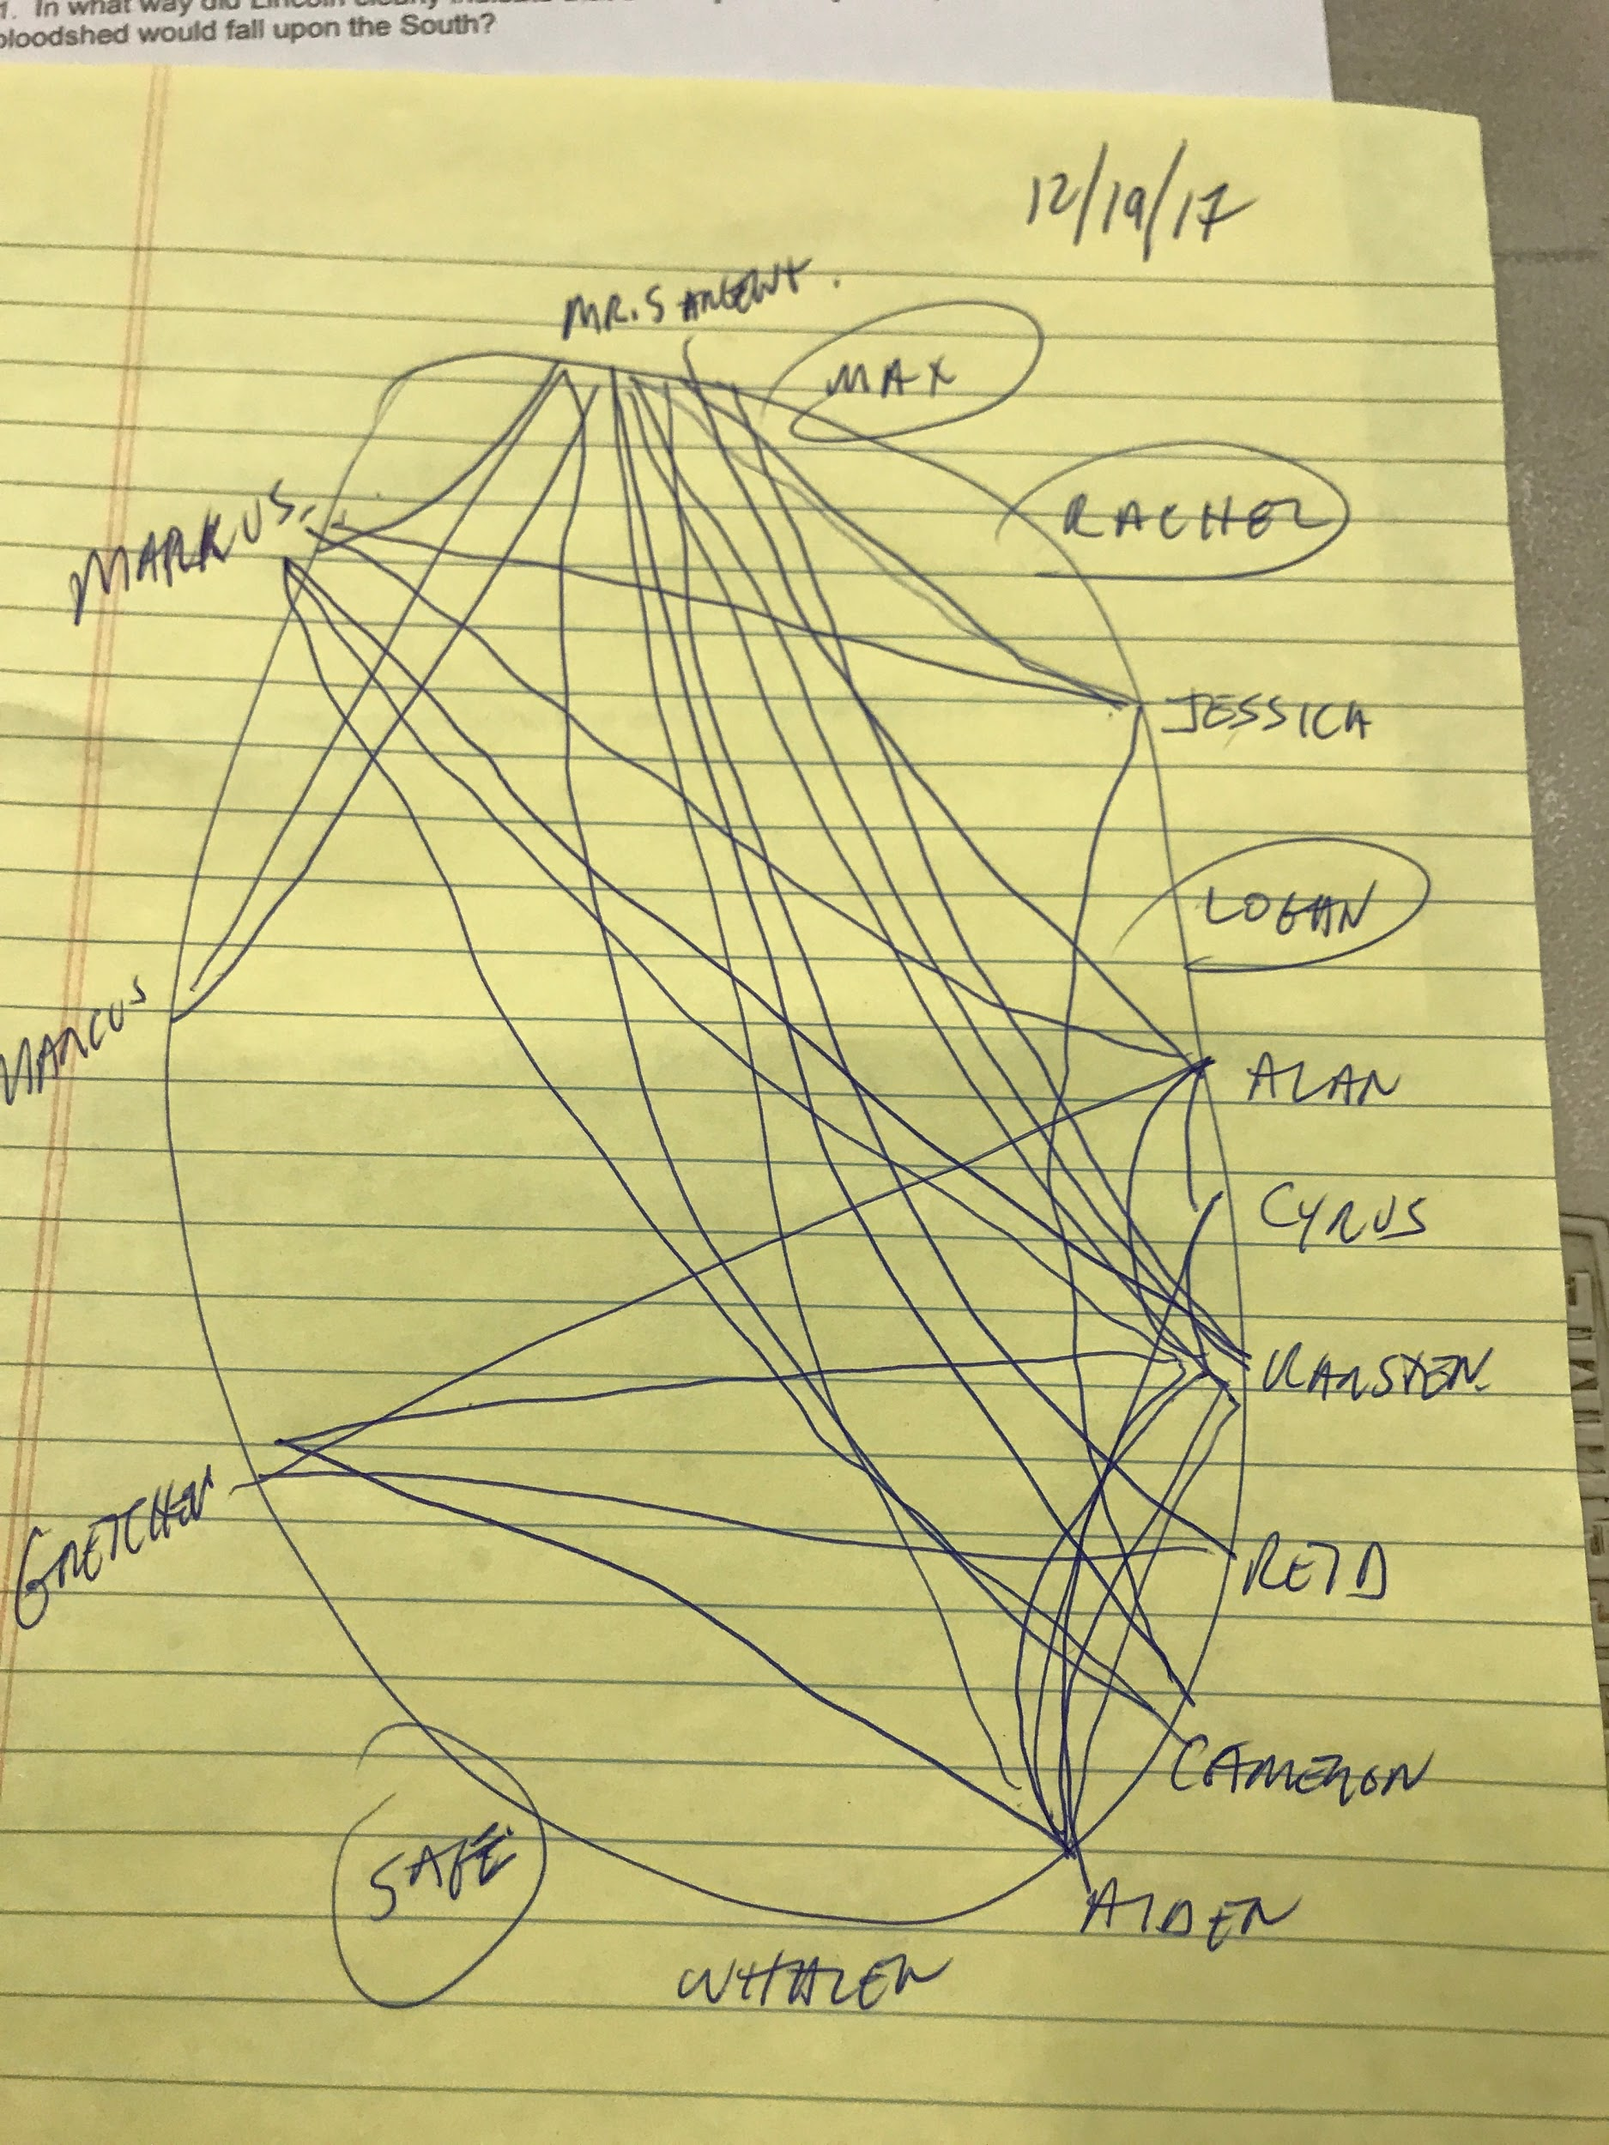
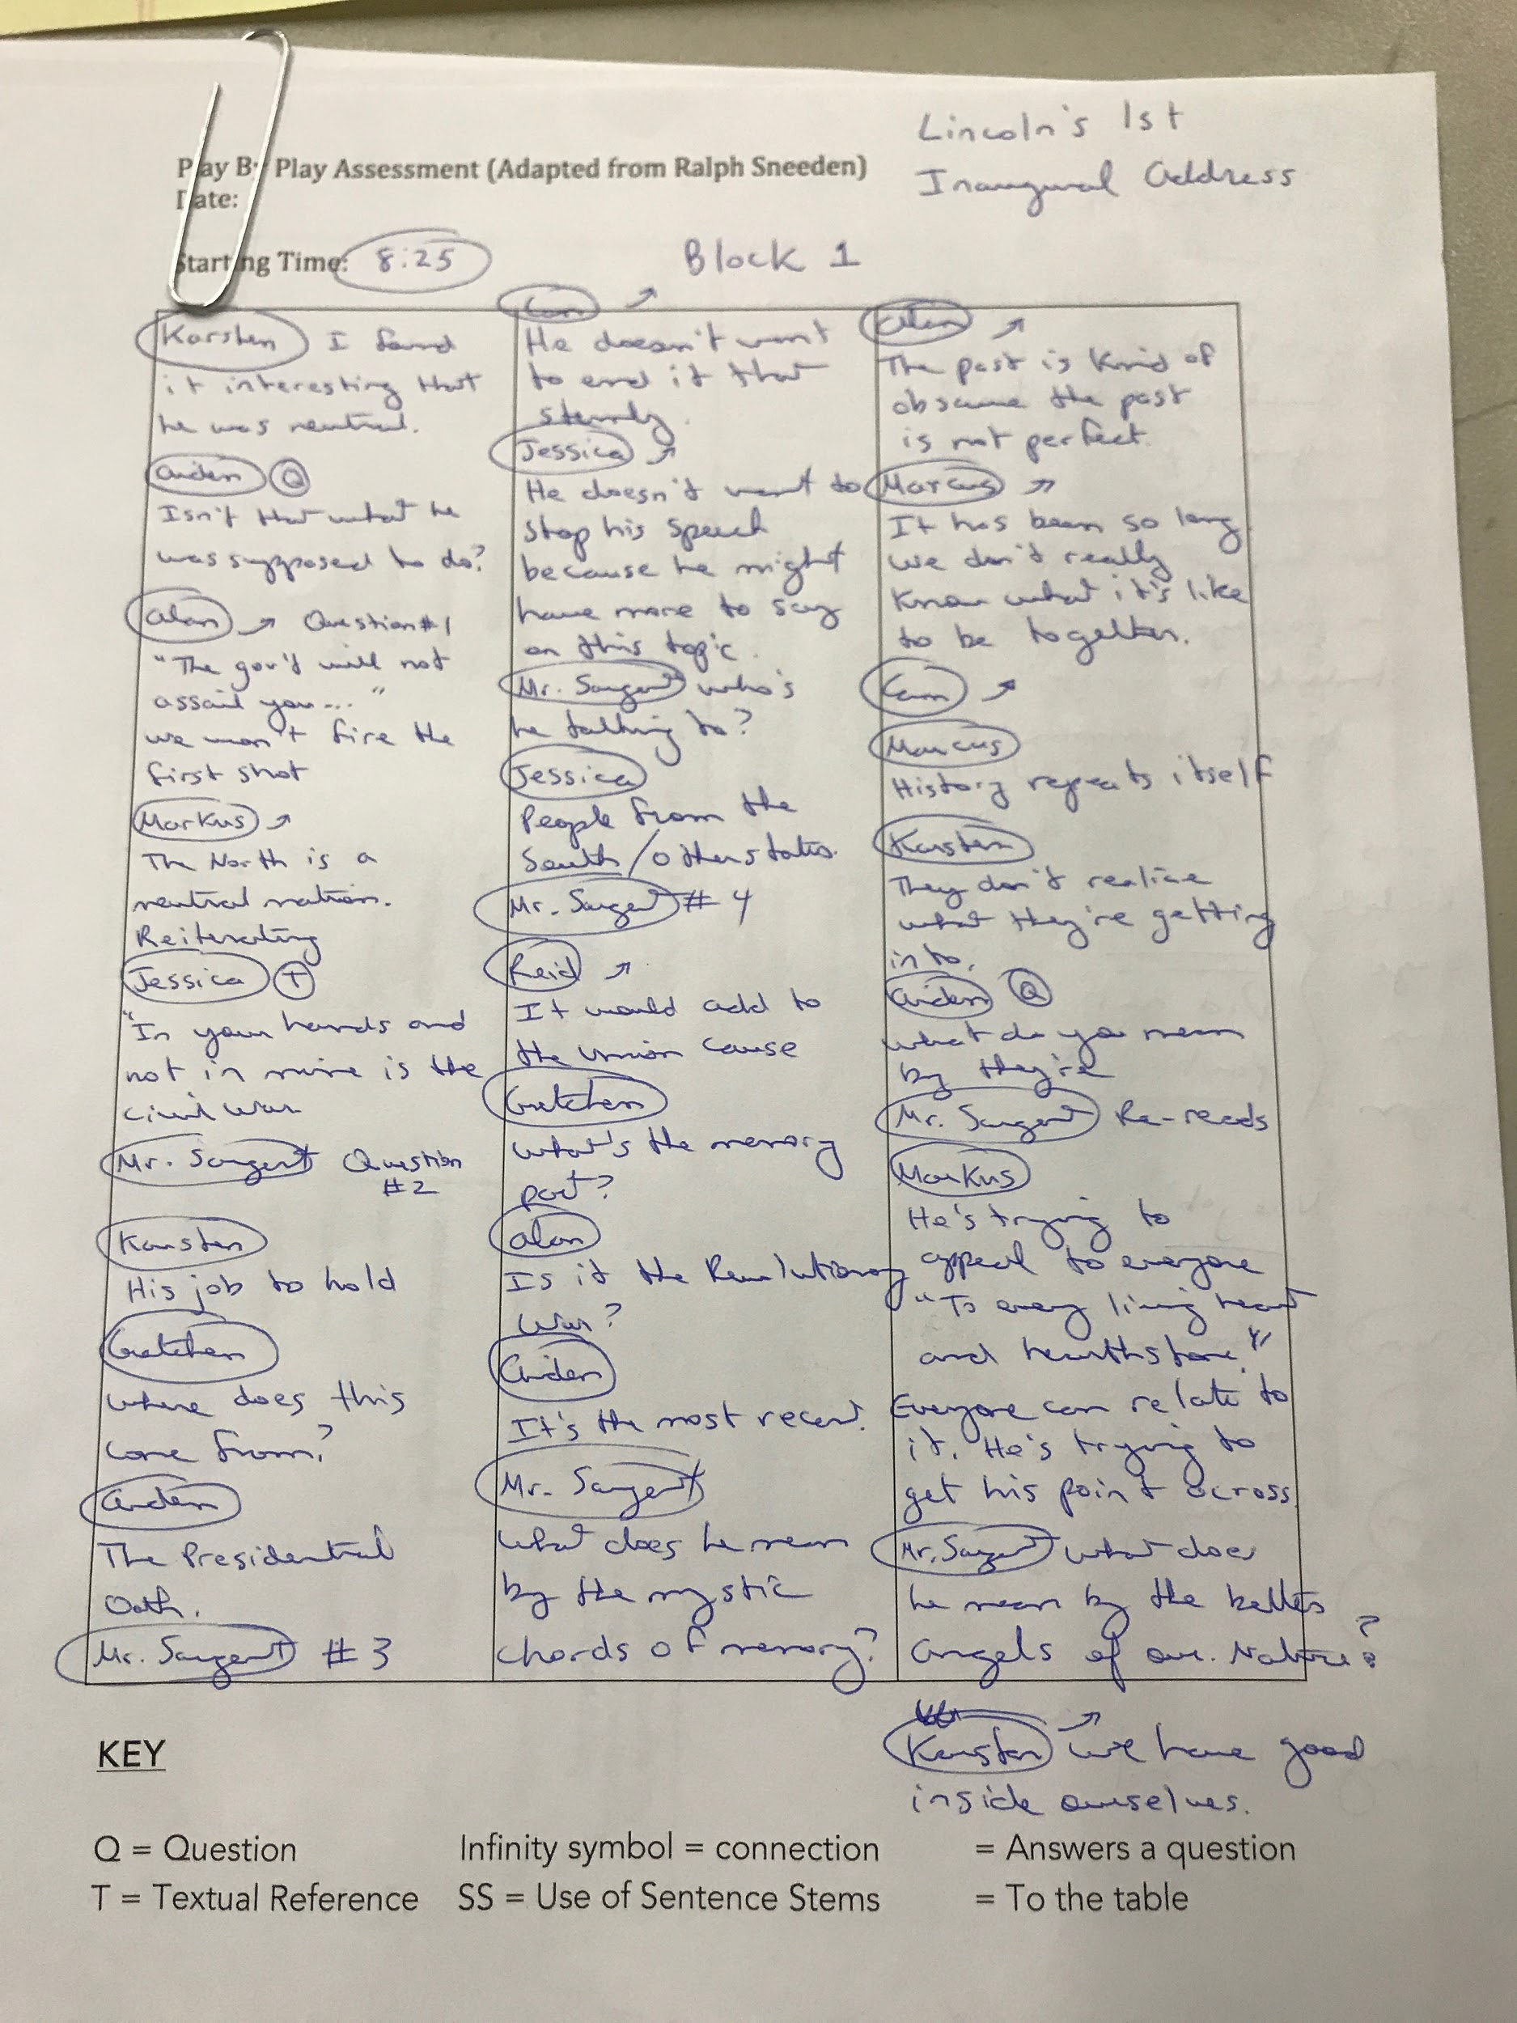
Teachers and Students Track the Discussion and Give Feedback
Notes:
Carlton
Probably one of my favorite parts of doing harkness.
So when we do harkness we usually have a tracker.
His or her job is to track the discussion and follow it.
By the end of the discussion the tracker gives advice and a point of view of the discussion on how it went.

Slide 16
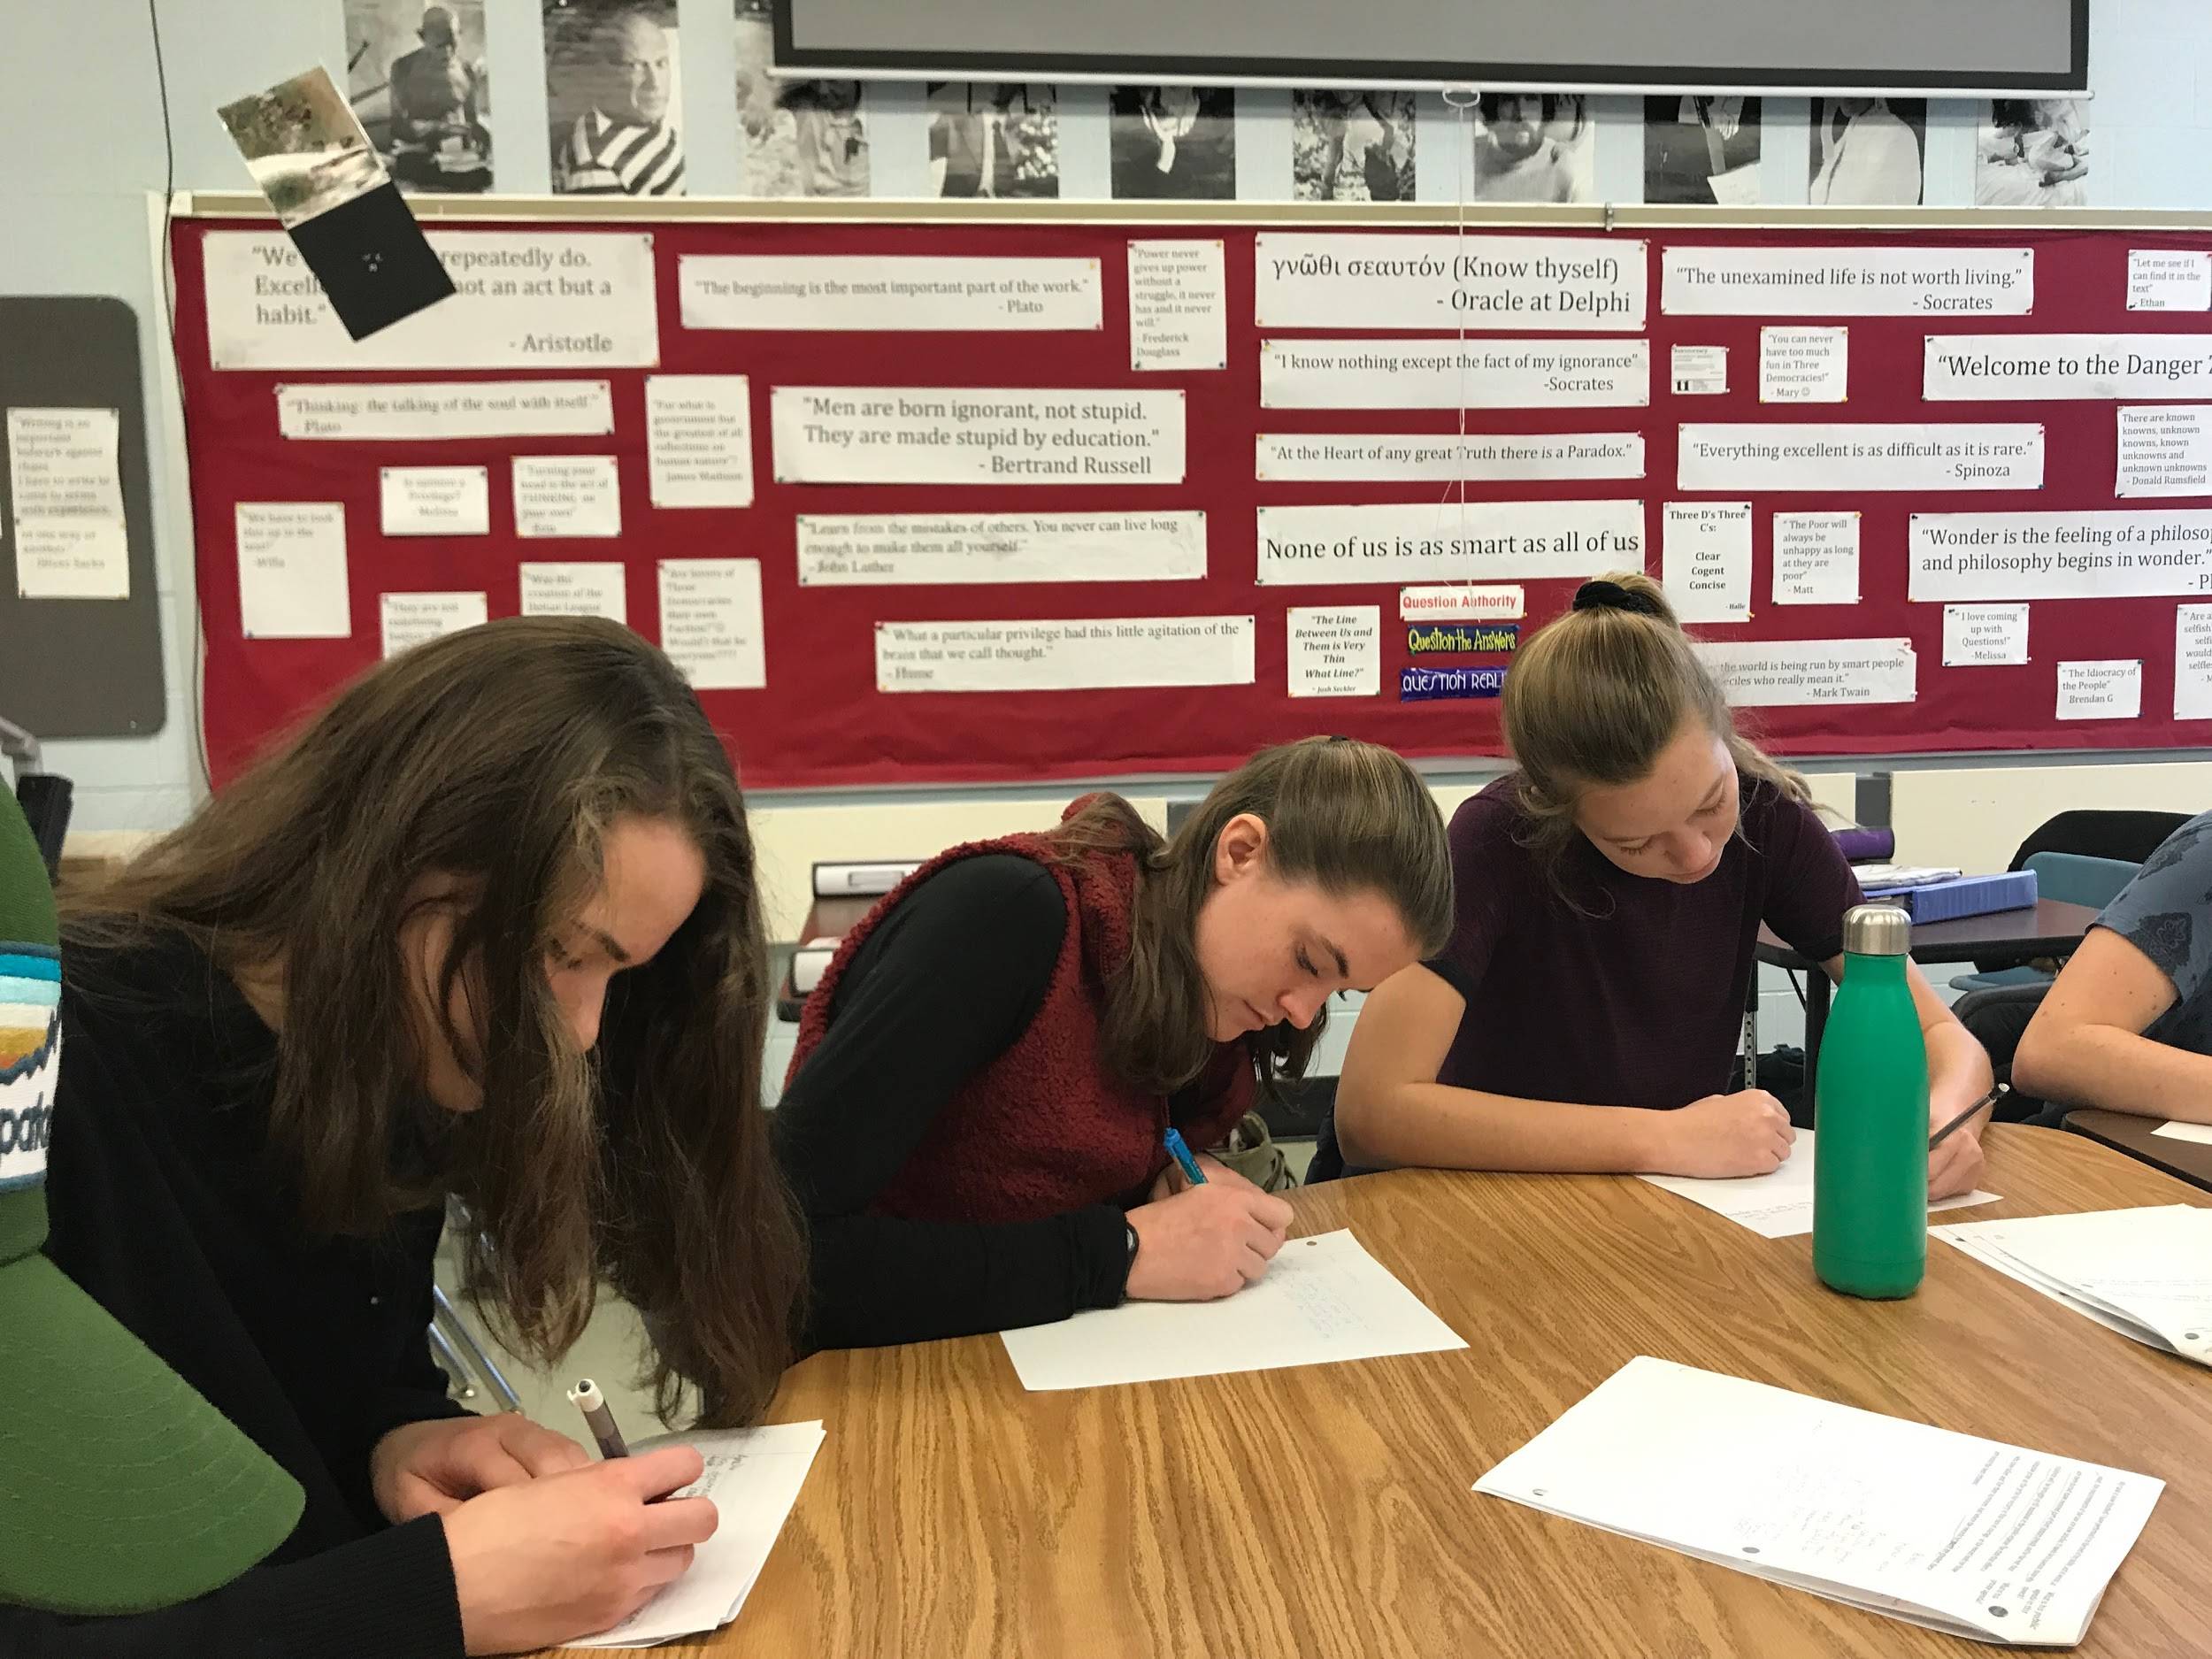
In Harkness We Self Assess and Reflect on our Learning
Notes:
Winter Through self assessment of our work we learn from it and grow because of it like.
For me at least I always want to talk the most but through harkness I learned that it is sometimes best to listen then talk.

Slide 17
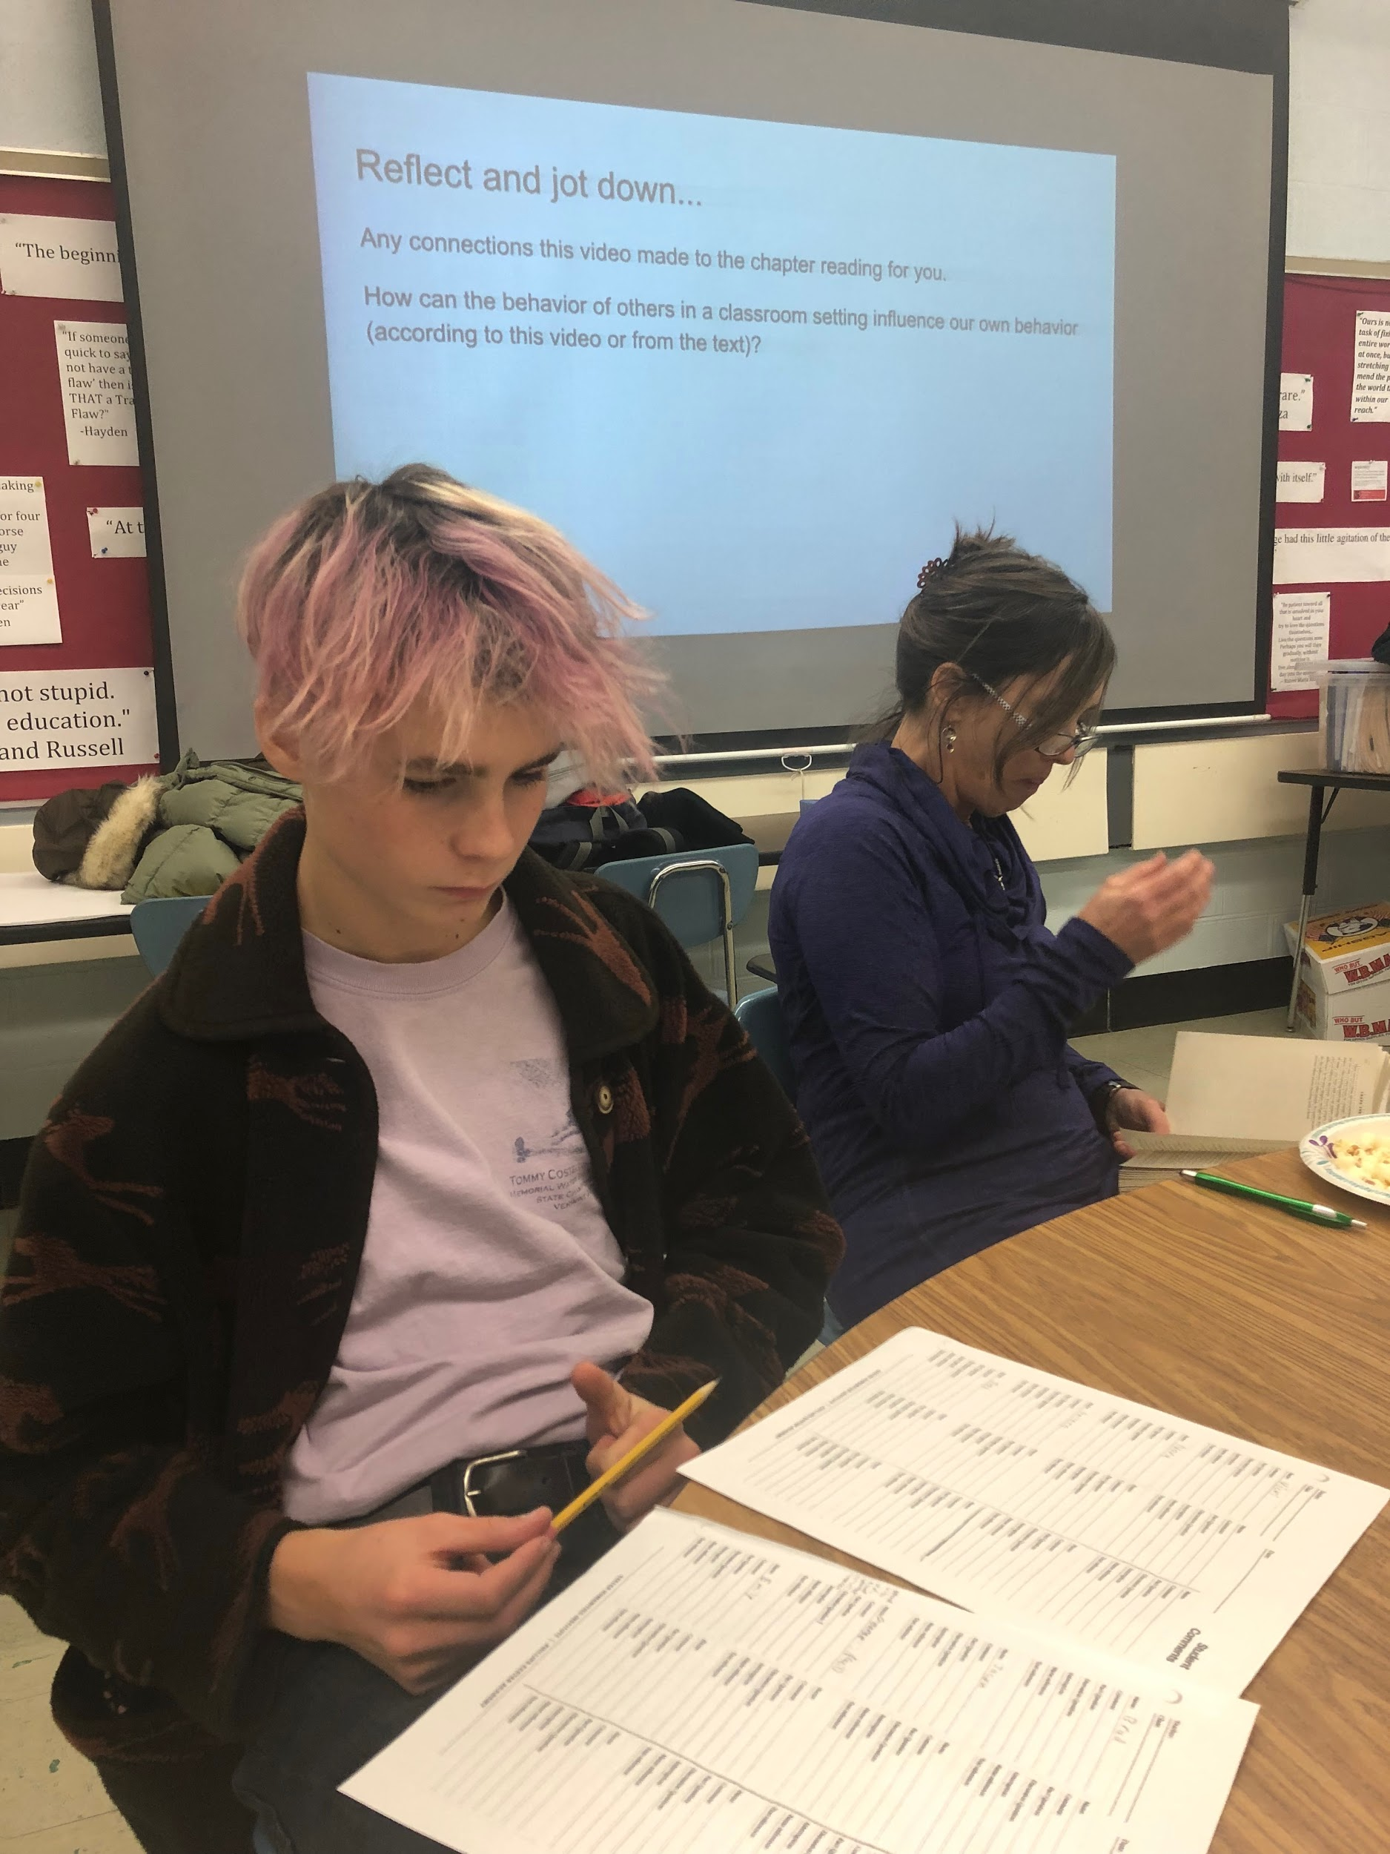
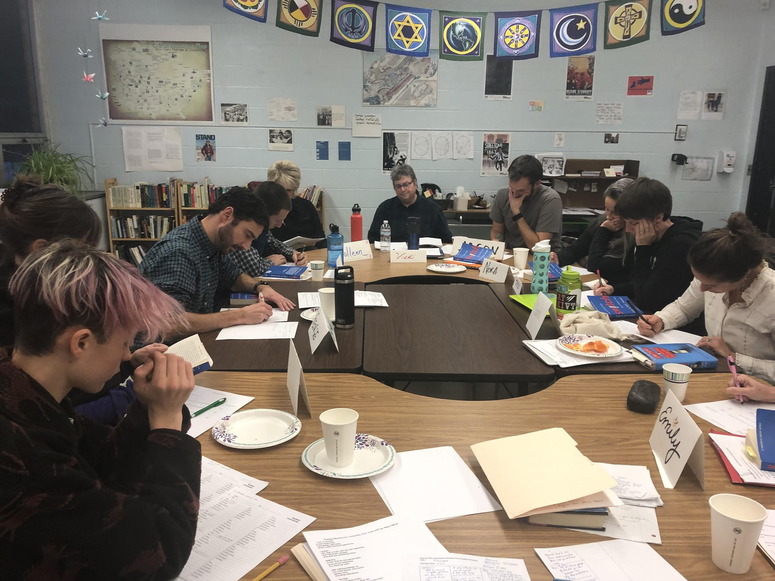
We also Give Feedback to Teachers on their Harkness Practice and How our Classes Can be Better
Notes:
Mason
Just as it is important for the teacher to give feedback to the students it is also important for the students to give feedback to the teachers. As the ones participating in the conversation the students are the ones who know what could be done better and how the process could be made easier and more enjoyable.

Slide 18
Harwood has been recognized by Phillips Exeter Academy as one of five public high schools in the nation for its work with Harkness
Our work using student- teacher partnerships as a model for school transformation is unique
Notes:
Hadley -

Slide 19
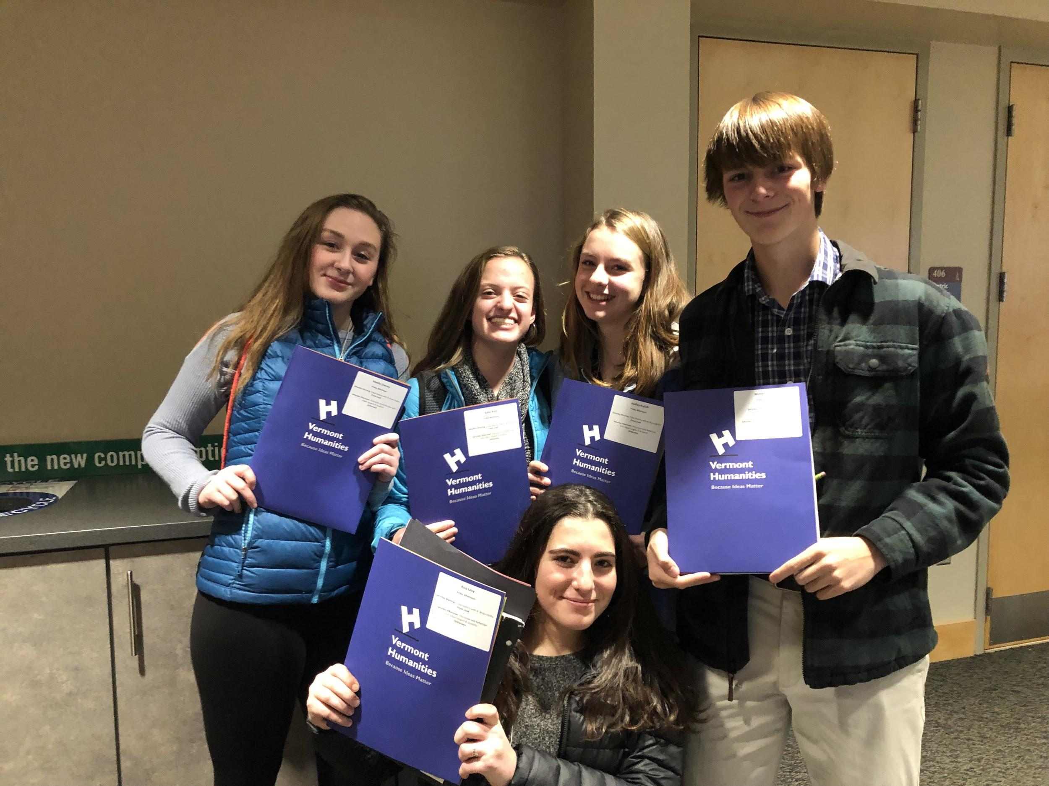
What is it like to Learn in a Classroom that are Designed Around Inquiry and Agency?
What new mindset and skills does this require for both students and teachers?
How does Harkness impact my learning?
What are the advantages of Harkness?
What is challenging about Harkness?

Slide 20
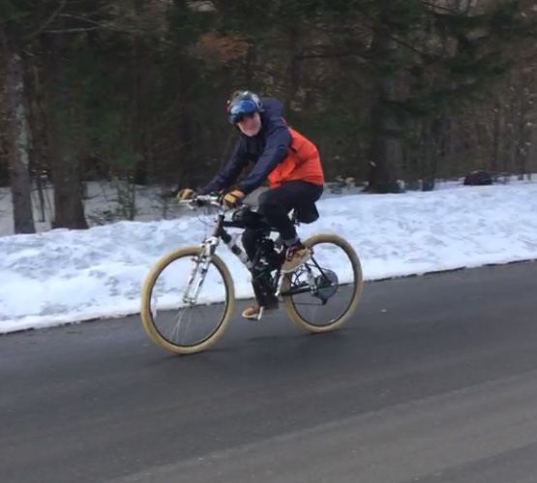
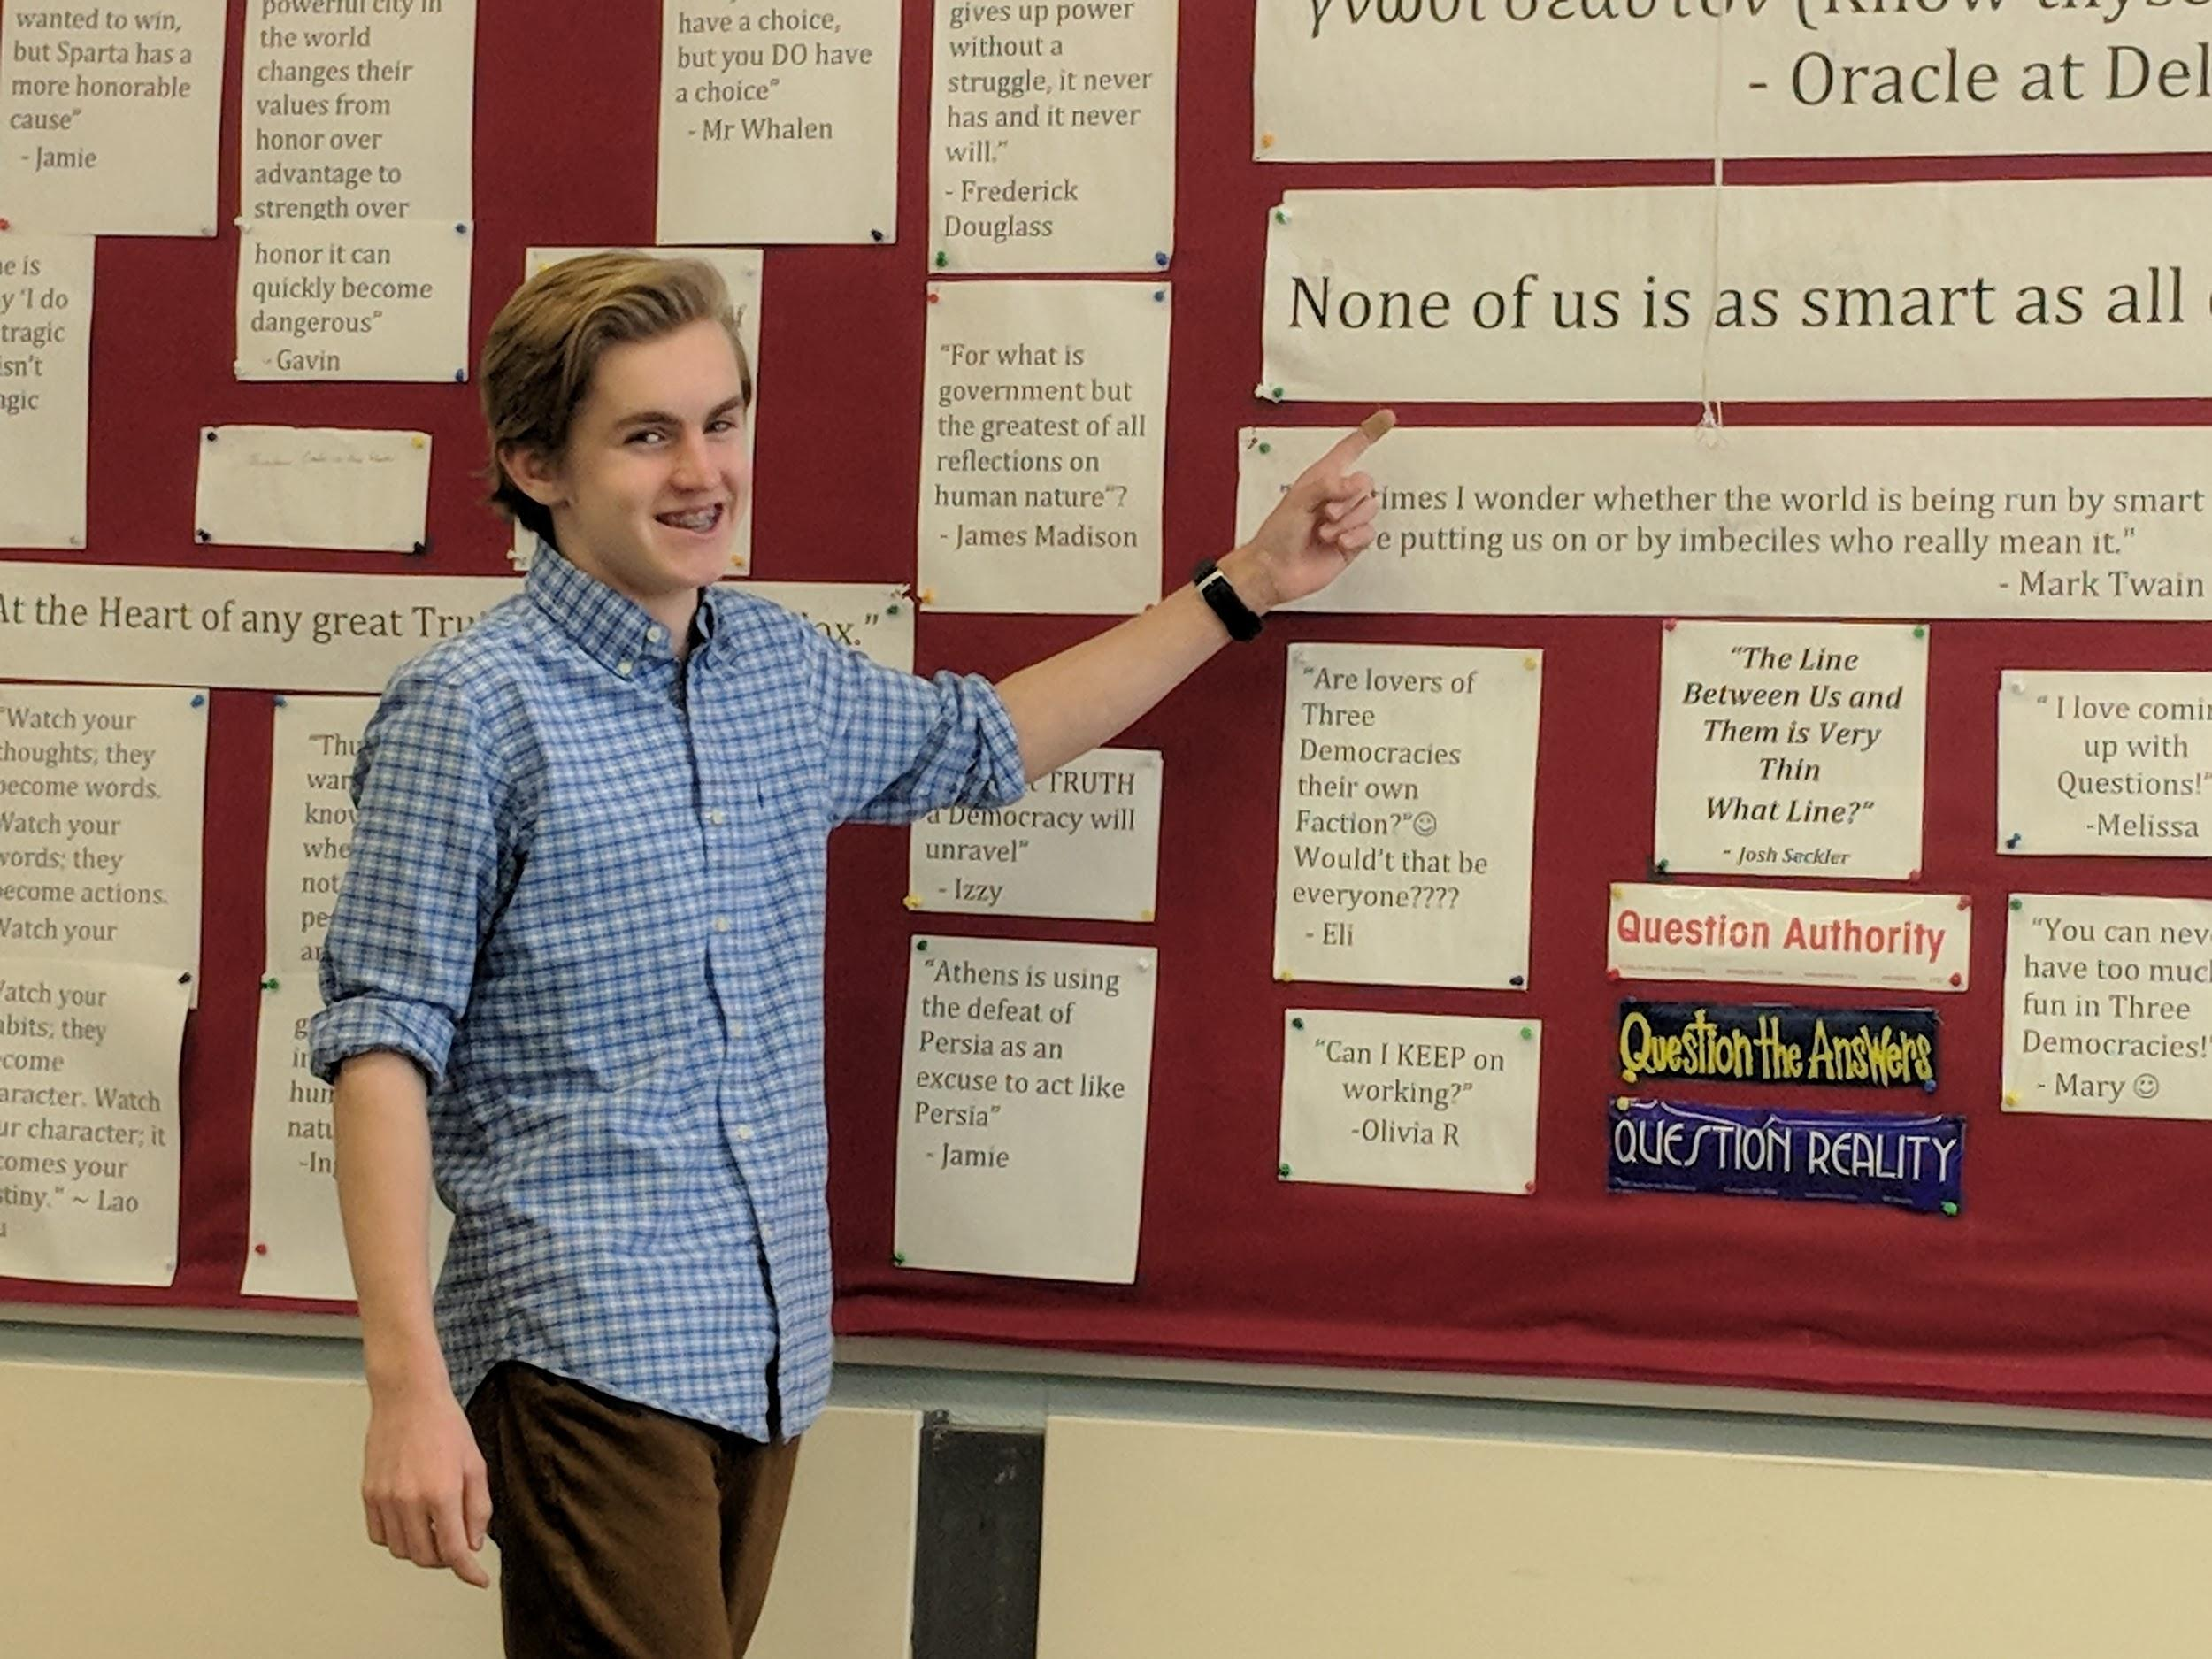
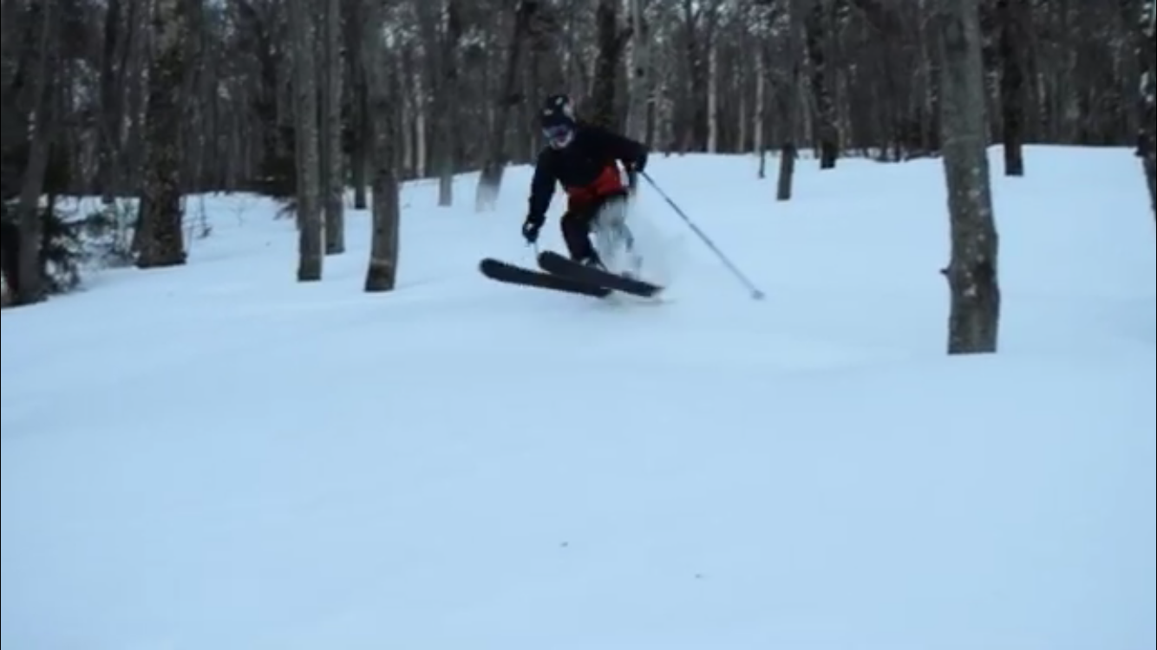
Carlton
Notes:
Carlton
Harkness is important to me because it makes everyone's voice heard. You get to explore different options and try to grasp a deeper understanding of the materials

Slide 21
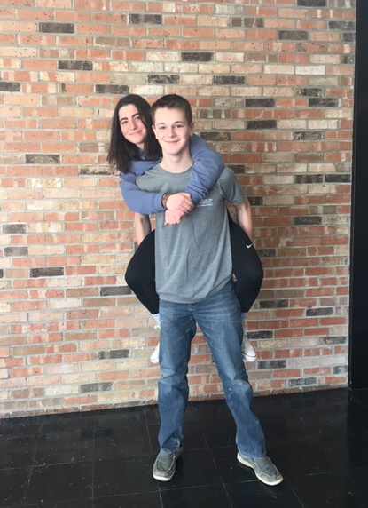
Winter and Kaia
Notes:
Winter
I was apprehensive that students might just see us as teachers, and to some degree they do. Despite the fact that they know us it’s the same principle as a teacher standing in front of the class taking. But something I have found to work very well is to lead by example. I participate with my classmates in soft skill practice and then in harkness and demonstrate the skills that are important for others to show.
Kaia
Harkness is meaningful to me because it’s the students finally taking control over their own education.
It has been difficult to change the role of a teacher and the role of a student. It was challenging when I was first put in a position to teach my peers, I felt like I had to make a choice of being a student or being a teacher. I later learned that the beauty of being a student leader is that you don’t have to choose. I’ve gotten to see myself both as a teacher and as a leader,

Slide 22
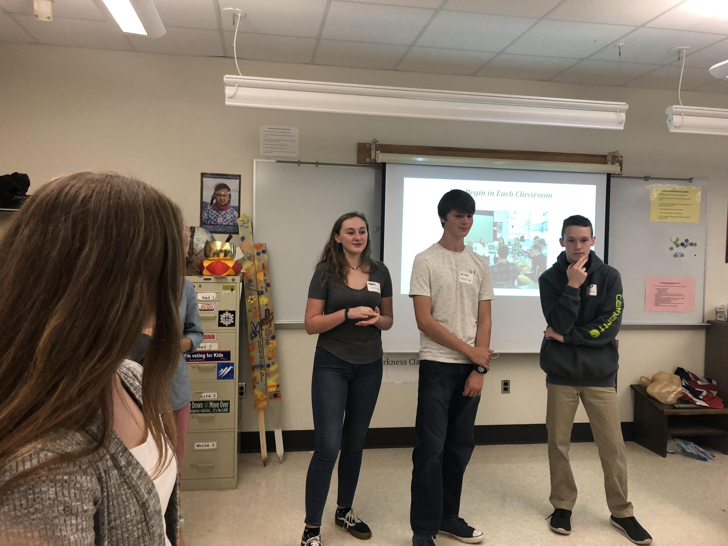
Liam

Slide 23
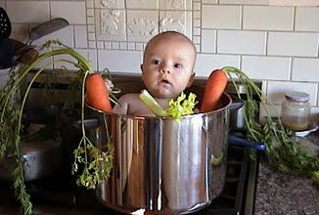
Mason
Notes:
What about those who are quiet, not prepared, etc...

Slide 24
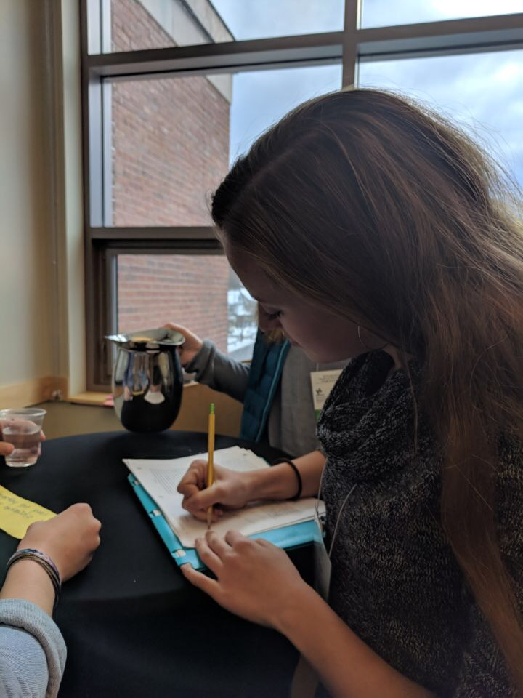
Katie and Hadley
Notes:
Hadley - enjoyed Harkness discussions in 9th grade so I decided to join this class… didn’t know what I had coming! At the beginning, I was extremely nervous about presentations, but learned to get more comfortable as the year went on.

Slide 25
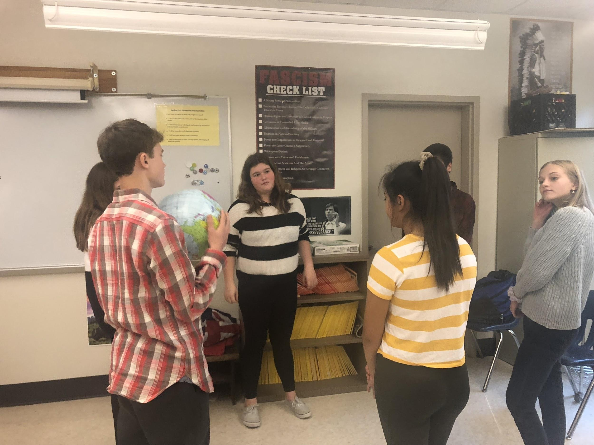
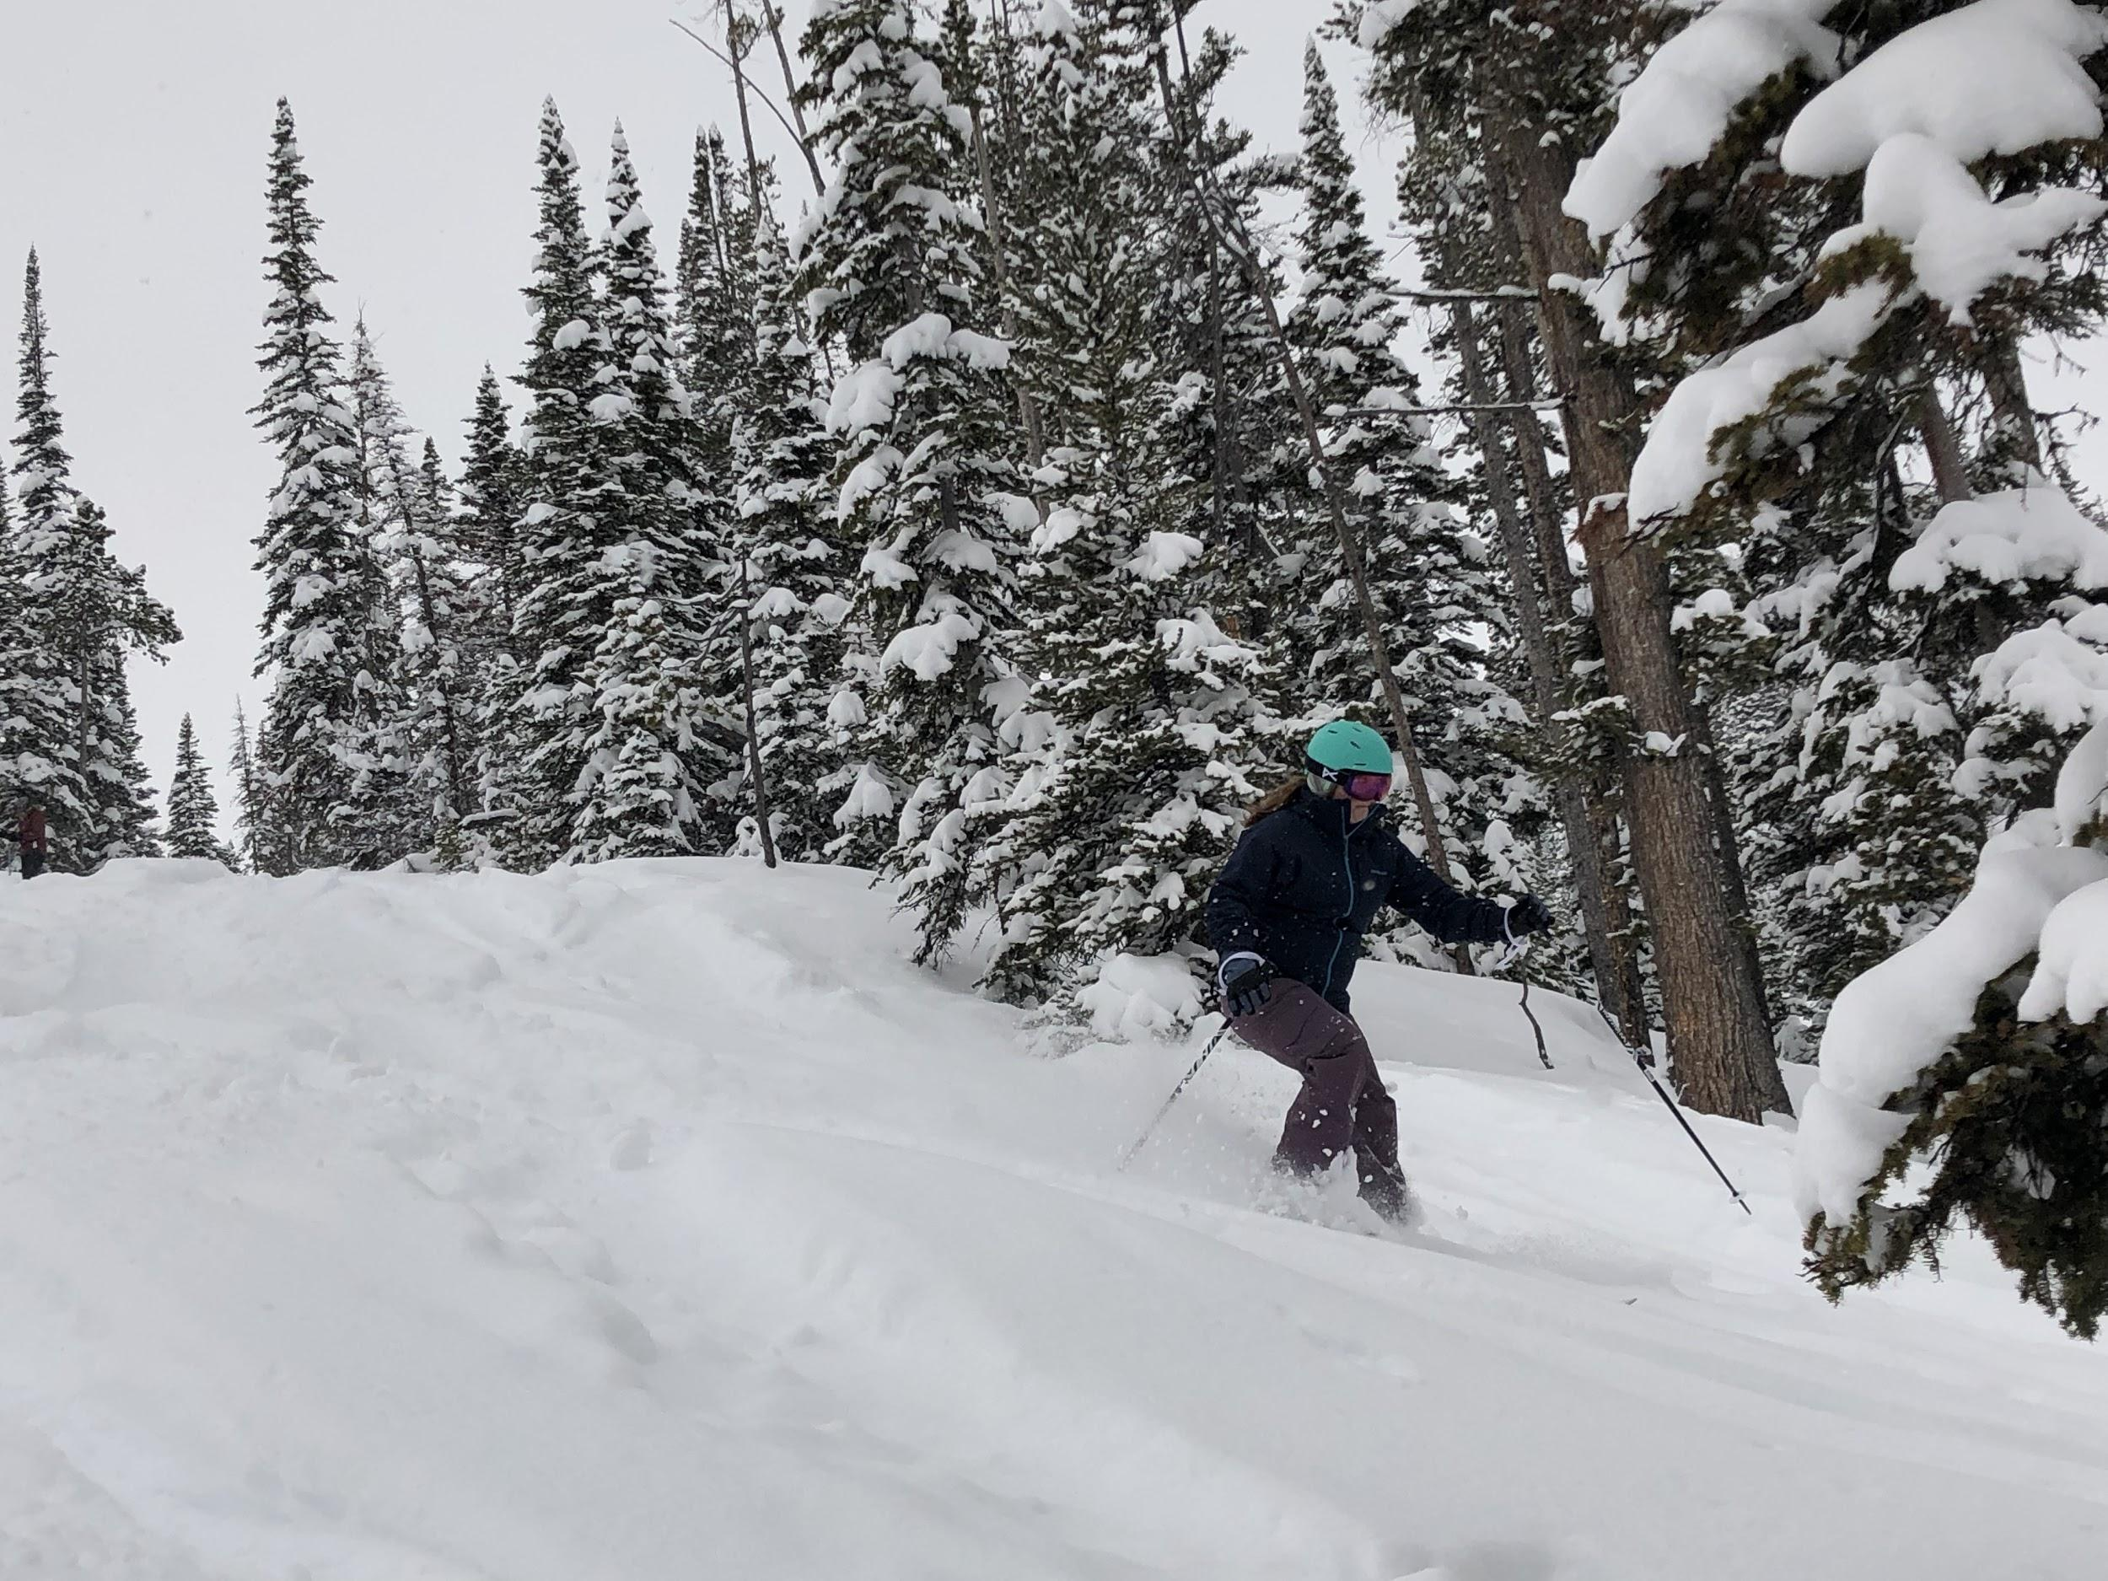
Eva

Slide 26
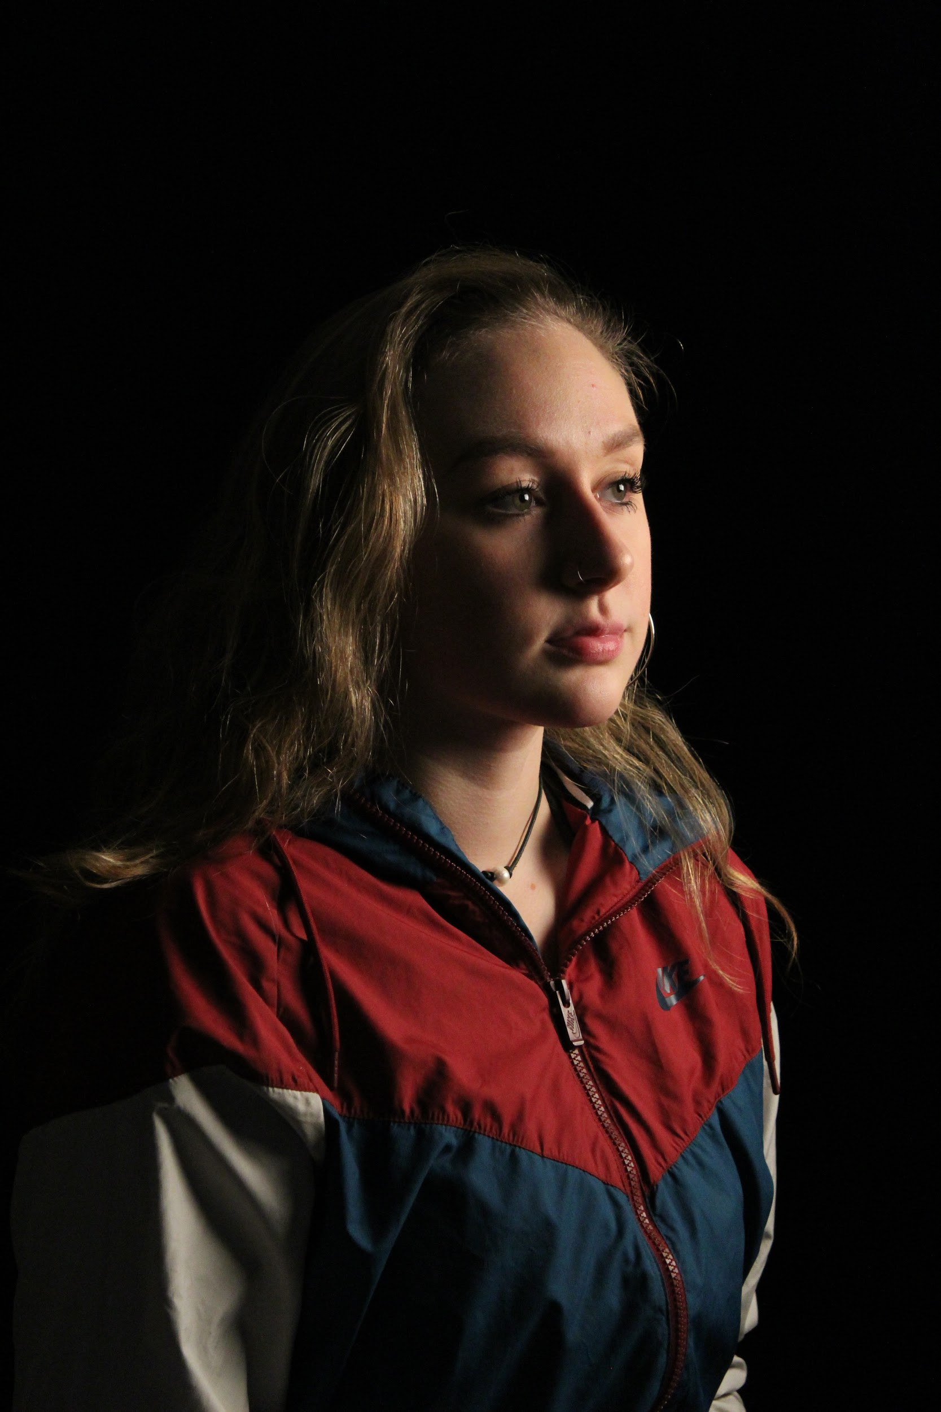
Maddy
Notes:
Working on harkness has taught me to

Slide 27
Are you interested in Harkness?
Harkness is Student Driven Inquiry!
It is grounded in principles of brain science and learning
It requires a new mindset and new roles for both students and teachers
It is an approach to learning that can be employed with any subject matter
It asks students to step up and engage in their own learning
It use the skills of civil discourse critical to our Democracy

Slide 28
Resources to learn about the Harkness Pedagogy:
See the link to website Strategies in Classroom Dialogue here:
https://katherinecadwell.wordpress.com/
See a TED TALK Kathy gave entitled "Students Drive the Classroom" here:
https://www.youtube.com/watch?v=gzQhiB2EOVE&t=1s
See the podcast in which Kathy talks about the importance of Classroom Dialogue here:
https://www.podomatic.com/podcasts/socratescafe/episodes/2018-09-10T16_51_37-07_00
See a film of a Harkness class in action, "Coming to the Table:Dialogue for School Transformation" filmed by the Vermont Folklife Center here:
https://www.youtube.com/watch?v=8OMzfJvHZ1s&t=1430s
Contact Katherine Cadwell for more information at katherinewcadwell@gmail.com

