Slide 1
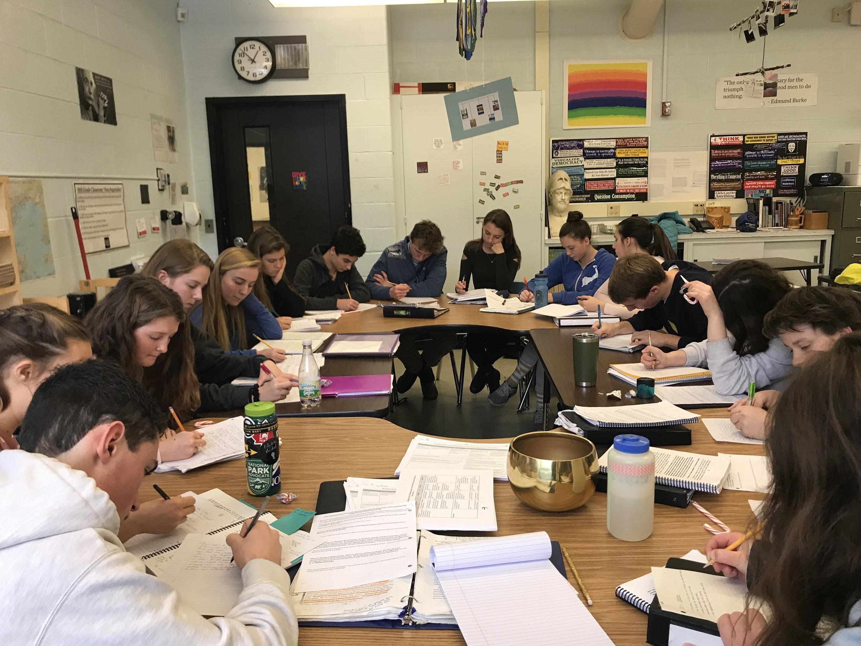
Steps of Planning for Harkness

Slide 2
At the Harkness table, students should have a safe environment in which to learn.
There are four key pieces to this:

Slide 3
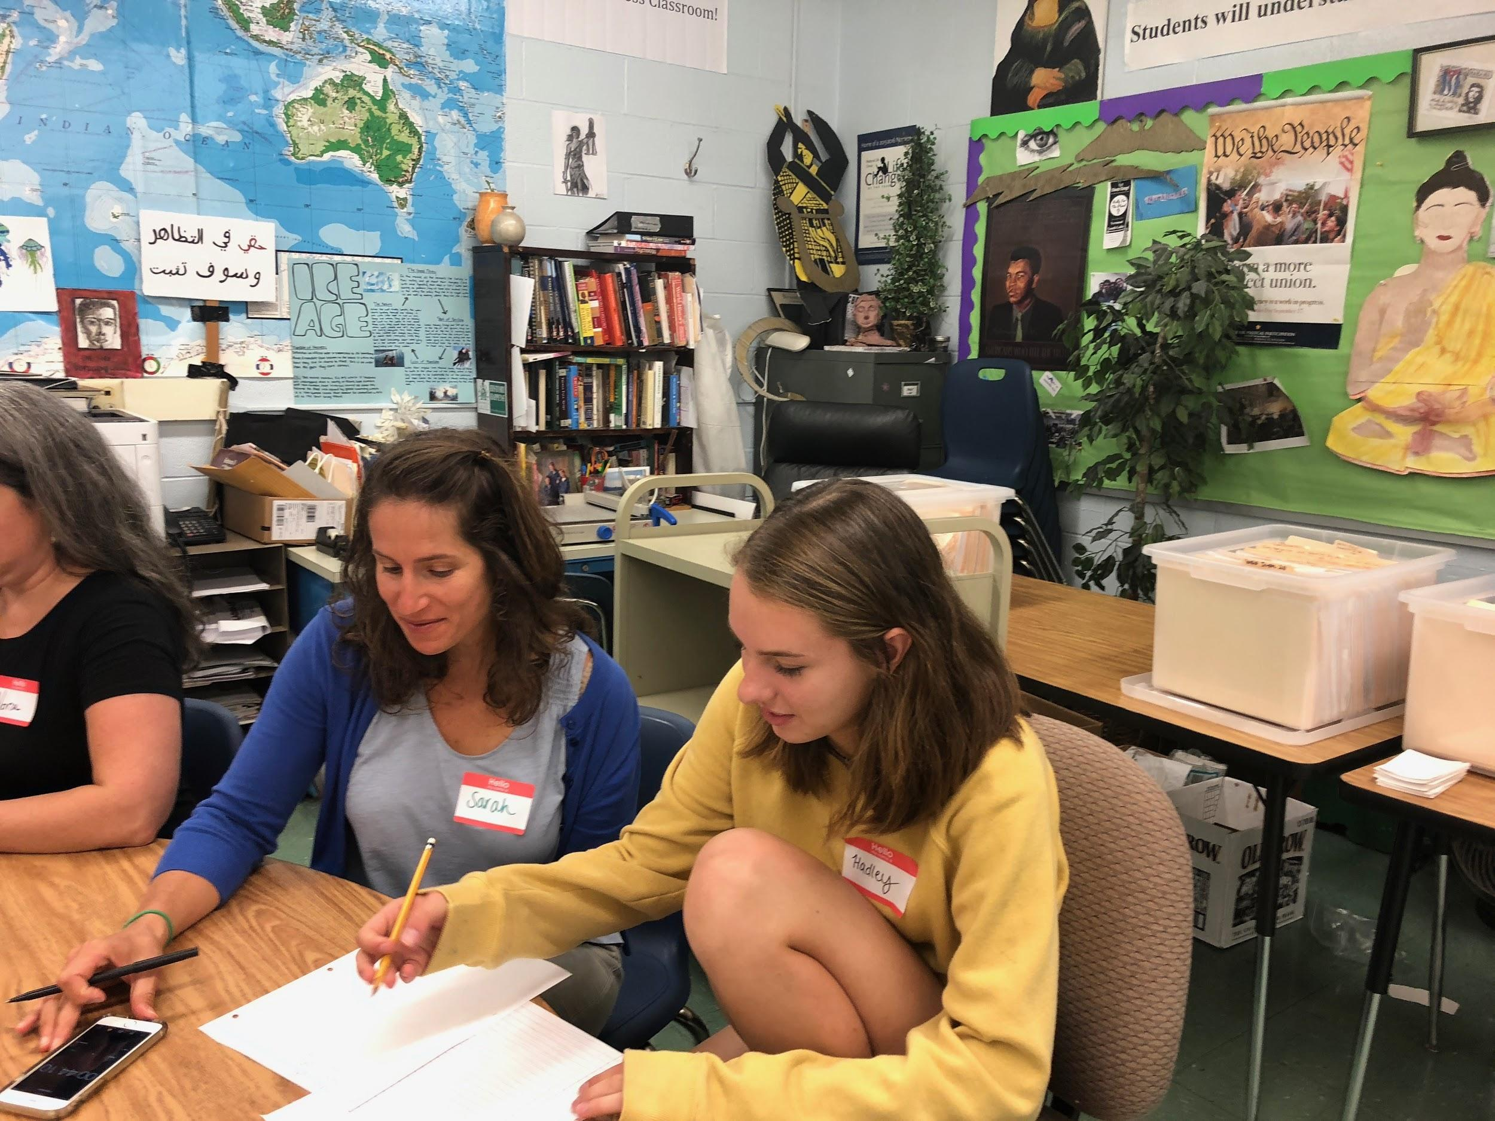
Teacher-student relationships and student-student relationships grounded in trust and collaboration

Slide 4
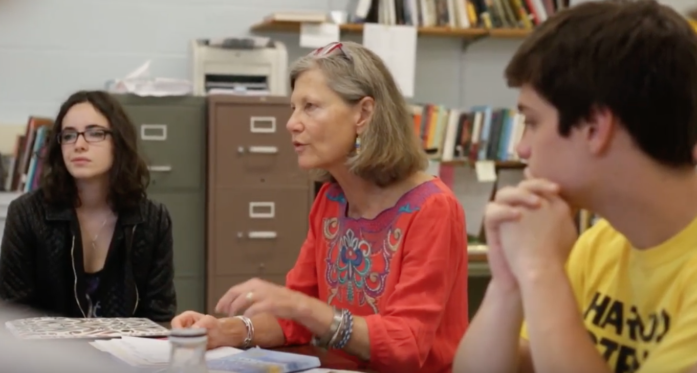
2. Facilitator Expectations—What students can expect from you as a facilitator

Slide 5
3. Student Expectations – What you expect of students

Slide 6
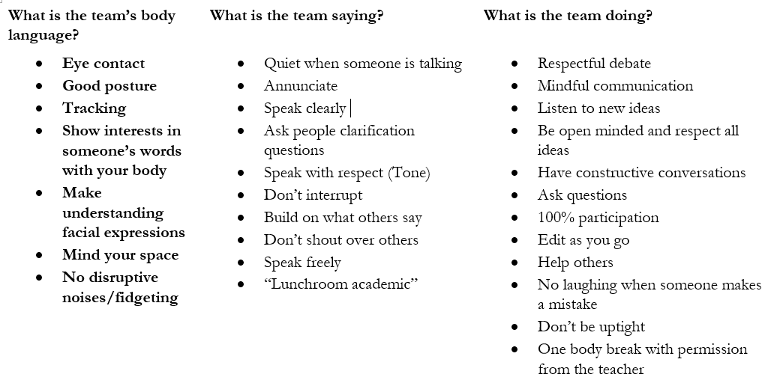
4. Student Norms – What “norms” students can set and hold each other accountable for?

Slide 7
Before You Begin Planning for Harkness, Think about the Ending..
What do you want students to be able to know, understand and DO at the end of a unit of study?

Slide 8
Consider the Purpose of the Discussion:
What do you want students to do at the Table?
What do you want them TO DO with what they LEARN
at the Table?

Slide 9
Step I: Choosing Materials
Chose text, film or content that ……..
Is accessible or that can be modified
Is high interest and/or is related to the content of your class
Is material that can be “unpacked”

Slide 10
Ask Yourself...
Does this text/activity help answer essential unit questions?
2) Does the text/activity align to my unit objectives?

Slide 11
Ask Yourself...
3) Is this text/activity rigorous? on grade level? Will it need to be modified?
4) What does this experience demand that the student do?

Slide 12
Ask Yourself...
5) What perspective does this discussion/material provide and why is it important?
6) What else might I pair with this text/activity to provide a comprehensive understanding of the material?

Slide 13
Step II. Preparation for the Table
Ask yourself beforehand…
HOW do you want the students to engage with the material?
Create a PREP SHEET designed to help students focus on important points/aspects of the content- and connect this to your GOAL for the discussion

Slide 14
Step III: Teacher Moves at the Table
Consider options on a spectrum of instructor involvement ranging from less involvement and planning to more involvement and planning...

Slide 15
Top Down Approach
Point A to Point B
Develop sequence of questions prior to the discussion
Driven by Content coverage

Slide 16
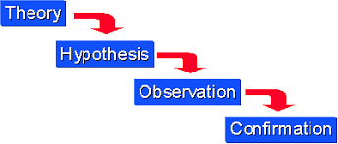
Moving From the General to the Particular:
Discussion begins with a broad interpretive question then moves to particular questions
“What is happening to the Athenian Democracy?”

Slide 17
From the Particular to the General
Discussion begins by information-seeking questions on the particulars of the reading/ problem to determine student understanding the material THEN switches to the general discussion
“What questions do you have?”
“What is puzzling to you?”

Slide 18
T.
The Bubble Up Approach
Students work their way through “cold” material with occasional guidance when appropriate. Discussion is exploratory; there is no set agenda. Students prepare questions ahead of time or they come up organically through discussion.
This is advanced work!

Slide 19
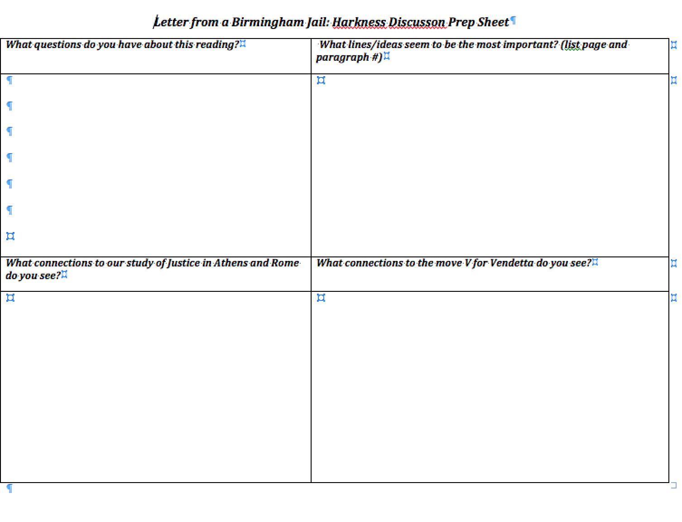
Step IV: Using Learning “From the Table”
What is the Purpose of Today’s Harkness?
Intentionally design your
Prep sheet and follow
up activity to have them
use what they have
learned at the Table

Slide 20
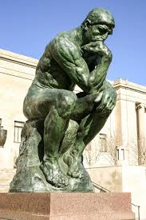
Step V: Student and Teacher Reflection
What did I learn in this discussion?
How did I do in the discussion today?
What do I need to work on in the next discussion?
What further questions do I have?

Slide 21
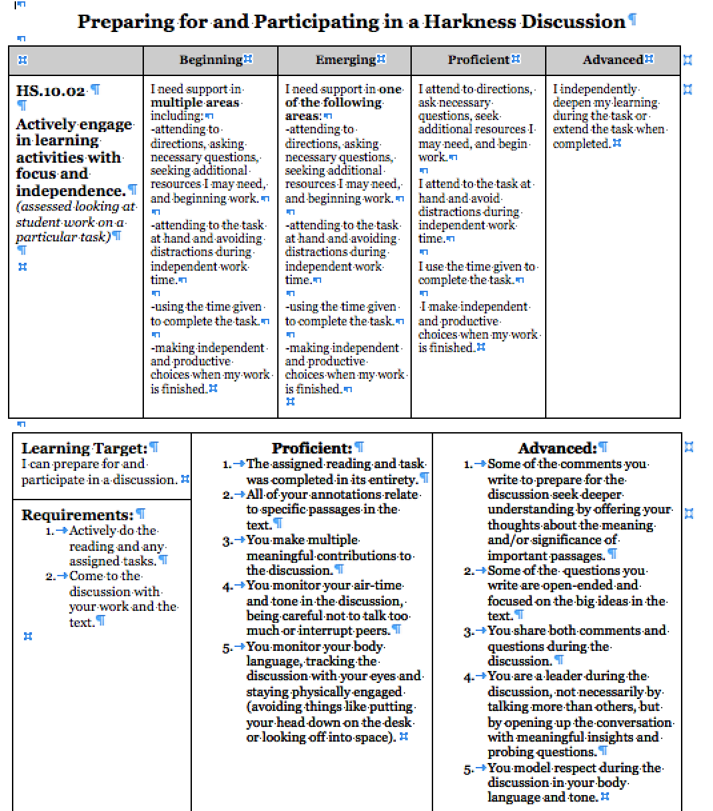
Be Specific About What You are Assessing

Slide 22
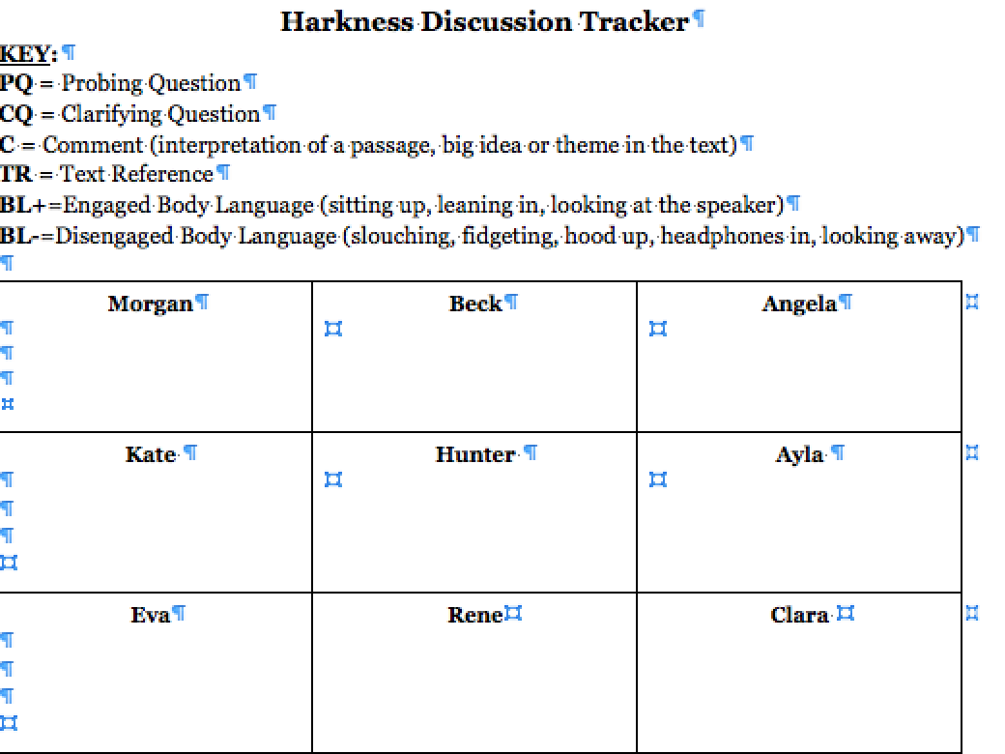
Decide What You are Going to Assess and Be Transparent with Students

Slide 23
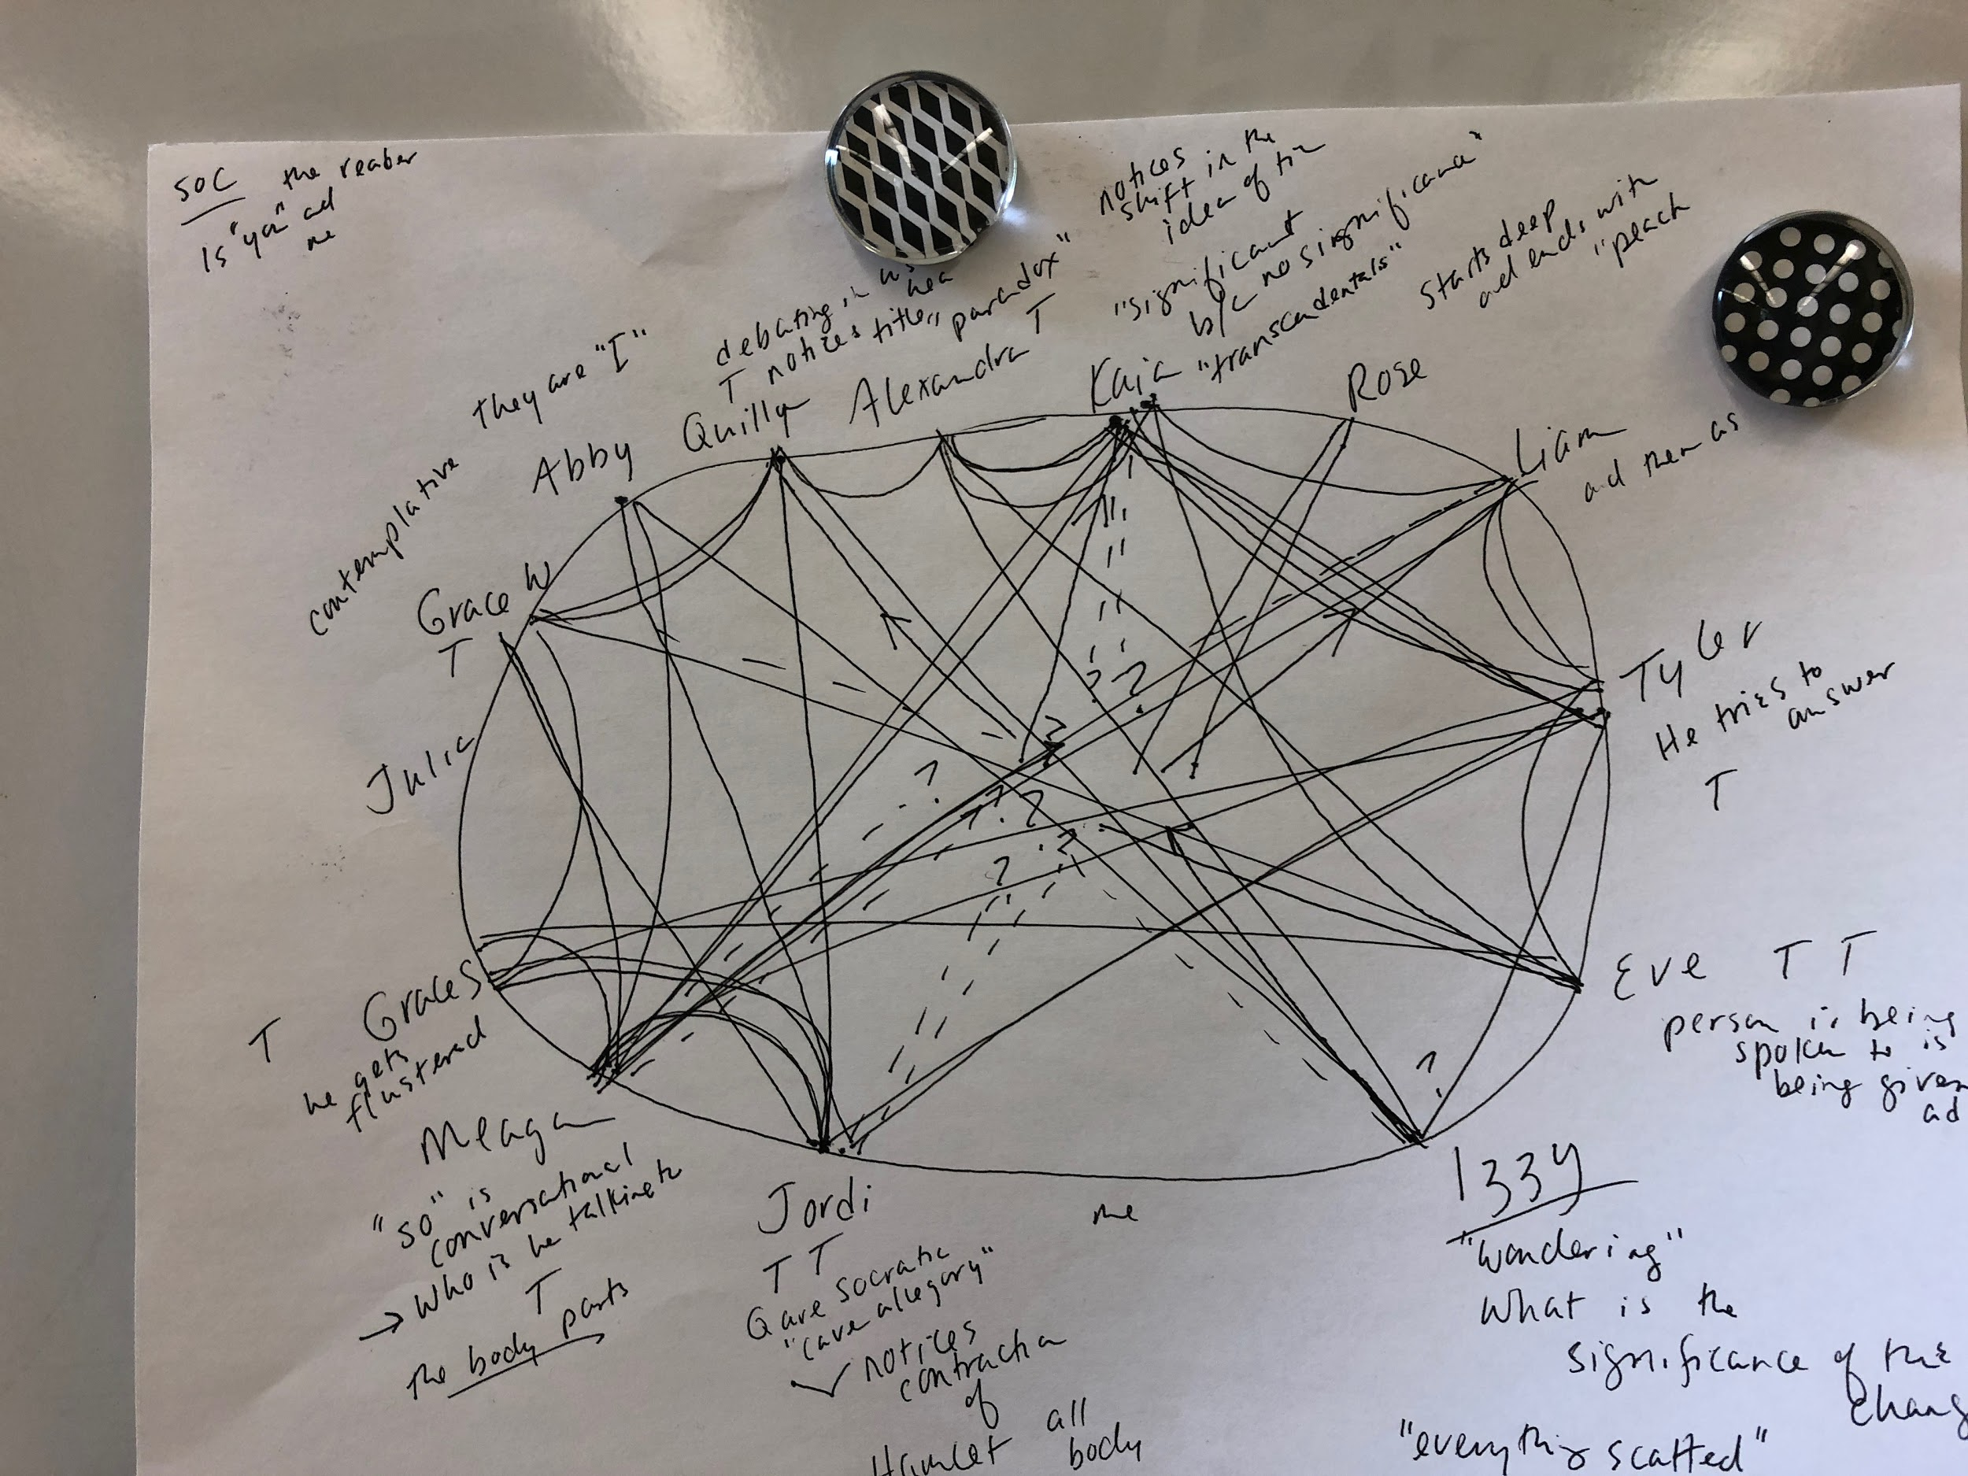
Always Give Feedback in a Timely Fashion!

