Slide 1
Here We Go!! ANOTHER YEAR!

Slide 2
A Few Thoughts……...
….. and a Disclaimer

Slide 3
Looking at Non Negotiables
They ARE Designed To
Promote Conditions for Learning
Non-Negotiable because they are
critical to create a learning
environment
Few in number
Valued by the Institution
Promoted with Pride and Grounded in Respect
Be“Support Beams” of Teaching and Learning
They are NOT
Classrooms Rules or Norms
Designed to be Punitive
A Magic Bullet that is an answer to all Discipline issues
A Formula for Success

Slide 4
What do our Students Want US to Do?
(We Asked them)
Explain why we have the NN’s
“Explain to everyone how and why these were developed and what their purpose is”
“Each teacher should share these with their classes on the first day of school”
“We need to know WHY have these and what purpose they serve”

Slide 5
State Clearly and POST how the NN’s will be implemented in each Teacher’s Classroom
“Teachers are different and I understand that. We just need to know the specific expectations of each teacher. Some teachers say I can use my cell phone and others say “only on a break” and others say NEVER!”
“Where should I put my phone and my backpack? If it is different in each class we need to be told- then it is less confusing”
“What does it mean to “distract from the learning of others”? We need to know what different teachers think and it needs to be clear”
“What does “being present and ready to learn” look like for different teachers? Teachers should tell us the first day”

Slide 6
Enforce the NN’s with Consistency and Clarity
“The reason that they are not being followed is that they are not being enforced” “
“All teachers should be on the same page and enforce these the same way” .
”We need a standard for all teachers and students”
“We know the teachers who we can take advantage of”
“Some teachers just point at the list and say ,”You are breaking this NN” and that does not do anything”

Slide 7
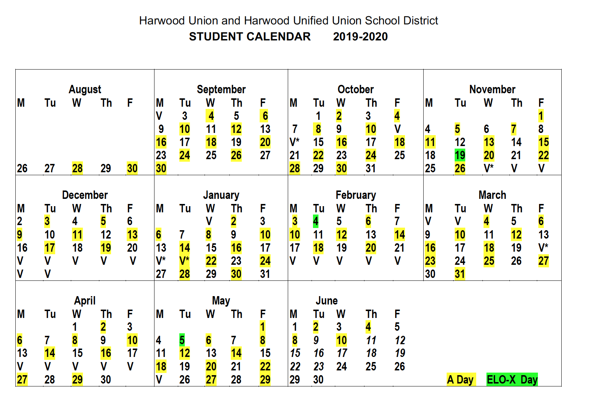
Starting From Day One………..
Establishing a Classroom Based on Trust, Mutual Respect, Collaboration and Inclusivity

Slide 8
What sort of Learning Environment Do We Want to Create at Our School?
In YOUR CLASSROOM………...
What do you want to see and hear students doing in your class?
What do you want them to see and hear YOU doing?

Slide 9
What do the Students Say?
What does a classroom based on trust, mutual respect and collaboration look like? | What can the TEACHER do to create this atmosphere? | What can STUDENTS do to create this atmosphere?
There IS OPEN DIALOGUE between students and teachers There is a welcoming atmosphere and positive interactions There are appreciative and supportive comments that show teachers CARE about us We feel comfortable and safe asking questions We are engaged, focused and helping one another- using appropriate voice tone and body language A variety of information/ projects and teaching methods are offered | Show connections to the real world Pose questions to encourage our learning and engagement Build individual relationships to help guide us in our learning journey Greet us at the door Show us that you are willing to invest extra time to help Support us in school and in other activities CHALLENGE US even when we may not like it :) Show us they BELIEVE in us Respect individual differences | Respect the teacher as a person Respect the learning environment by putting away technology Respect and support one another in their learning Be prepared for class Work to be engaged and give one another and the teacher constructive feedback TRY our best! Develop the courage to ASK QUESTIONS and share if we are confused

Slide 10
Key Components of Effective Classrooms
Urgency for Learning
Collaboration
Trust
Mutual Respect
Inclusivity

Slide 11
Creating an “Urgency for Learning”

Slide 12
What is “Urgency for Learning?

Slide 13
“Urgency for Learning” Sends the Message
YOU are Important..
LEARNING is Important...
EVERY MOMENT
of our time together
is important!

Slide 14
Components of Urgency for Learning are
Being Prepared
Being Fully Present in the
Moment
“Is your MIND in the Room?”
Starting the Class in a way that allows
for transition and focus

Slide 15
Urgency for Learning means
Setting the Bar High!

Slide 16
If We Create an Urgency for Learning in all Classrooms in our School
What Message Does This Send Parents and Community?
To Students…...
To Parents………
To Our Community?

Slide 17
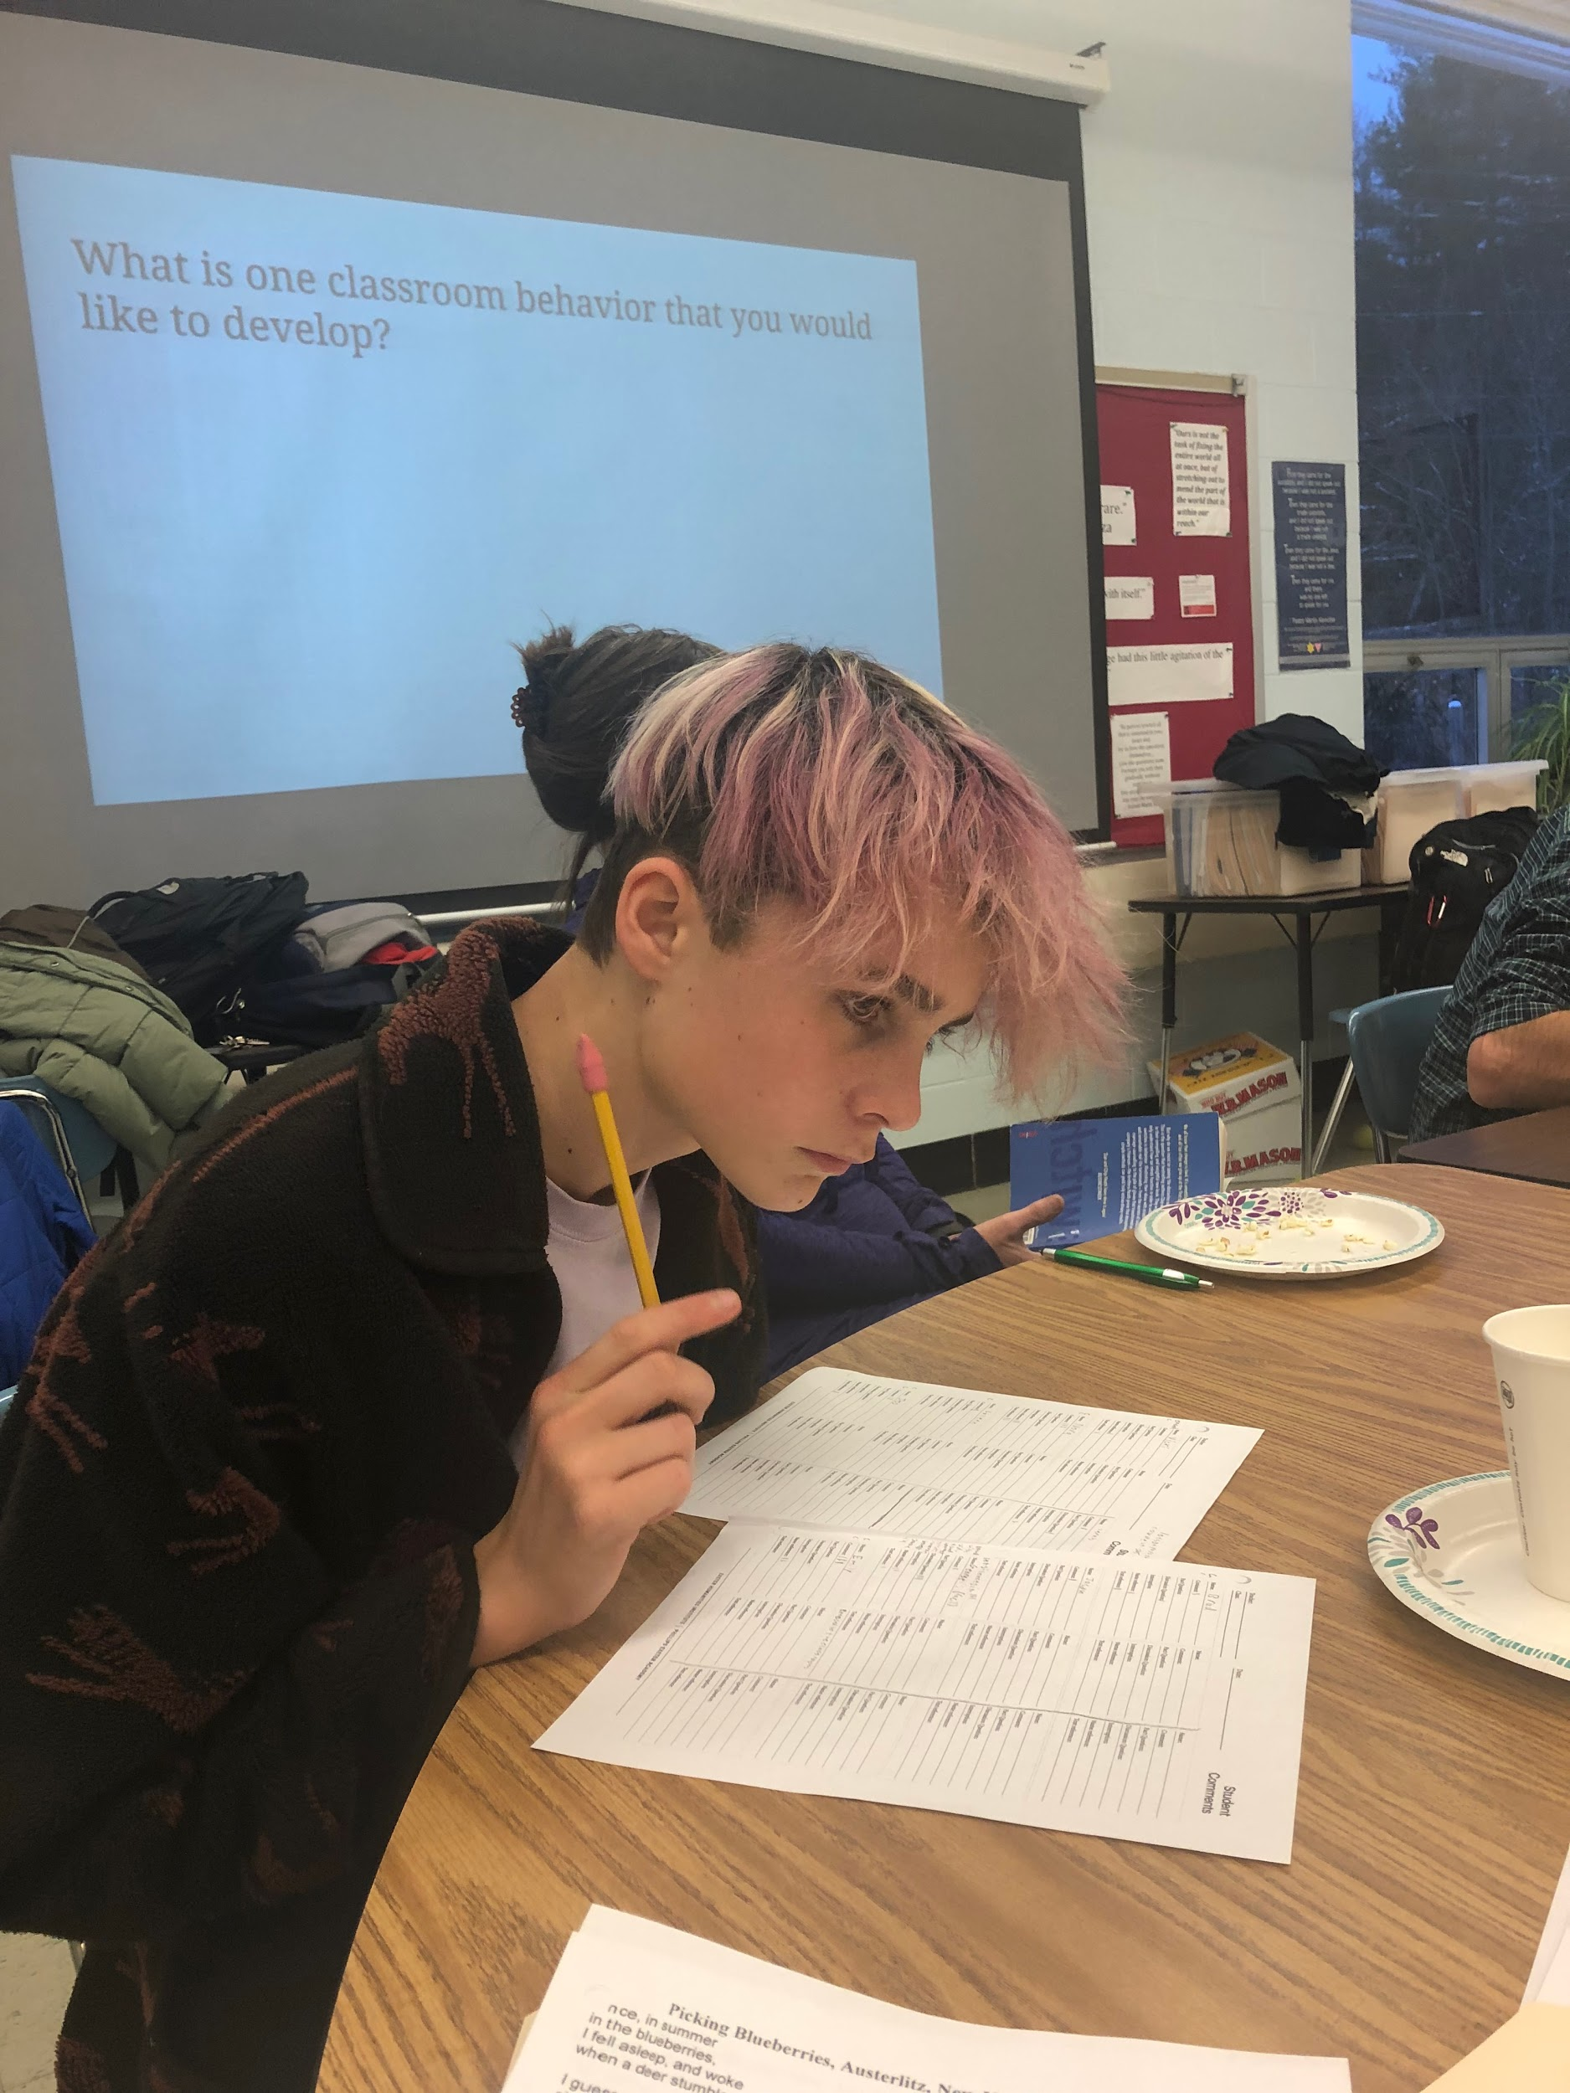
Using Every Moment:Start with DO NOW!
All students are working before the second bell
Instructions are on the board before students enter the room
Establishes Routine for Learning
No time is wasted

Slide 18
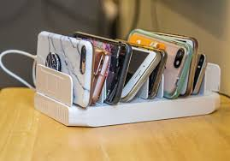
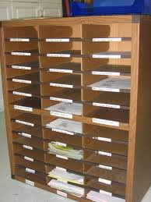
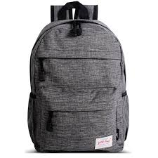
Establishing Systems and Routines to Support Urgency for Learning

Slide 19
Establishing Trust
“It is all About Relationships”
THINK of a Great Teacher in Your Life...
What did He or She Do that
Made an Impression on You?

Slide 20
Qualities of Great Teachers “4C’s
They CARE
They are CLEAR about expectations
They make learning COMPELLING
They make CONNECTIONS to the world beyond the classroom

Slide 22
Establishing Mutual Respect
We Have to Actively Teach the Behaviors We Want Our Students to Exhibit
Tone of Voice
Eye Contact
Skills of Civil Discourse
Body Language

Slide 23
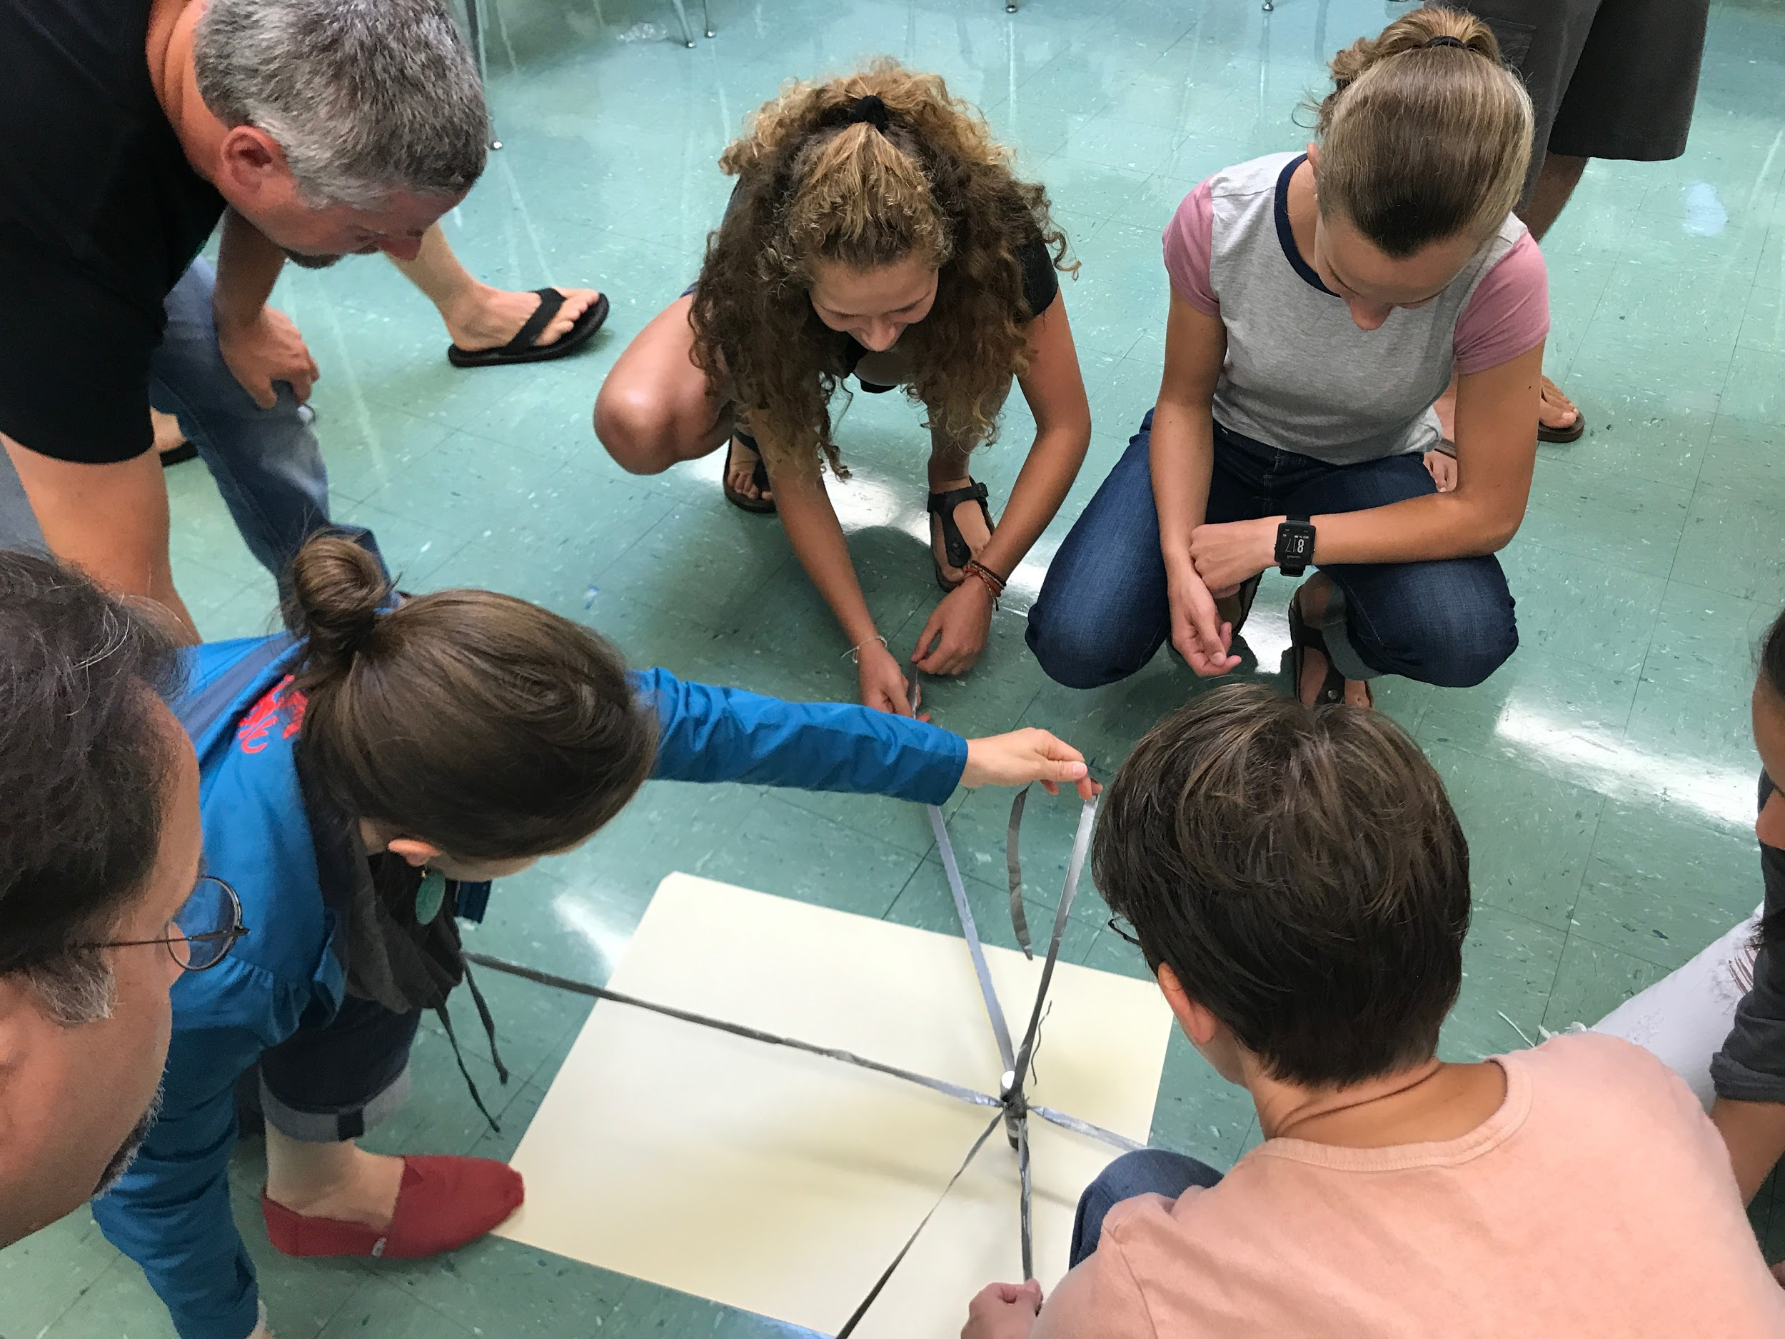
Creating a Climate of Collaboration
Practice with games and activities
Learning is not a competition
Use “I” statements
Working together is LEARNED Behavior
Lean into discomfort
Be Willing to make mistakes MODEL this for kids!

Slide 24
Inclusivity as the Foundation
All Voices are Valued
“None of us is as smart as all of us”

Slide 25
Inclusivity Implies Student Agency
Everyone feels comfortable speaking
Students take an active role in
their own
learning
Individuals are treated equitably
Learning is a Partnership
This Means New Roles for Students and Teachers!

Slide 26
What will YOU do on the FIRST DAY of School to create a Learning Environment in Your Classroom?

