Slide 1
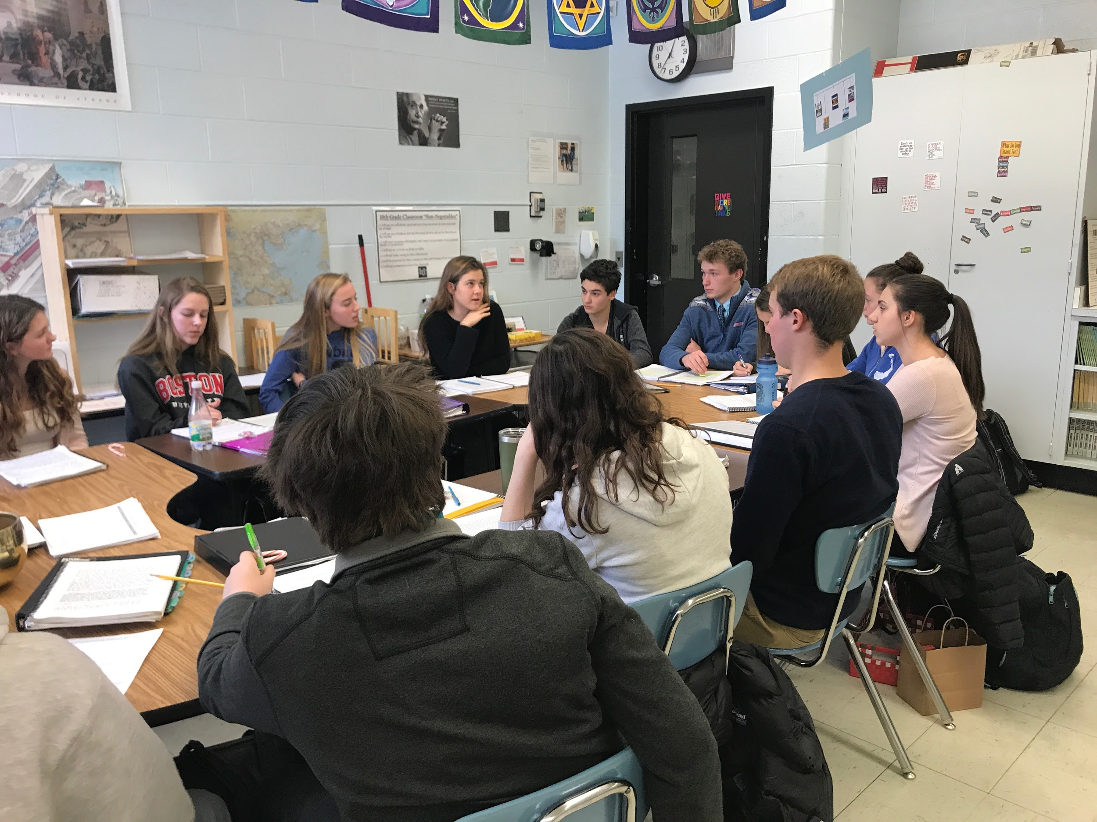
“Setting the Table” For High Quality Harkness

Slide 2
Are Your Students READY?
• Can they demonstrate eye contact?
• Are they aware of their body language and presence in the room?
• Do they understand tone of voice?
• Are they aware of active listening skills?
• Have they practiced with Sentence Stems to unpack conversations?
• Can they annotate text?
• Are they learning to ask Clarifying and Probing questions?

Slide 3
“Setting the Table” Means…..
WHAT CAN TEACHERS DO TO……
Activate our students to ask questions and be curious?
Make sure that students can understand what the text/ challenge/ problem is (more scaffolding and modification may be needed)
Create the opportunity for ALL students to enter into the conversation
Work to eliminate our “Expert Blind Spot” (just because WE know the content and perhaps the process of Harkness does not mean that the students do…)

Slide 4
How Do I Plan For Harkness?
ASK “WHAT IS YOUR GOAL FOR EACH HARKNESS DISCUSSION”?
Is the Conversation a Means to a Greater End or an End in Itself?
To practice civil discourse?
To unpack/ understand/ interpret a reading, poem or film?
To have students work collectively to solve a math problem or answer a driving question?
To reflect on ideas from a lab experiment and generate ideas for the lab report?
To generate ideas for a paper or project to follow?

Slide 5
“Priming the Pump”
What COMMON EXPERIENCES do you want students to bring to the Table?
Read and annotate a text central to your curriculum?
Perform an experiment and bring in their data?
Attempt a math problem and bring in their work?
Watch a film and bring in their observations/ interpretations?
Raise questions that they have from their investigations?
“Bring to the Table What You DO NOT KNOW!”

Slide 6
“Priming the Pump”
2) CUSTOM DESIGN A PREP SHEET to get them Ready for the Table
Perhaps a prep sheet with categories that you want students to explore in
order to unpack the driving question: important lines, quotations, question you
have, connections to other material, etc..
Scaffold the introduction to the Table so everyone can be prepared to talk
You may need to modify this prep sheet for different students
Design the sheet so that it helps them use the information from the
Discussion for the next task

Slide 7
Clarifying Questions: (Write down any factual questions you might have) Text Evidence (Write down page numbers of evidence you would like to use during the discussion) | Probing Questions: (Questions you might have that will help us think more deeply about the reading) Key points (What are the important ideas or topics from this reading?)

Slide 8
#3“Opening the Conversation”
Design an opening/focus question that you hand out to students in advance and ask them to prepare Such as the “How does the metaphor of the rider, the elephant and the path relate to our work to transform classroom practice?”
Have students each choose one question that they do not understand from the reading/and or what they want to talk about and put it on a note card Collect these cards in the middle of the table. Read the cards aloud and decide on a question to begin with
Have students each write one question on the board. Circle the questions that are similar. Decide on a question to begin with.
Pair shares at the beginning: What is puzzling? What is the most important questions/issue to begin with today? Have pairs share out their questions and choose one to begin with.Did you hear a good question?

Slide 9
“Opening the Conversation”
Have students identify a seminal quotation from the reading- share it out loud and share why they chose this.
Two minutes of think time, look through the text (or notes ) Identify one or two points/ questions that you are puzzled about
Begin by asking students to review their notes and annotation for discussion, then ask,” Does anyone want to begin?”
“2-2-2” (2 questions/ 2 Comments/2 connections) - Students come up with their own and share out in groups of three or four before choosing the best of each category from the group.These “Best Ofs’ form the basis of the conversation

Slide 10
Other Considerations at the Table
What am I going to assess in this conversation? BE TRANSPARENT
Body language? Eye contact? Using Sentence Stems? Probing Questions? Annotation? Types of Comments?
2) Design/Choose an Assessment Instrument for YOU and for the STUDENTS
2) Have the students self assess on the criteria you have told them you will look for- then you assess and provide feedback
3) Debrief with the entire group’ “How did we do and what do we need to work on?

