Slide 1
Teaching for Transformation: Socratic Dialogue and the Harkness Pedagogy in the High School Classroom
Katherine Cadwell, Kaia Cormier
Jordi Kulis, Jacob Singer-Skedzuhn
Harwood Union HS

Slide 2
What Do We Know About Teaching and Learning?
(That We Do Not Do in Schools)
We know that students learn best when they are challenged; goals are “high but achievable”
We know that students learn best when learning experiences are authentic,
engaging and relevant
We know that students learn best when they exercise their voices and drive
the inquiry
We know that “The One That Does the Work Does the Learning”

Slide 3
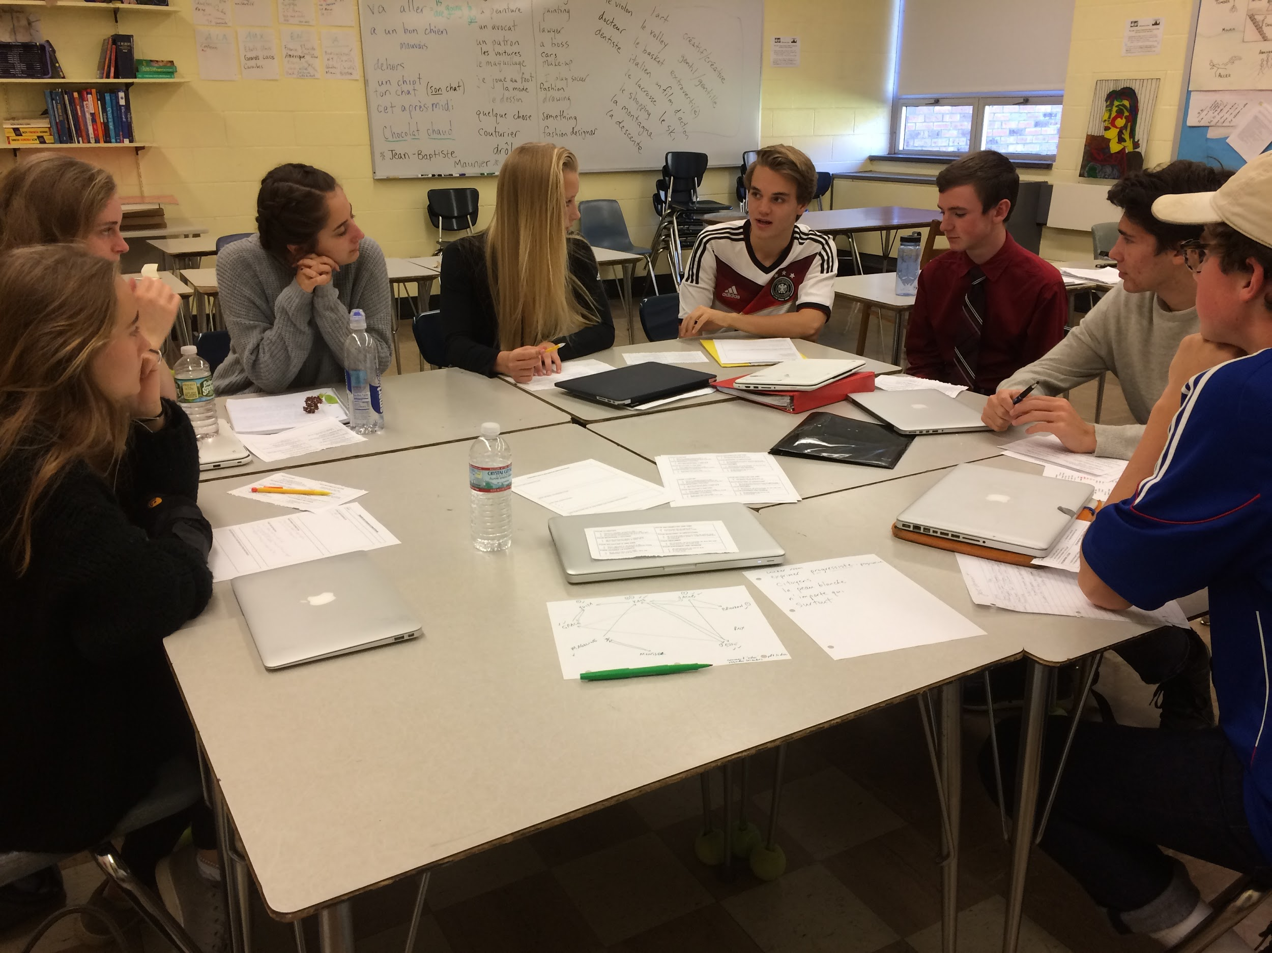
How Can We Move from Teacher-Centered to Teacher-Facilitated to Student-Driven classrooms?

Slide 4
We Need to Make a
Switch!
1. Establish a sense of urgency.
2. Create the Cadre.
3. Develop a vision and strategy.
4. Communicating the change vision.
5. Empower people for broad based action.
6. Generate short term wins.
7. Consolidate gains and producing more change.
8. Anchor this new approach in the culture.

Slide 5
Here is what We are Doing at Harwood!
15 Teachers and 10 Students are Working Together to Transform Classrooms at our School
This is our Story...
Coming to the Table :Dialogue for School Transformation

Slide 6
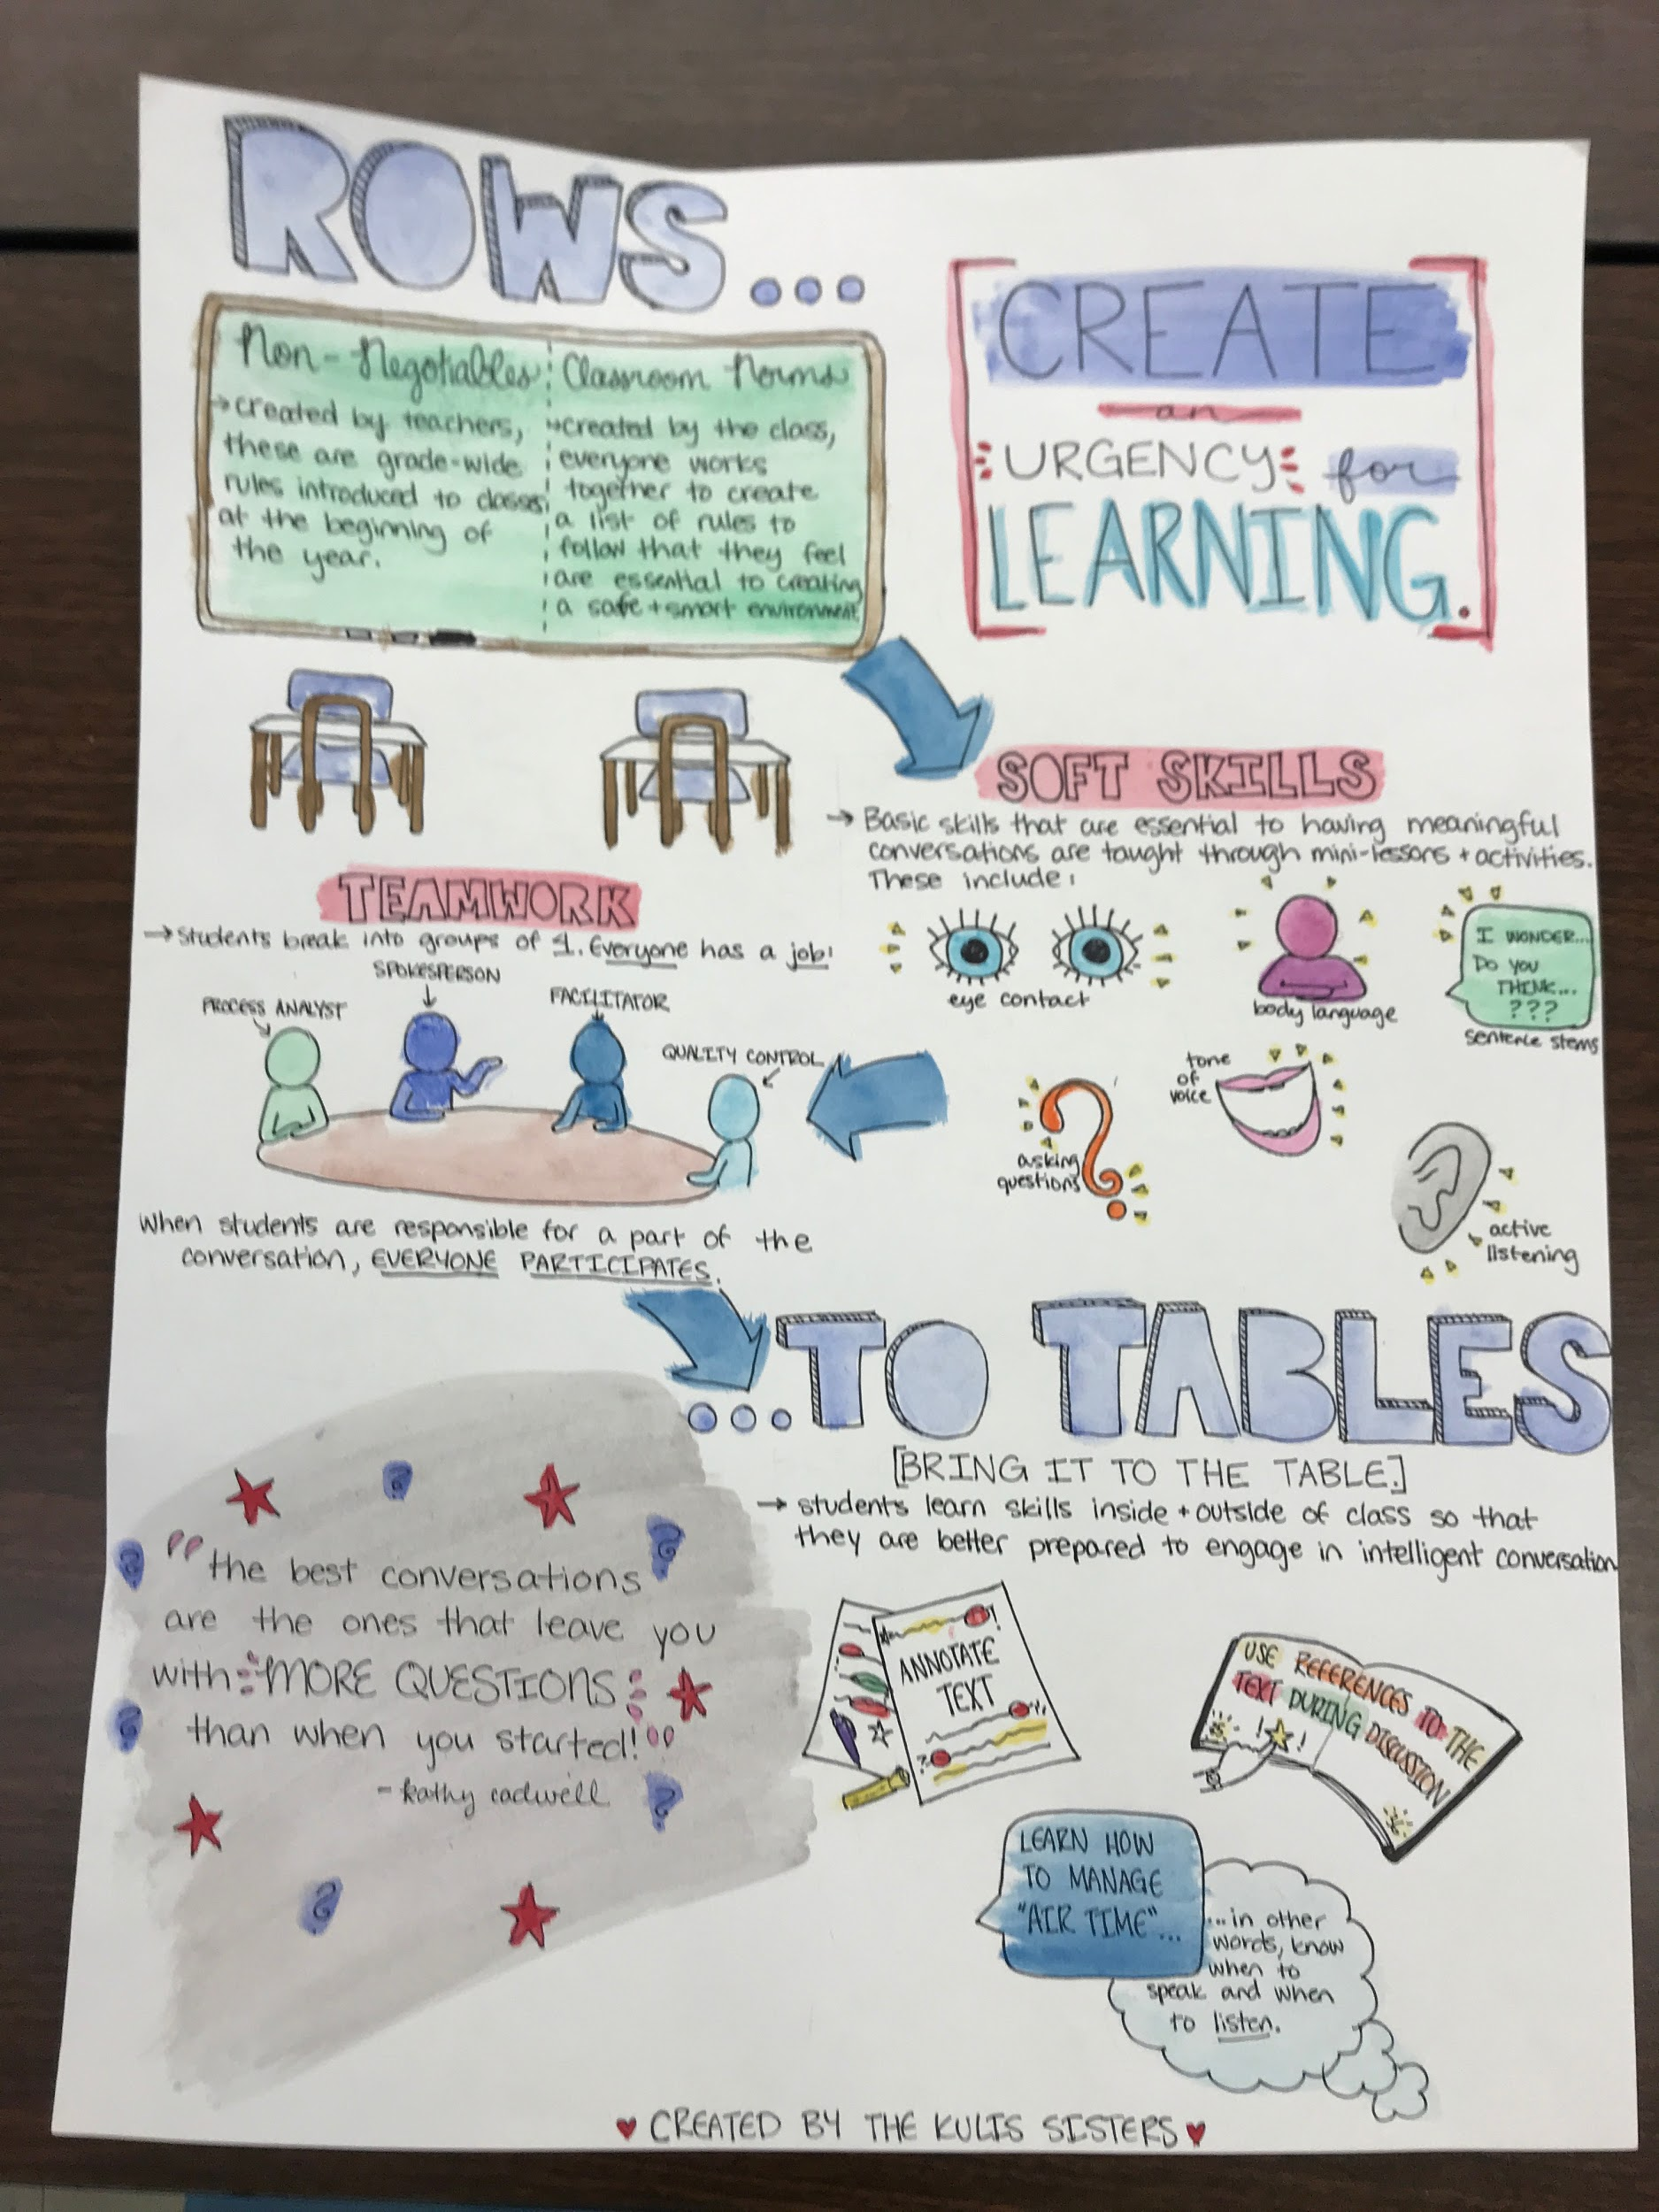
How Can We Scaffold Instruction to Create Student- Driven Classrooms?
How Can We go
From ROWS….
To Tables?

Slide 7
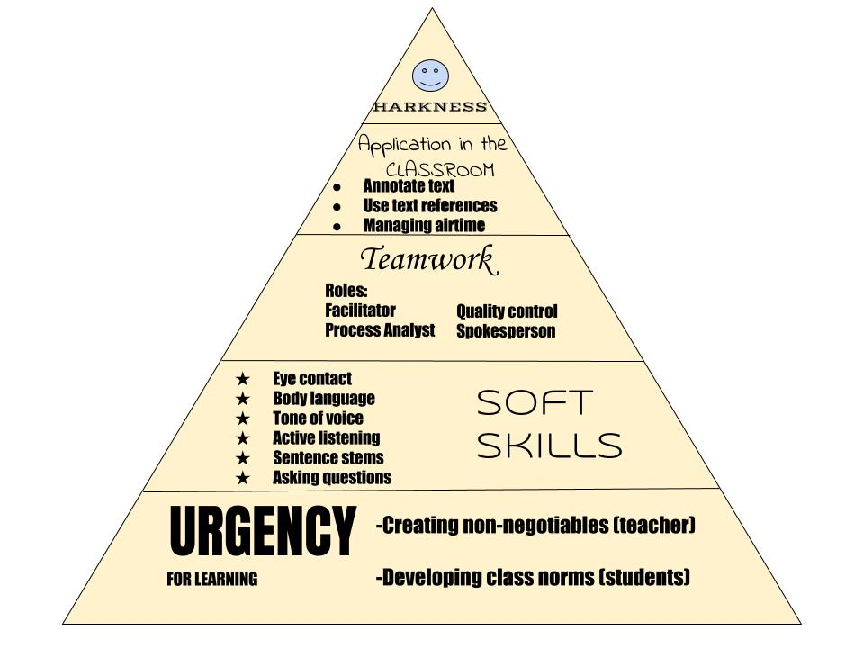
Riley’s Diagram of how we scaffold training for Harkness
Discussions

Slide 8
Creating the Urgency for Learning!
Students worked with Teachers to Develop Non- Negotiables

Slide 9
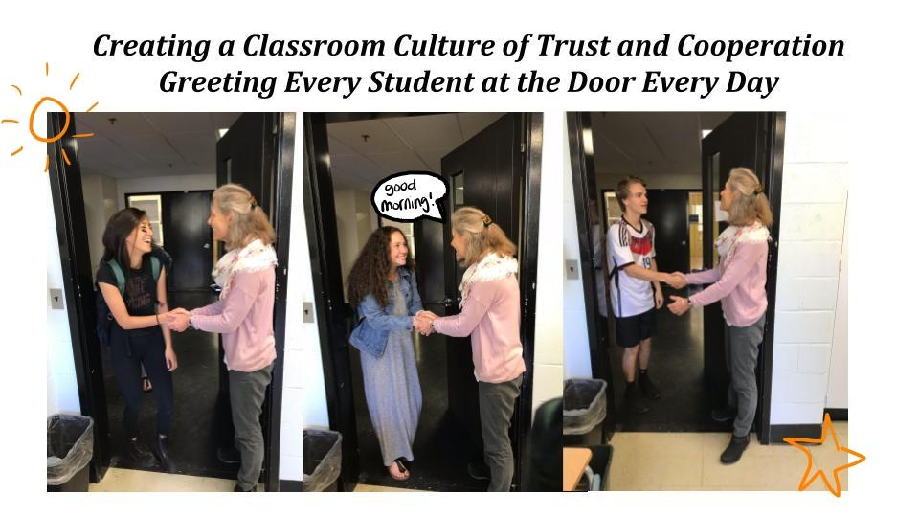
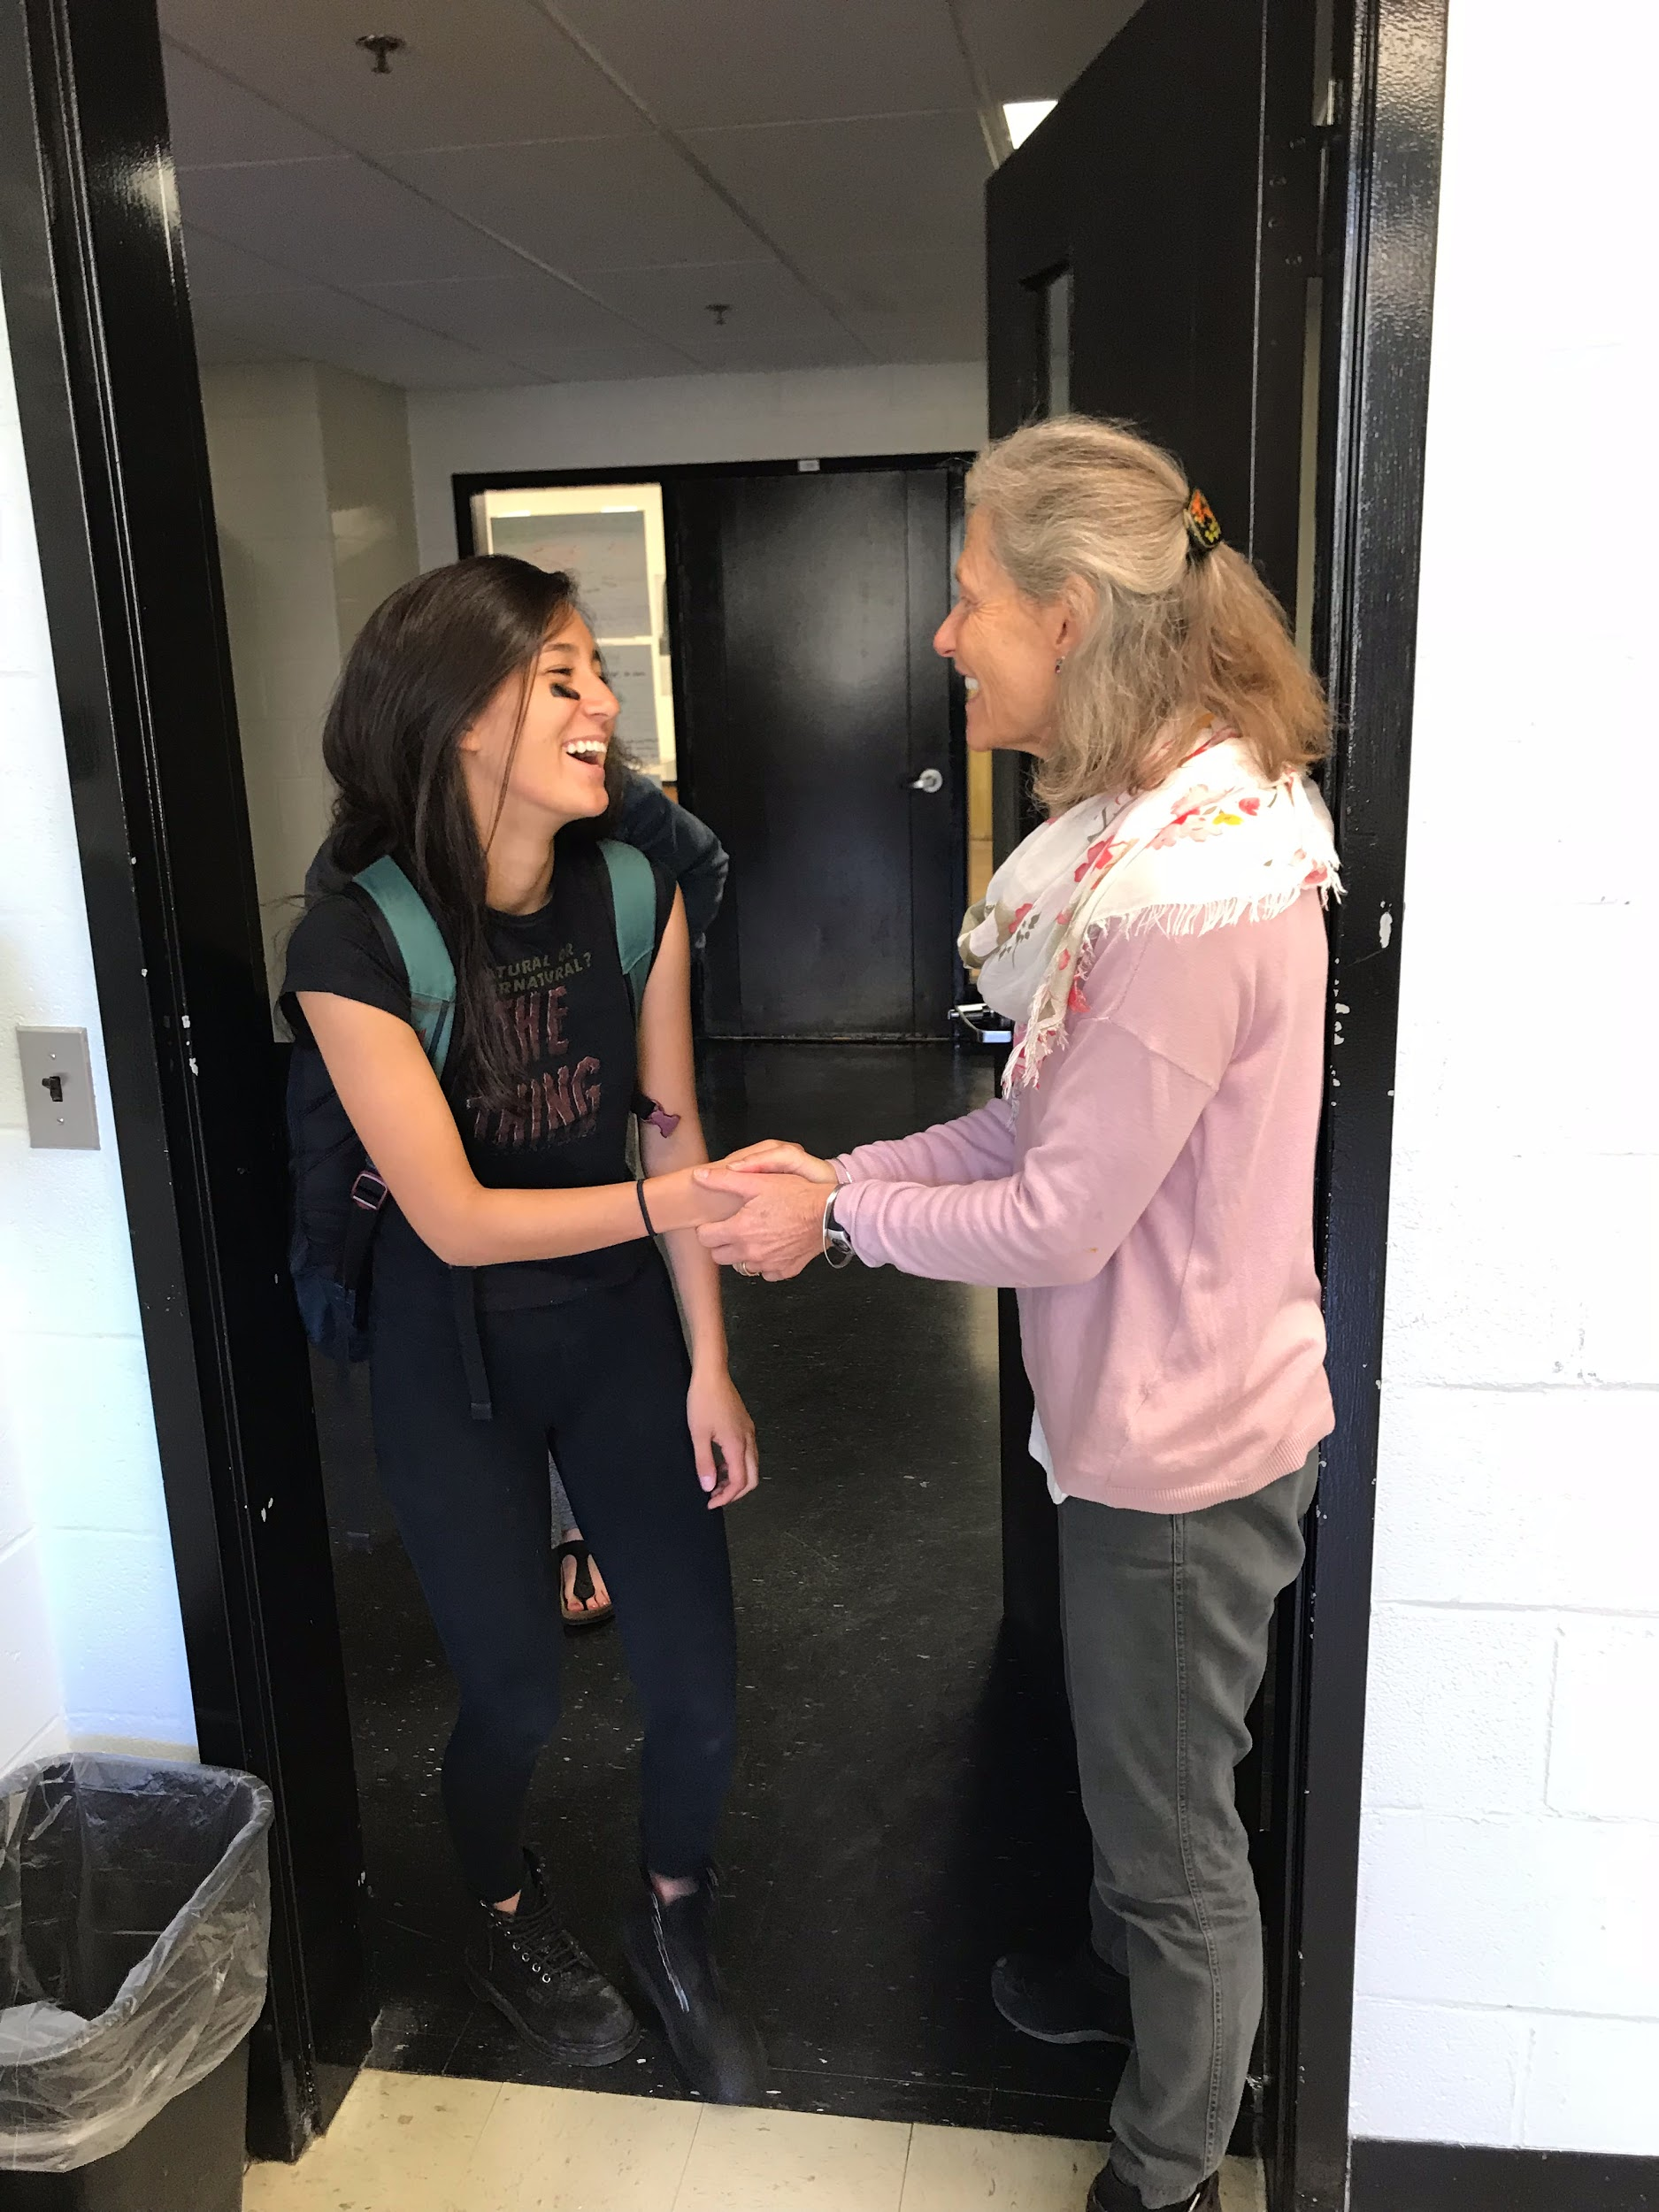
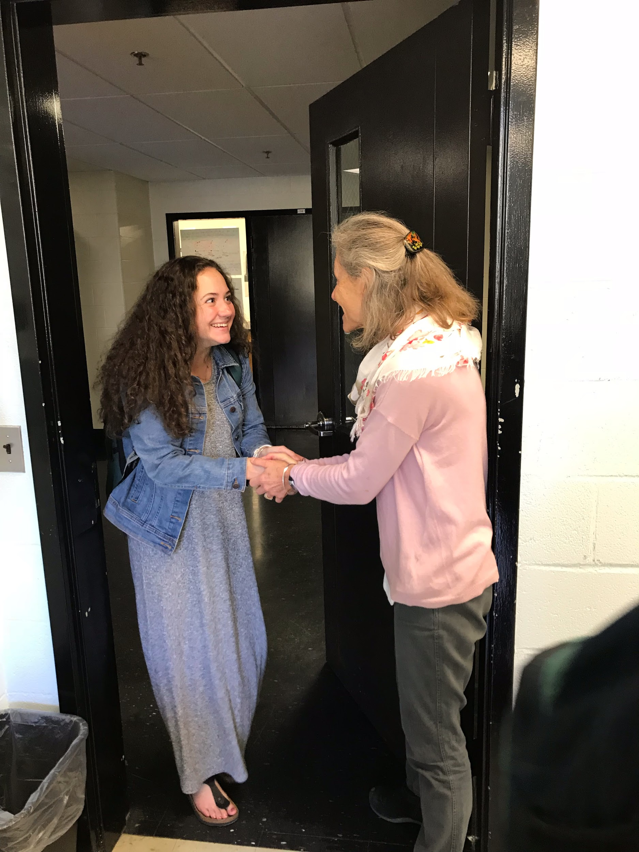
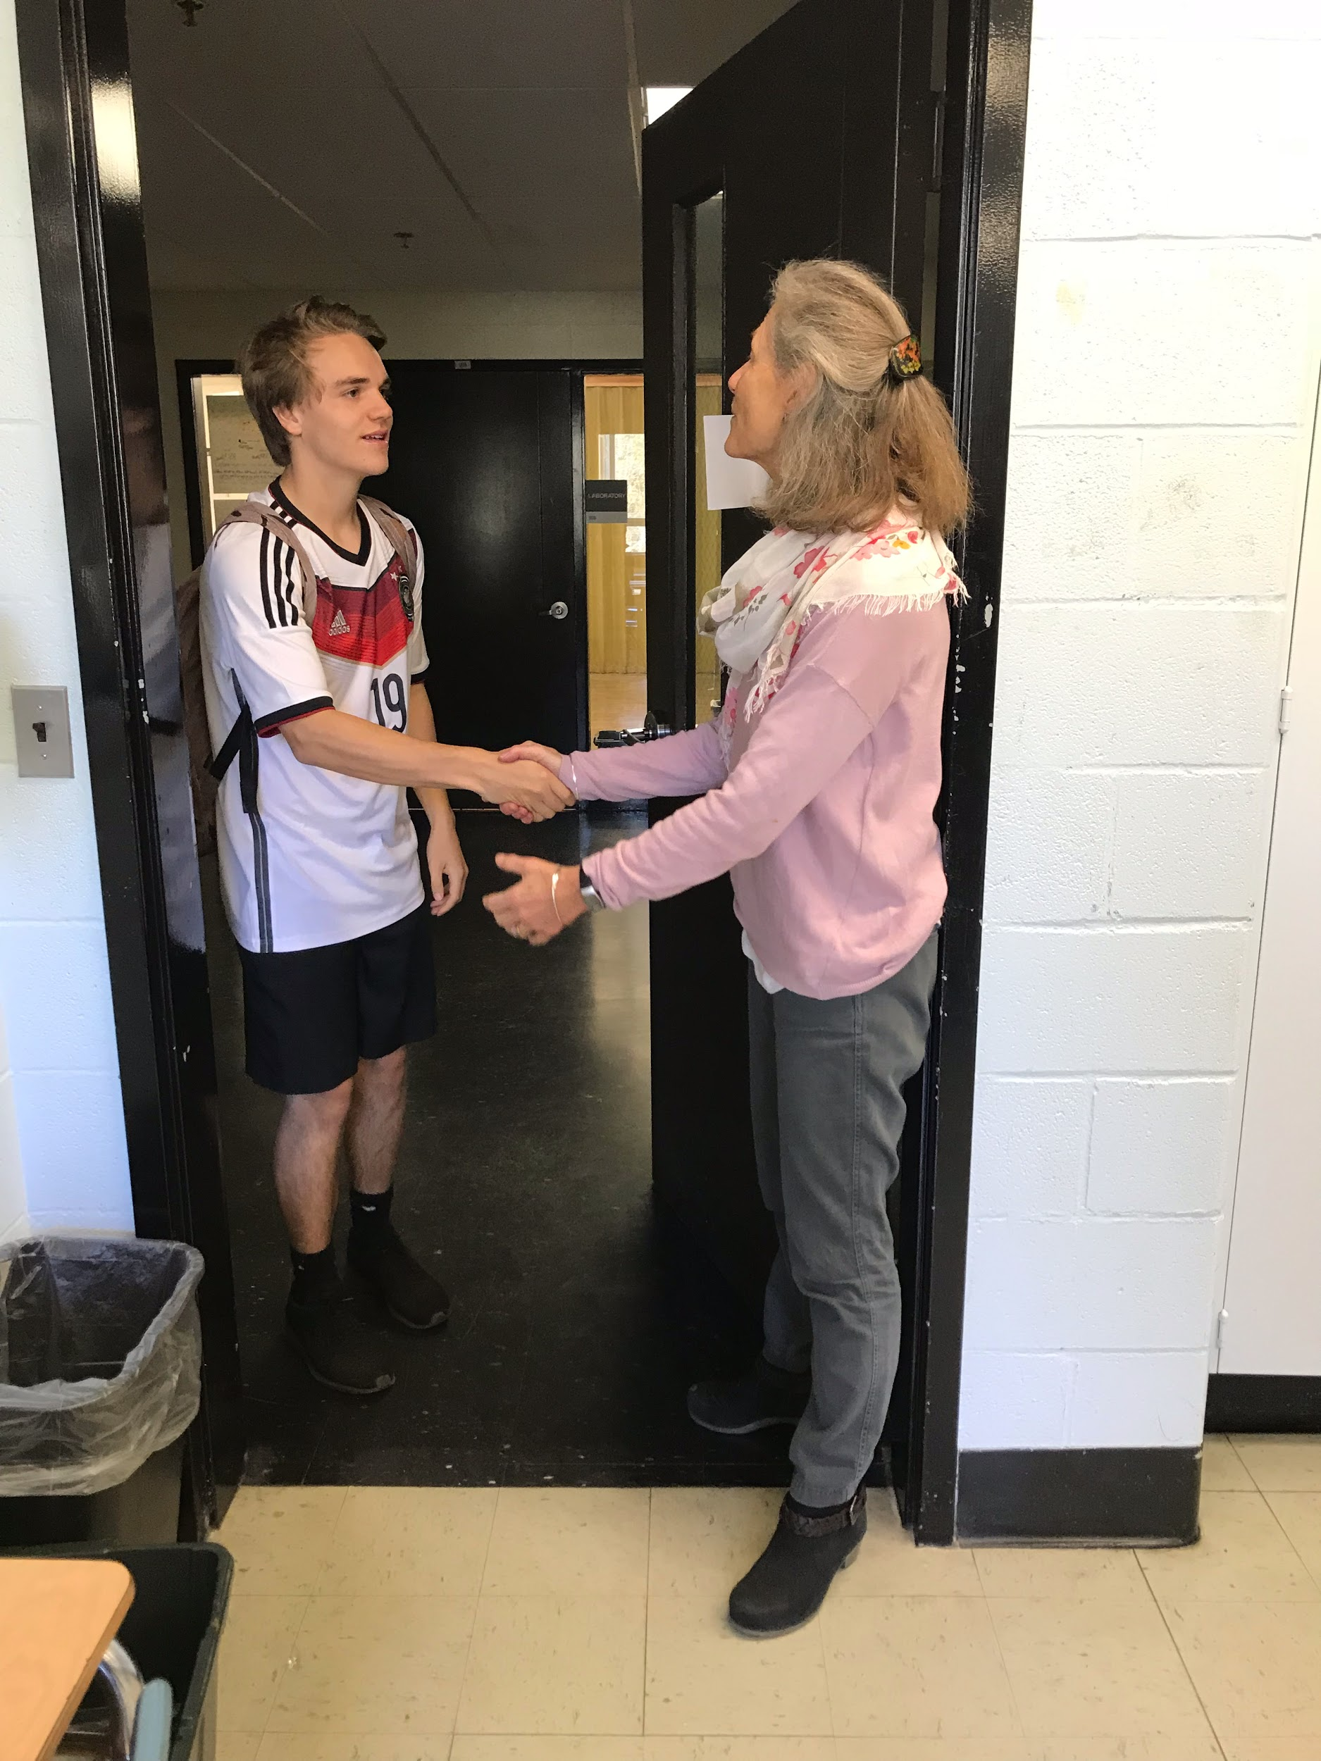
Creating a Classroom Culture of Trust and Cooperation
Greeting Every Student at the Door Every Day

Slide 10
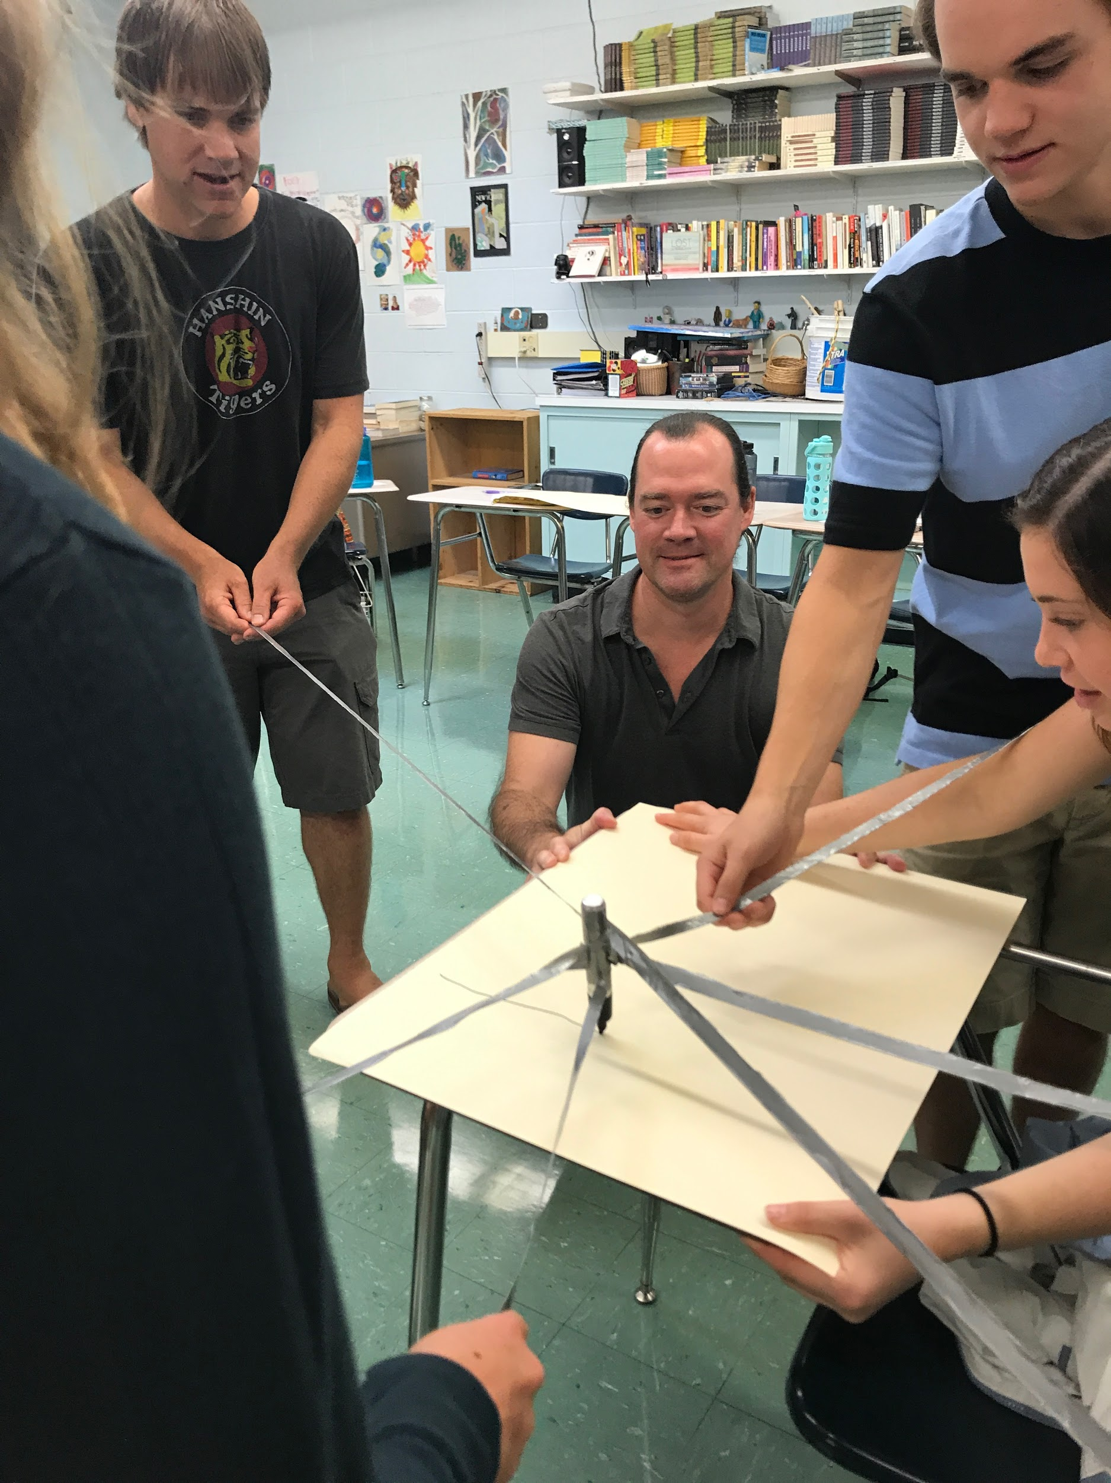
Beginning Each Class with a Cooperative Game Focused on Engagement and Trust

Slide 11
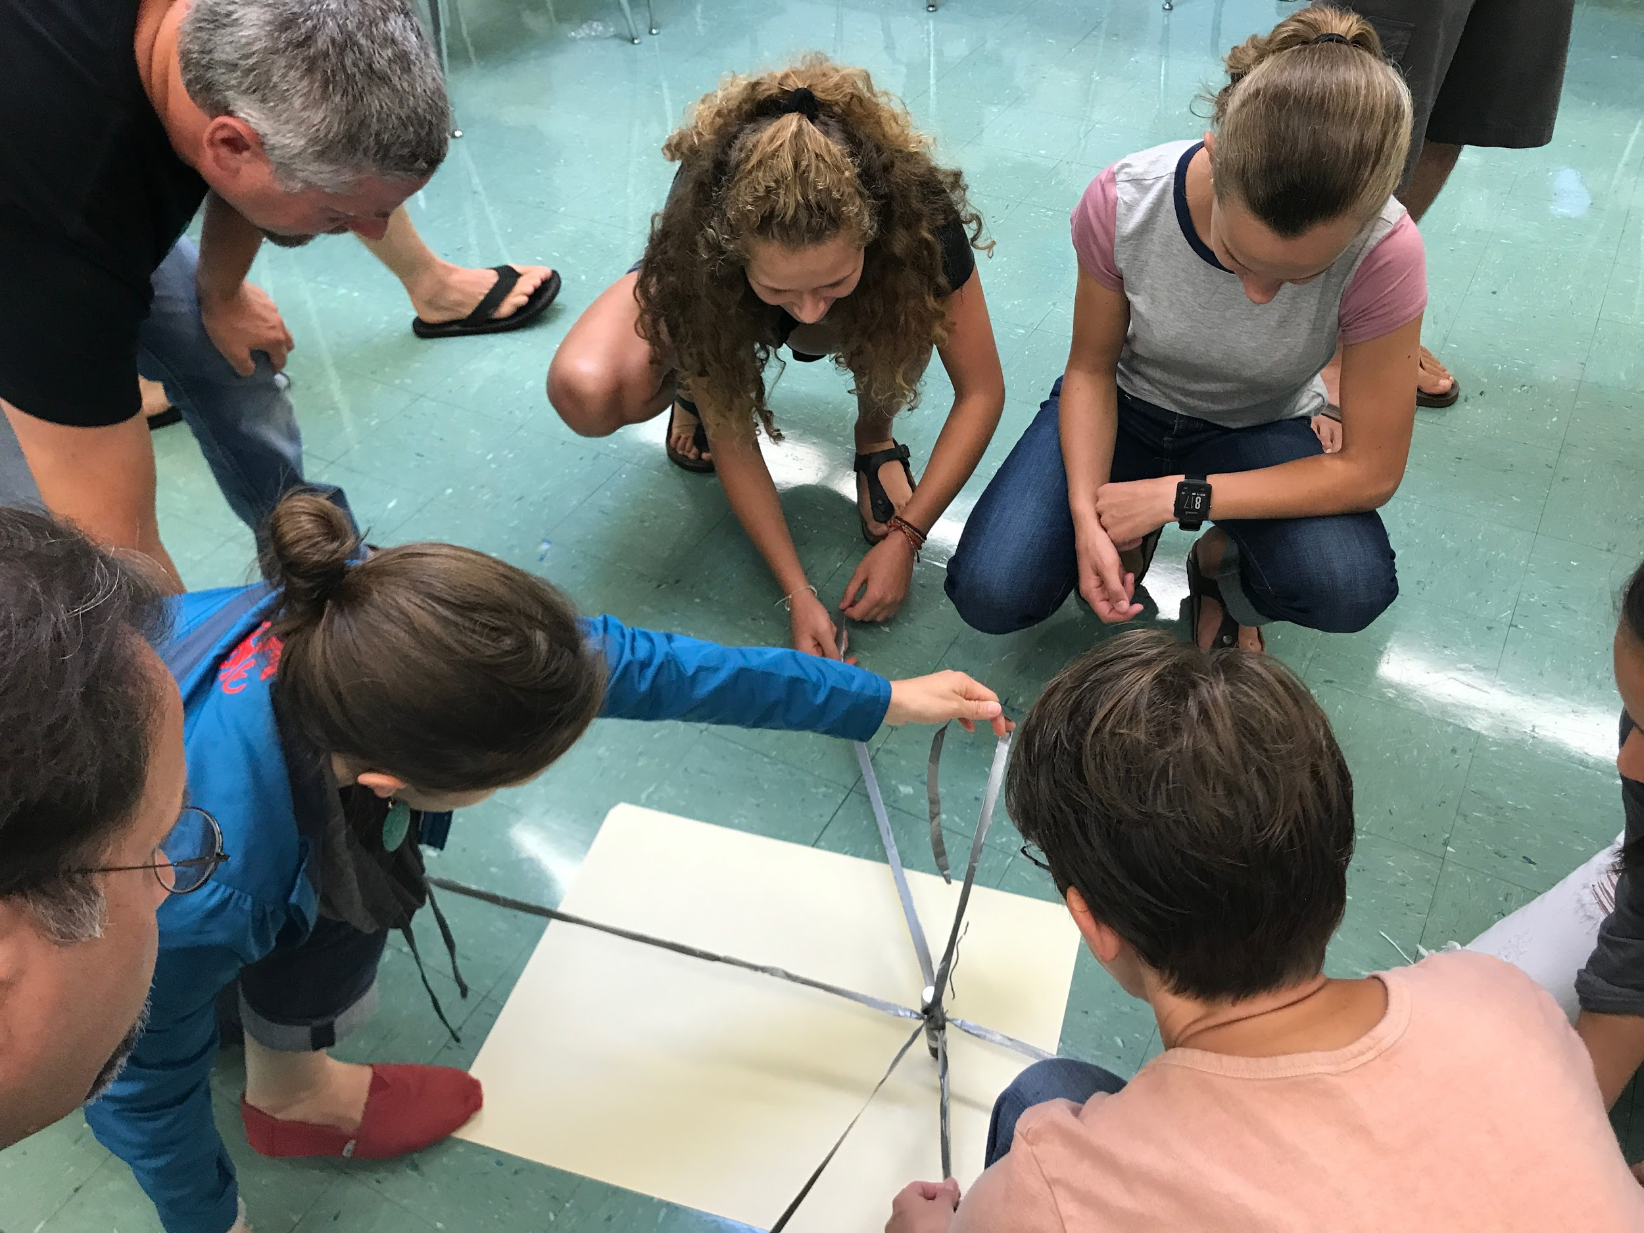

Slide 12
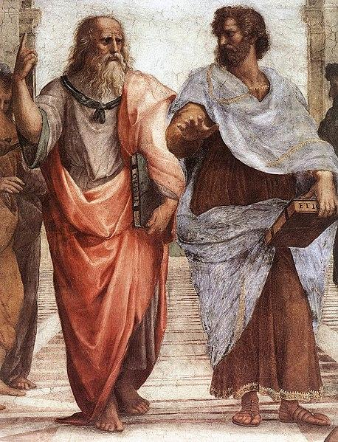
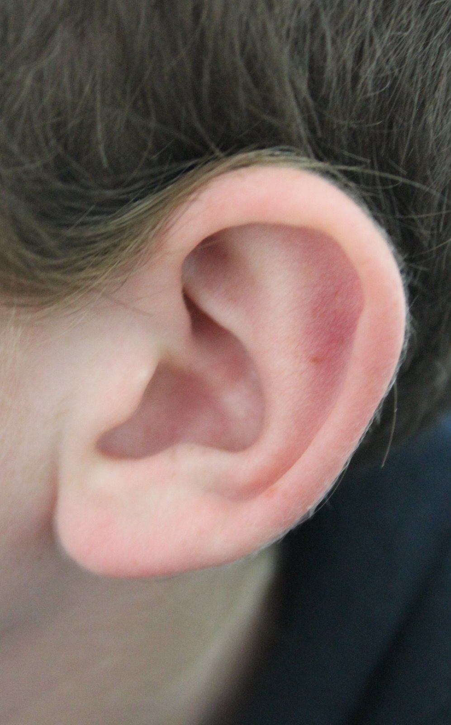
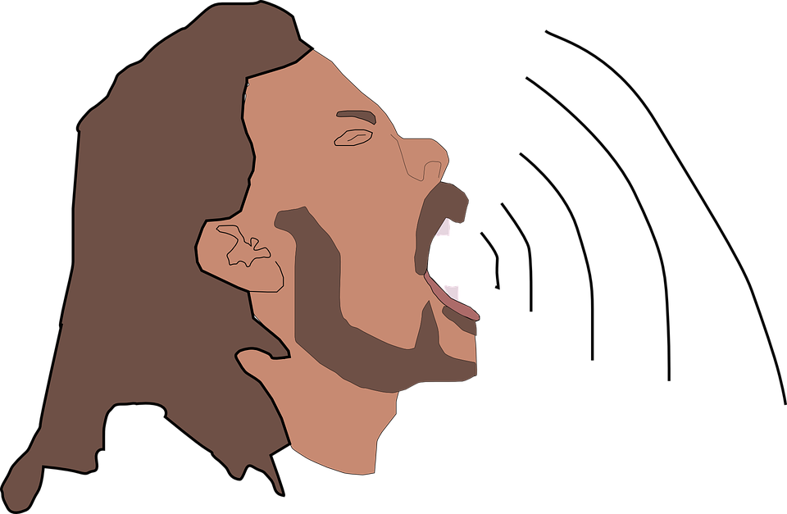
We have to Actively Teach the Specific Skills that We Want Students to Demonstrate!!
How to disagree respectively
How to use Sentence Stems to Deepen Conversations
How to use
Eye Contact
How to use appropriate Body Language
How to ask Questions!
How To Annotate Text for Discussion
How to use Active Listening
How to use appropriate Tone of Voice

Slide 13
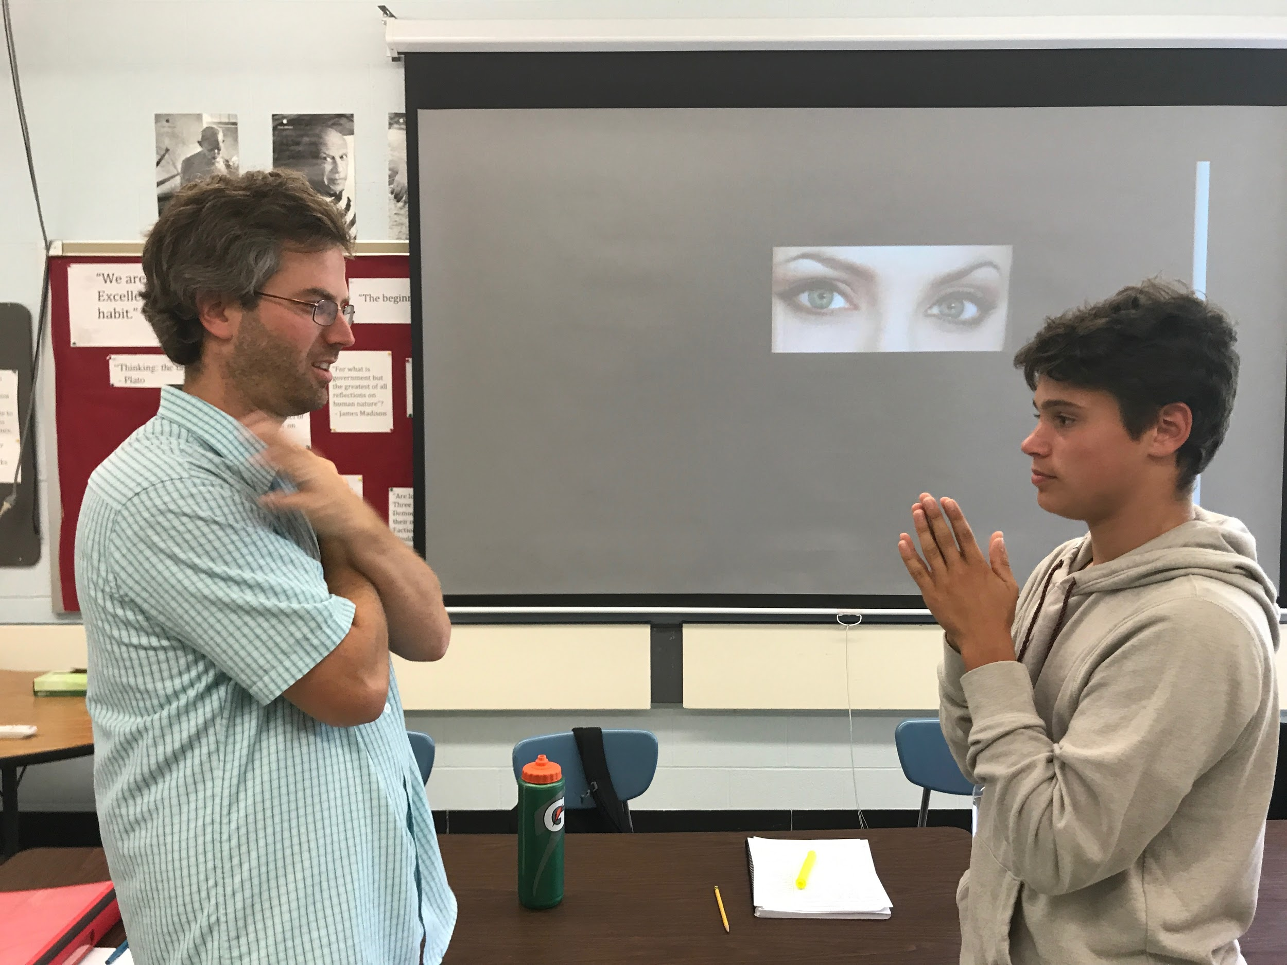
Teaching Eye Contact

Slide 14
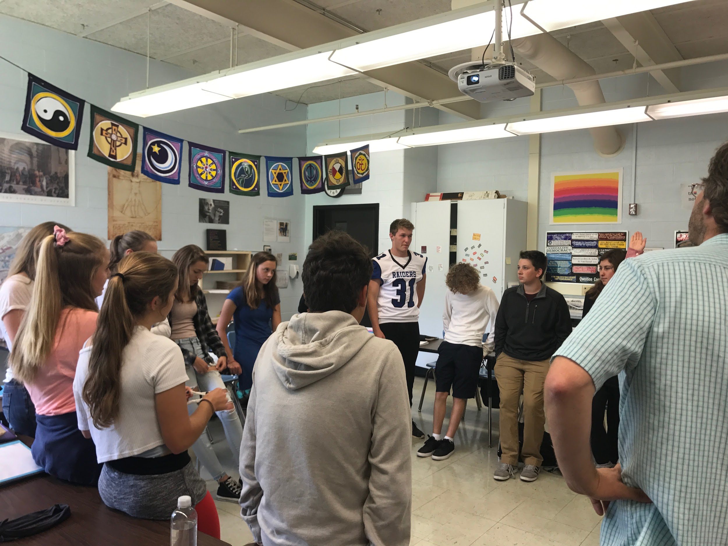
Teaching Body Language

Slide 15
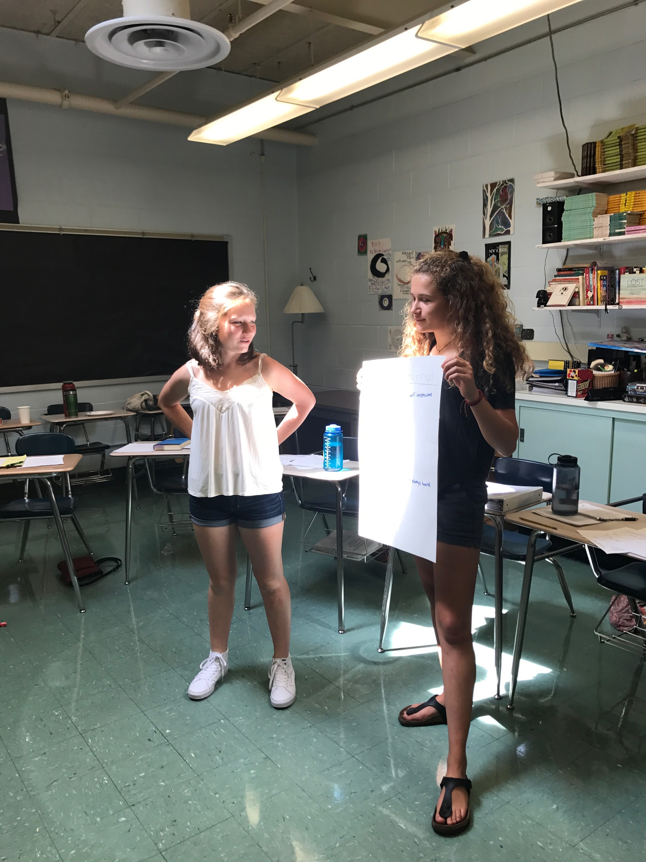
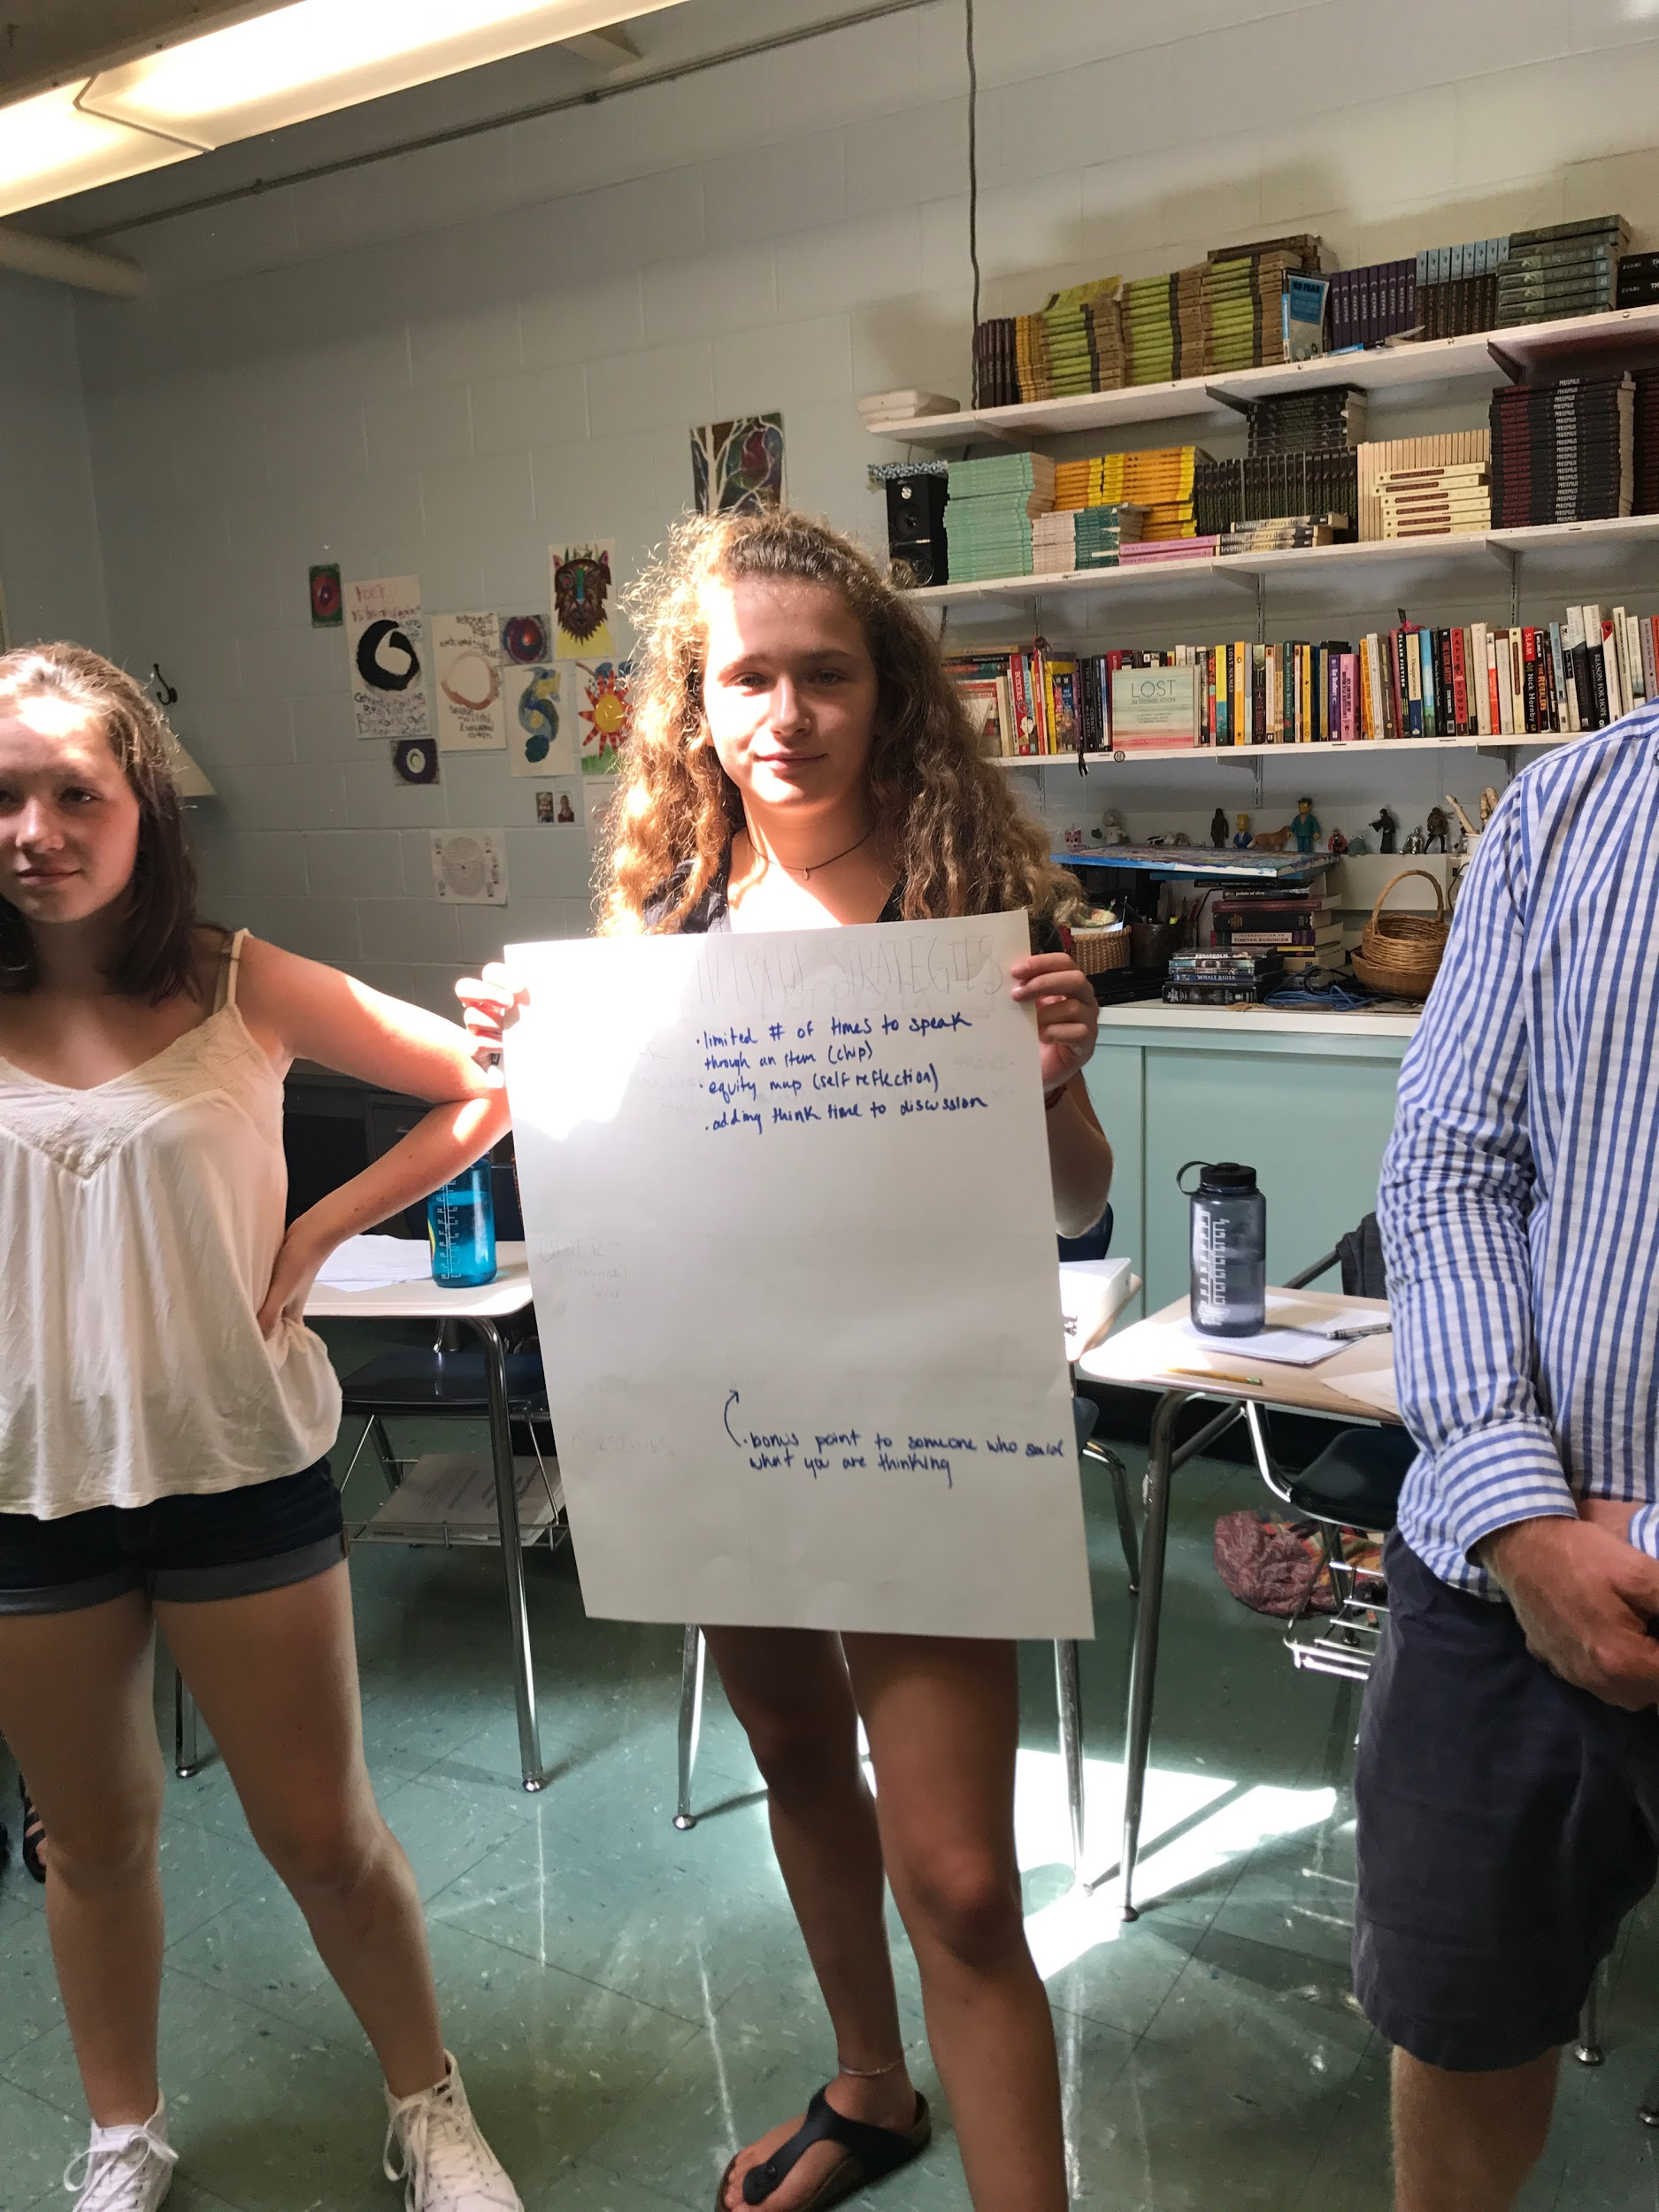
Teaching Active Listening

Slide 16
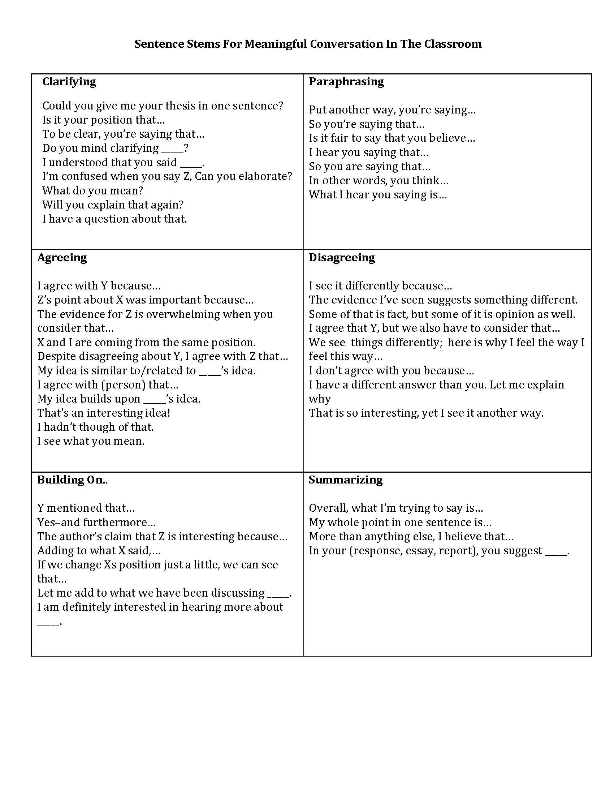
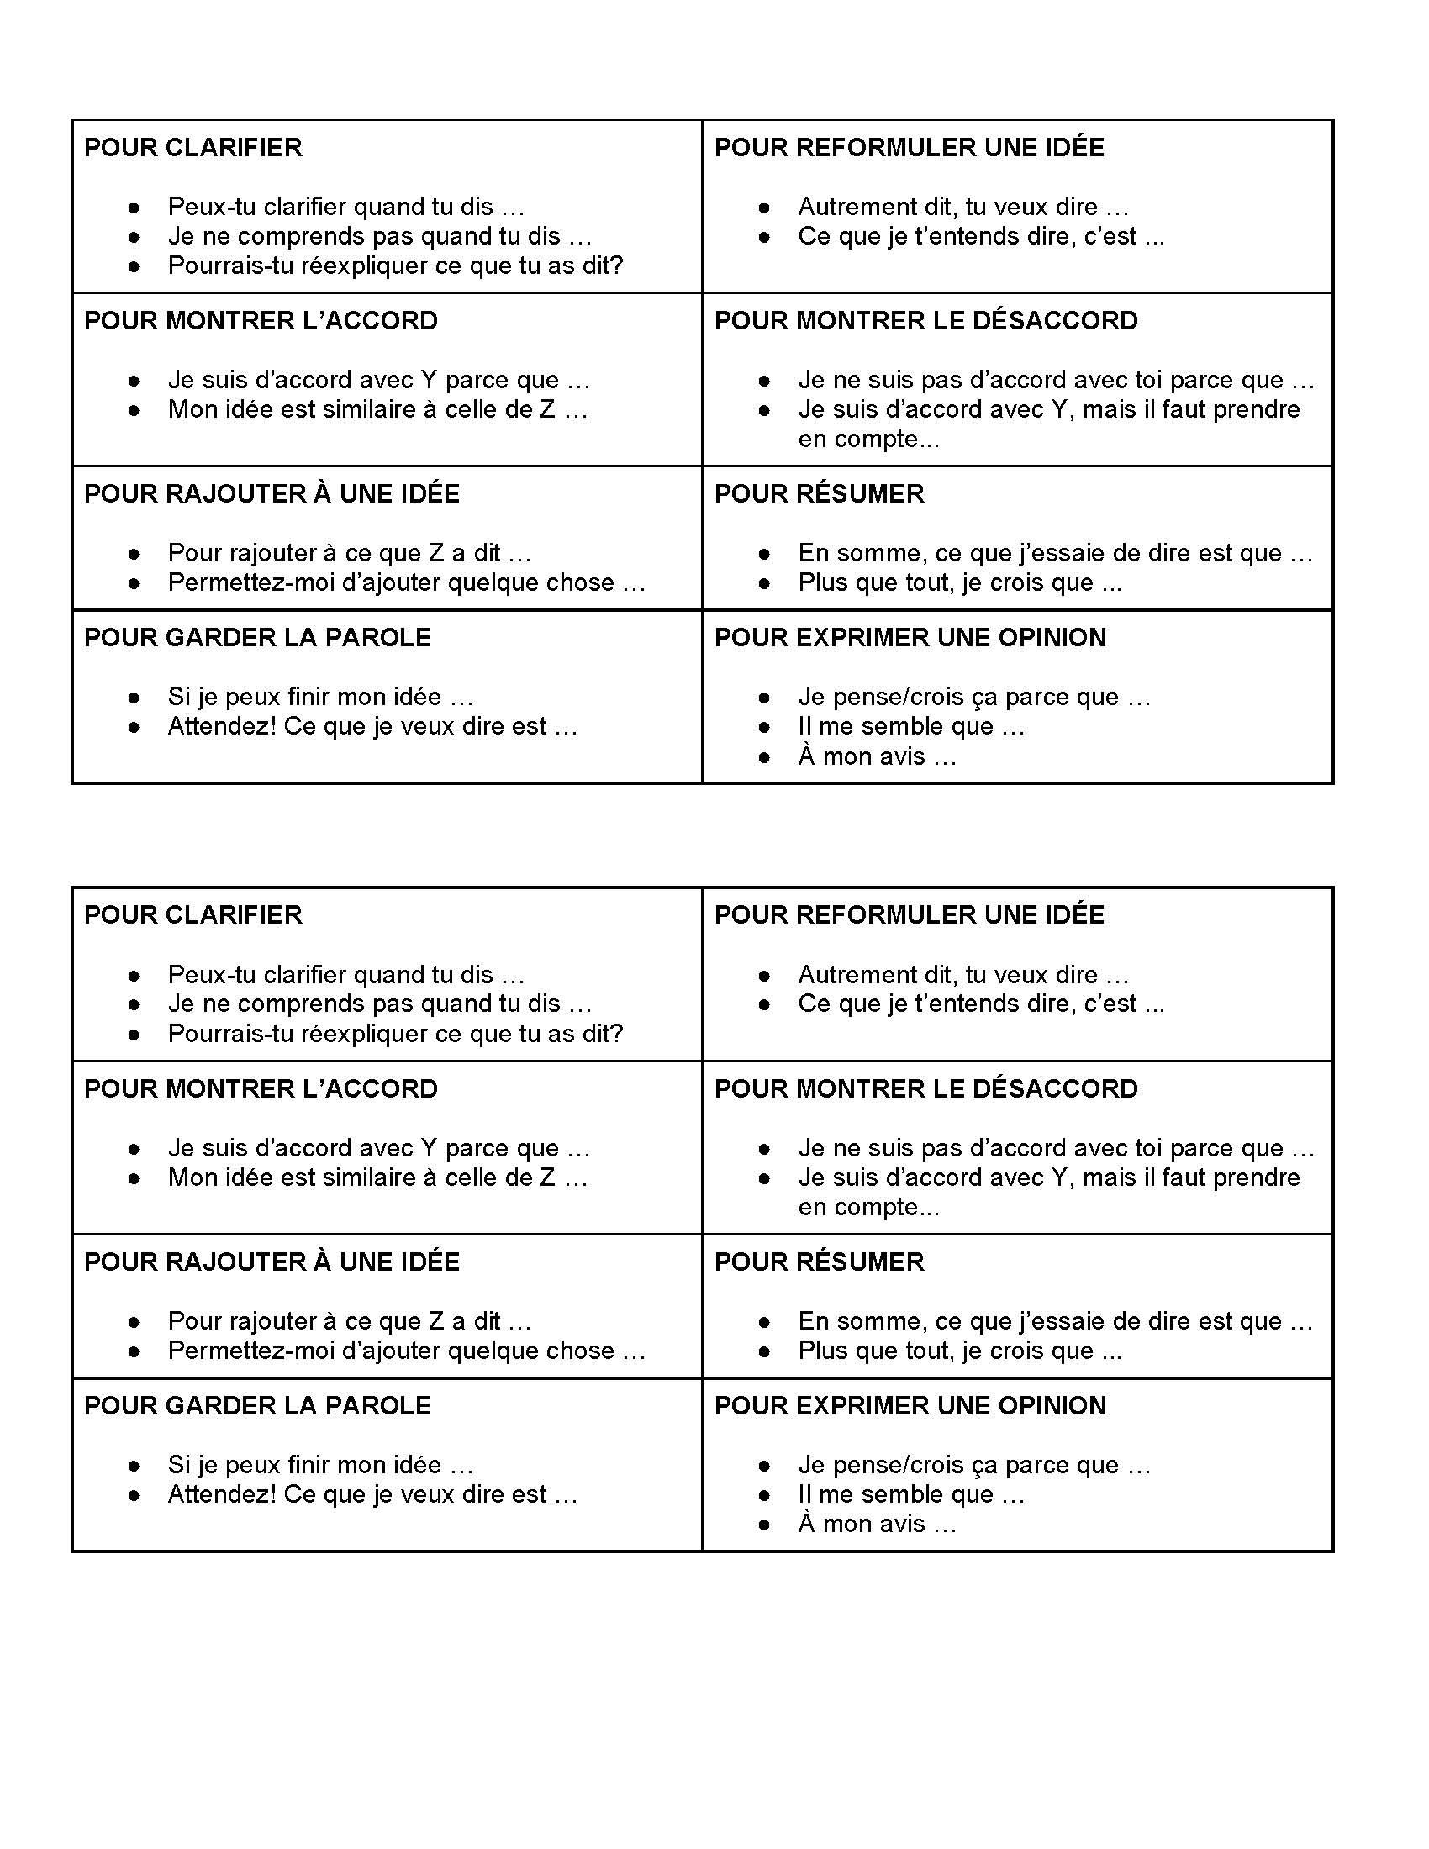
Teaching How to Deepen Conversations Using Sentence Stems

Slide 17
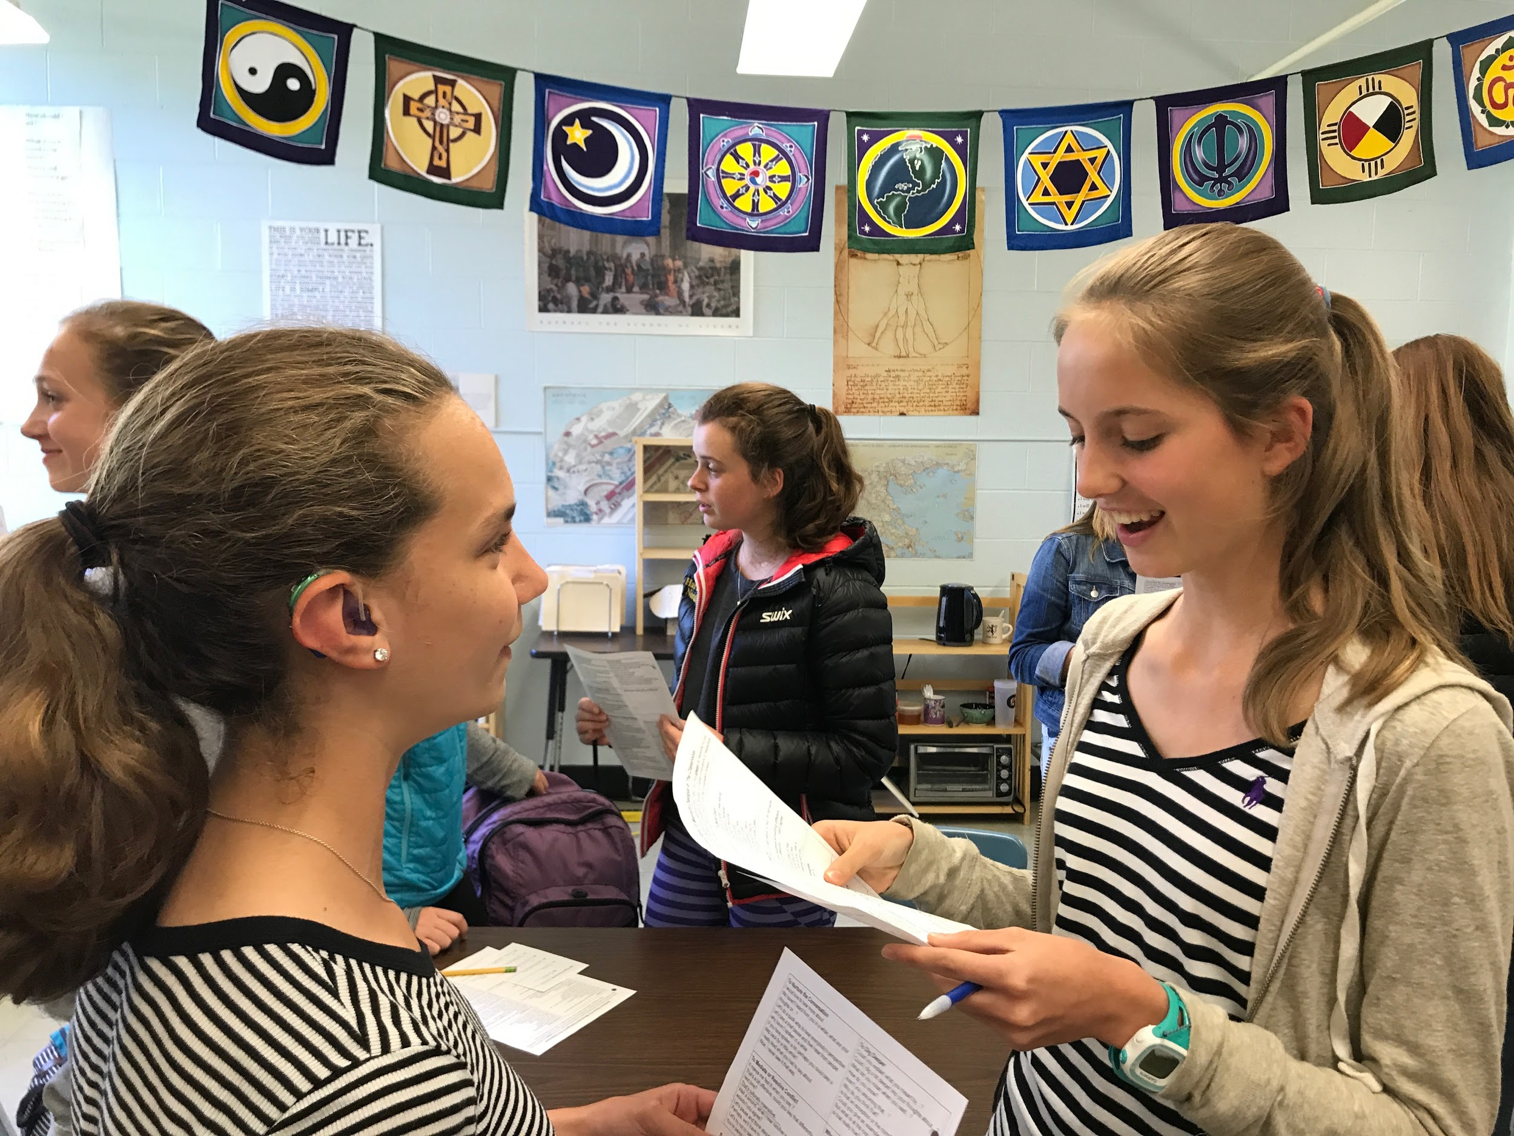
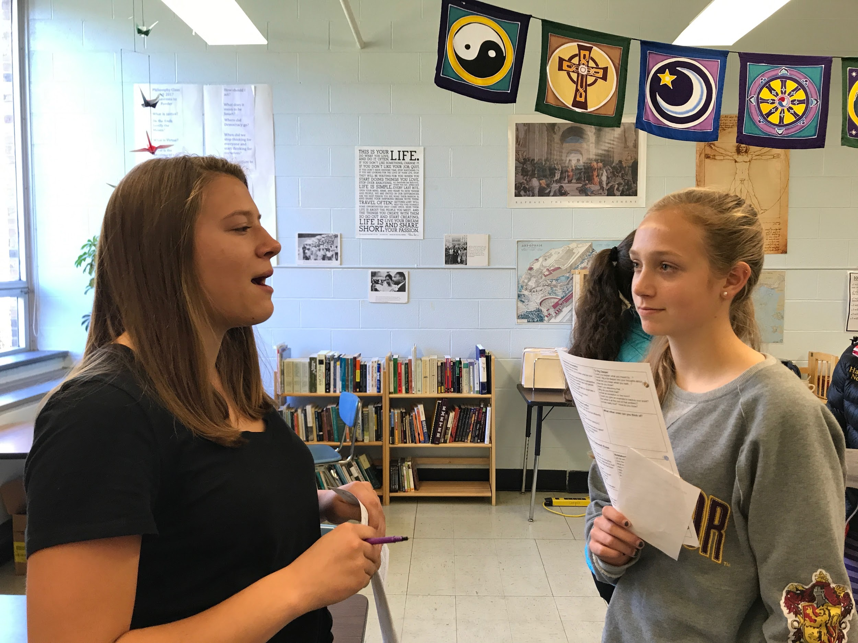
Teaching How to Ask Clarifying and Probing Questions
Students Teaching Students

Slide 18
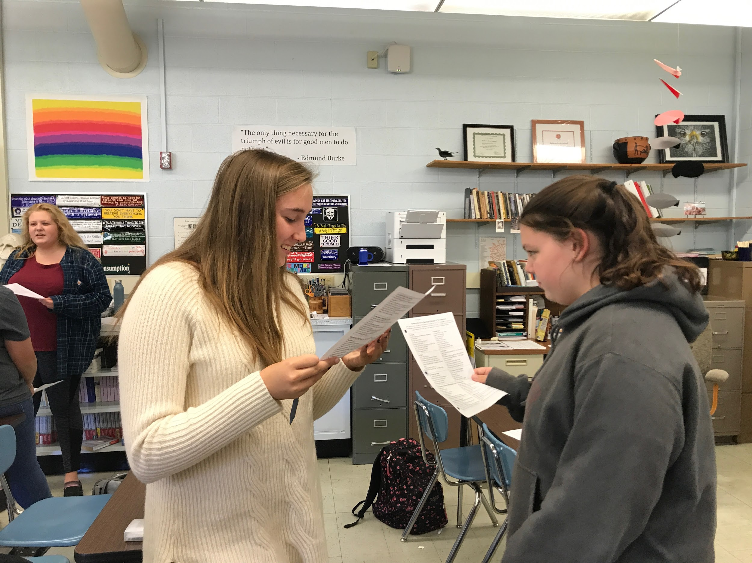
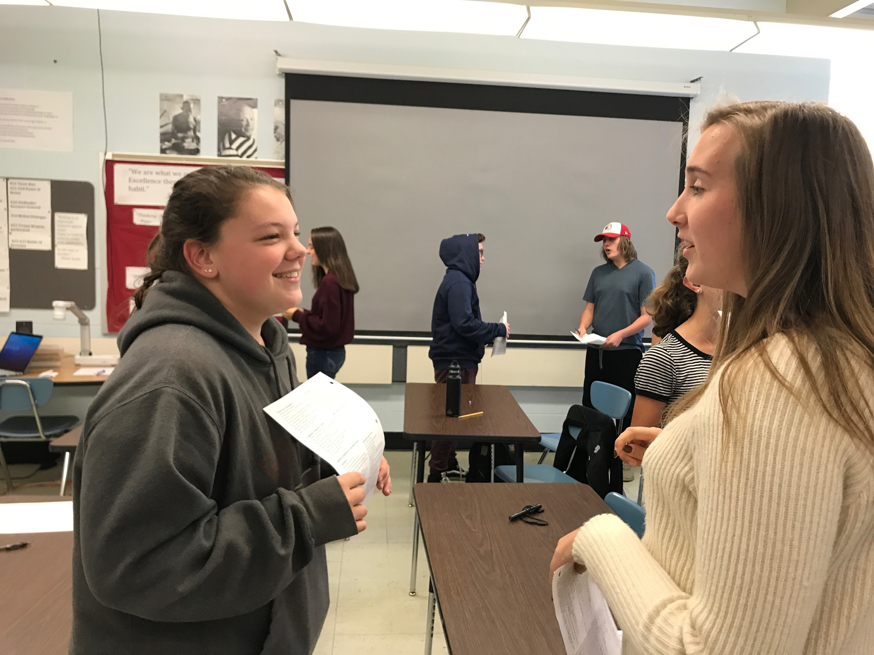
Teaching and Practicing How to Disagree Respectively

Slide 19
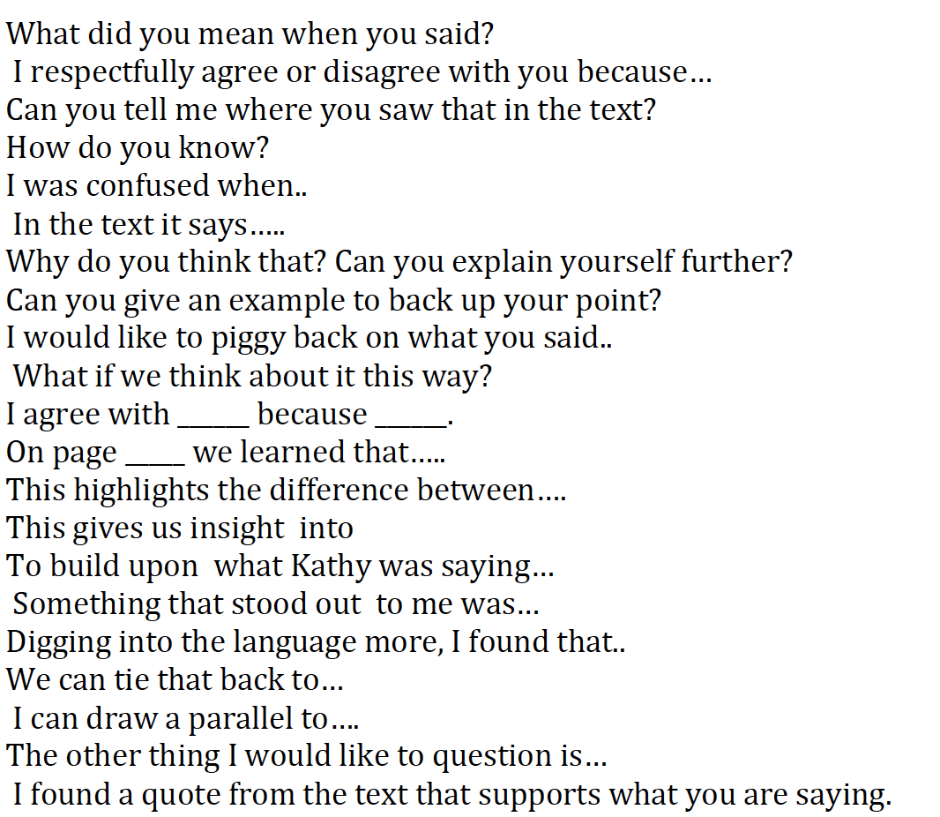
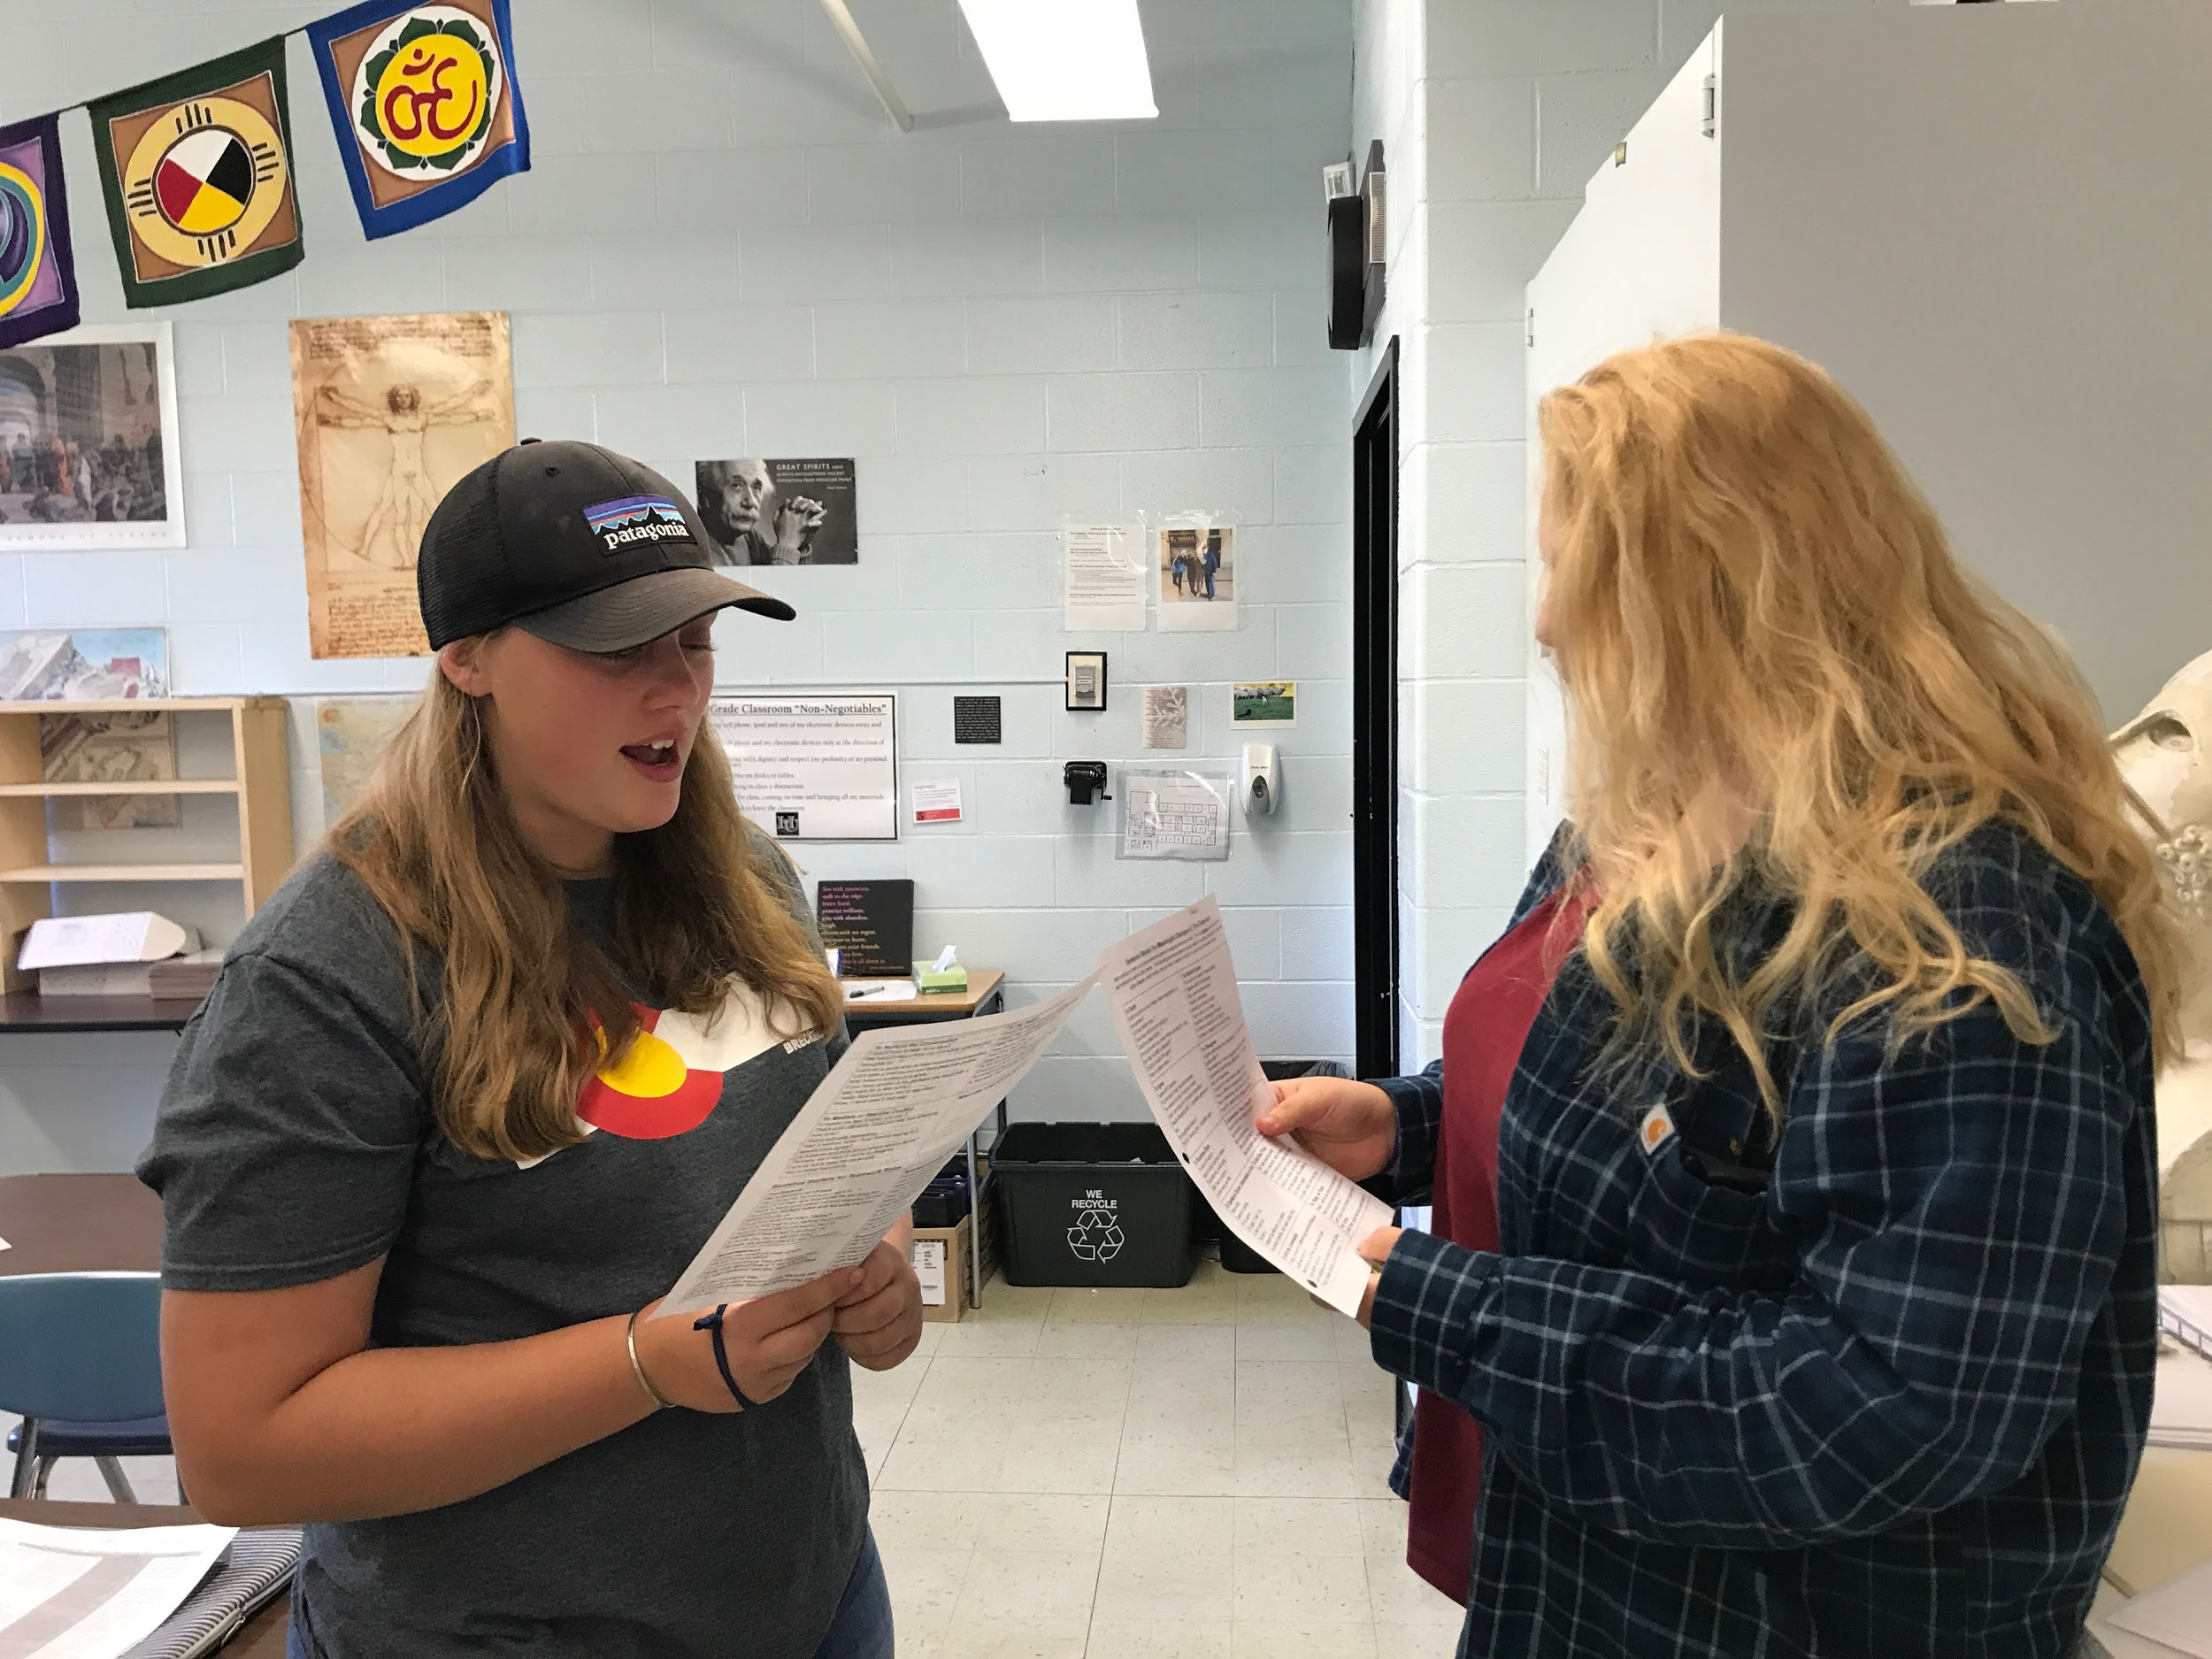
Teaching and Practicing Skills of Civil Discourse

Slide 20
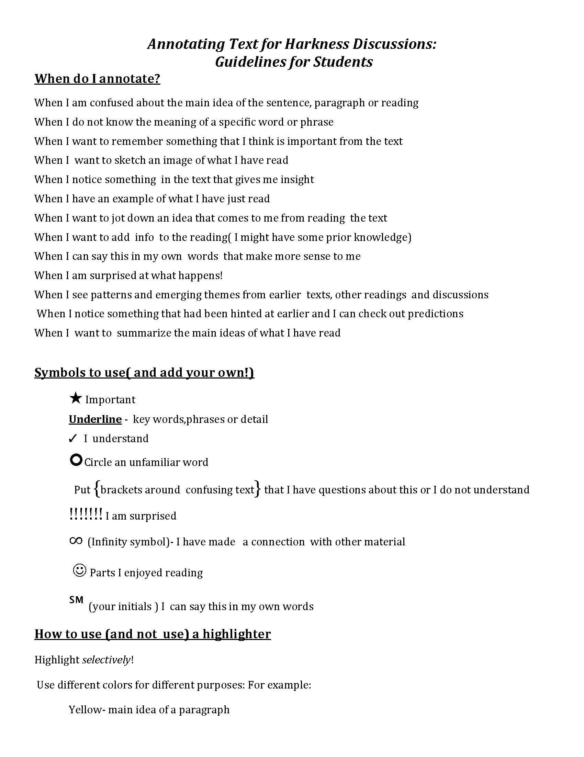
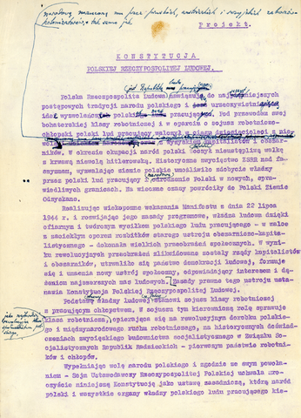
Teaching How to Annotate Complex Text

Slide 21
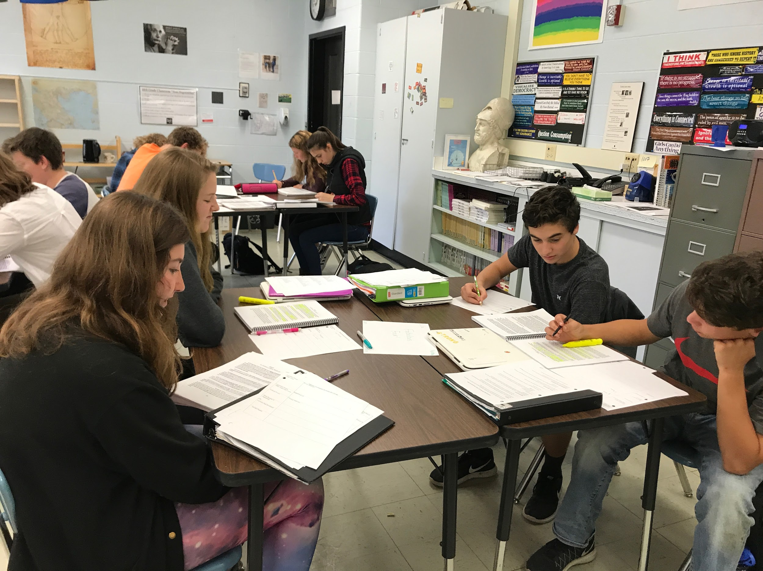
Students practice Roles of Harkness In Teamwork
Quality Control
Facilitator
Process
Analyst
Spokesperson

Slide 22
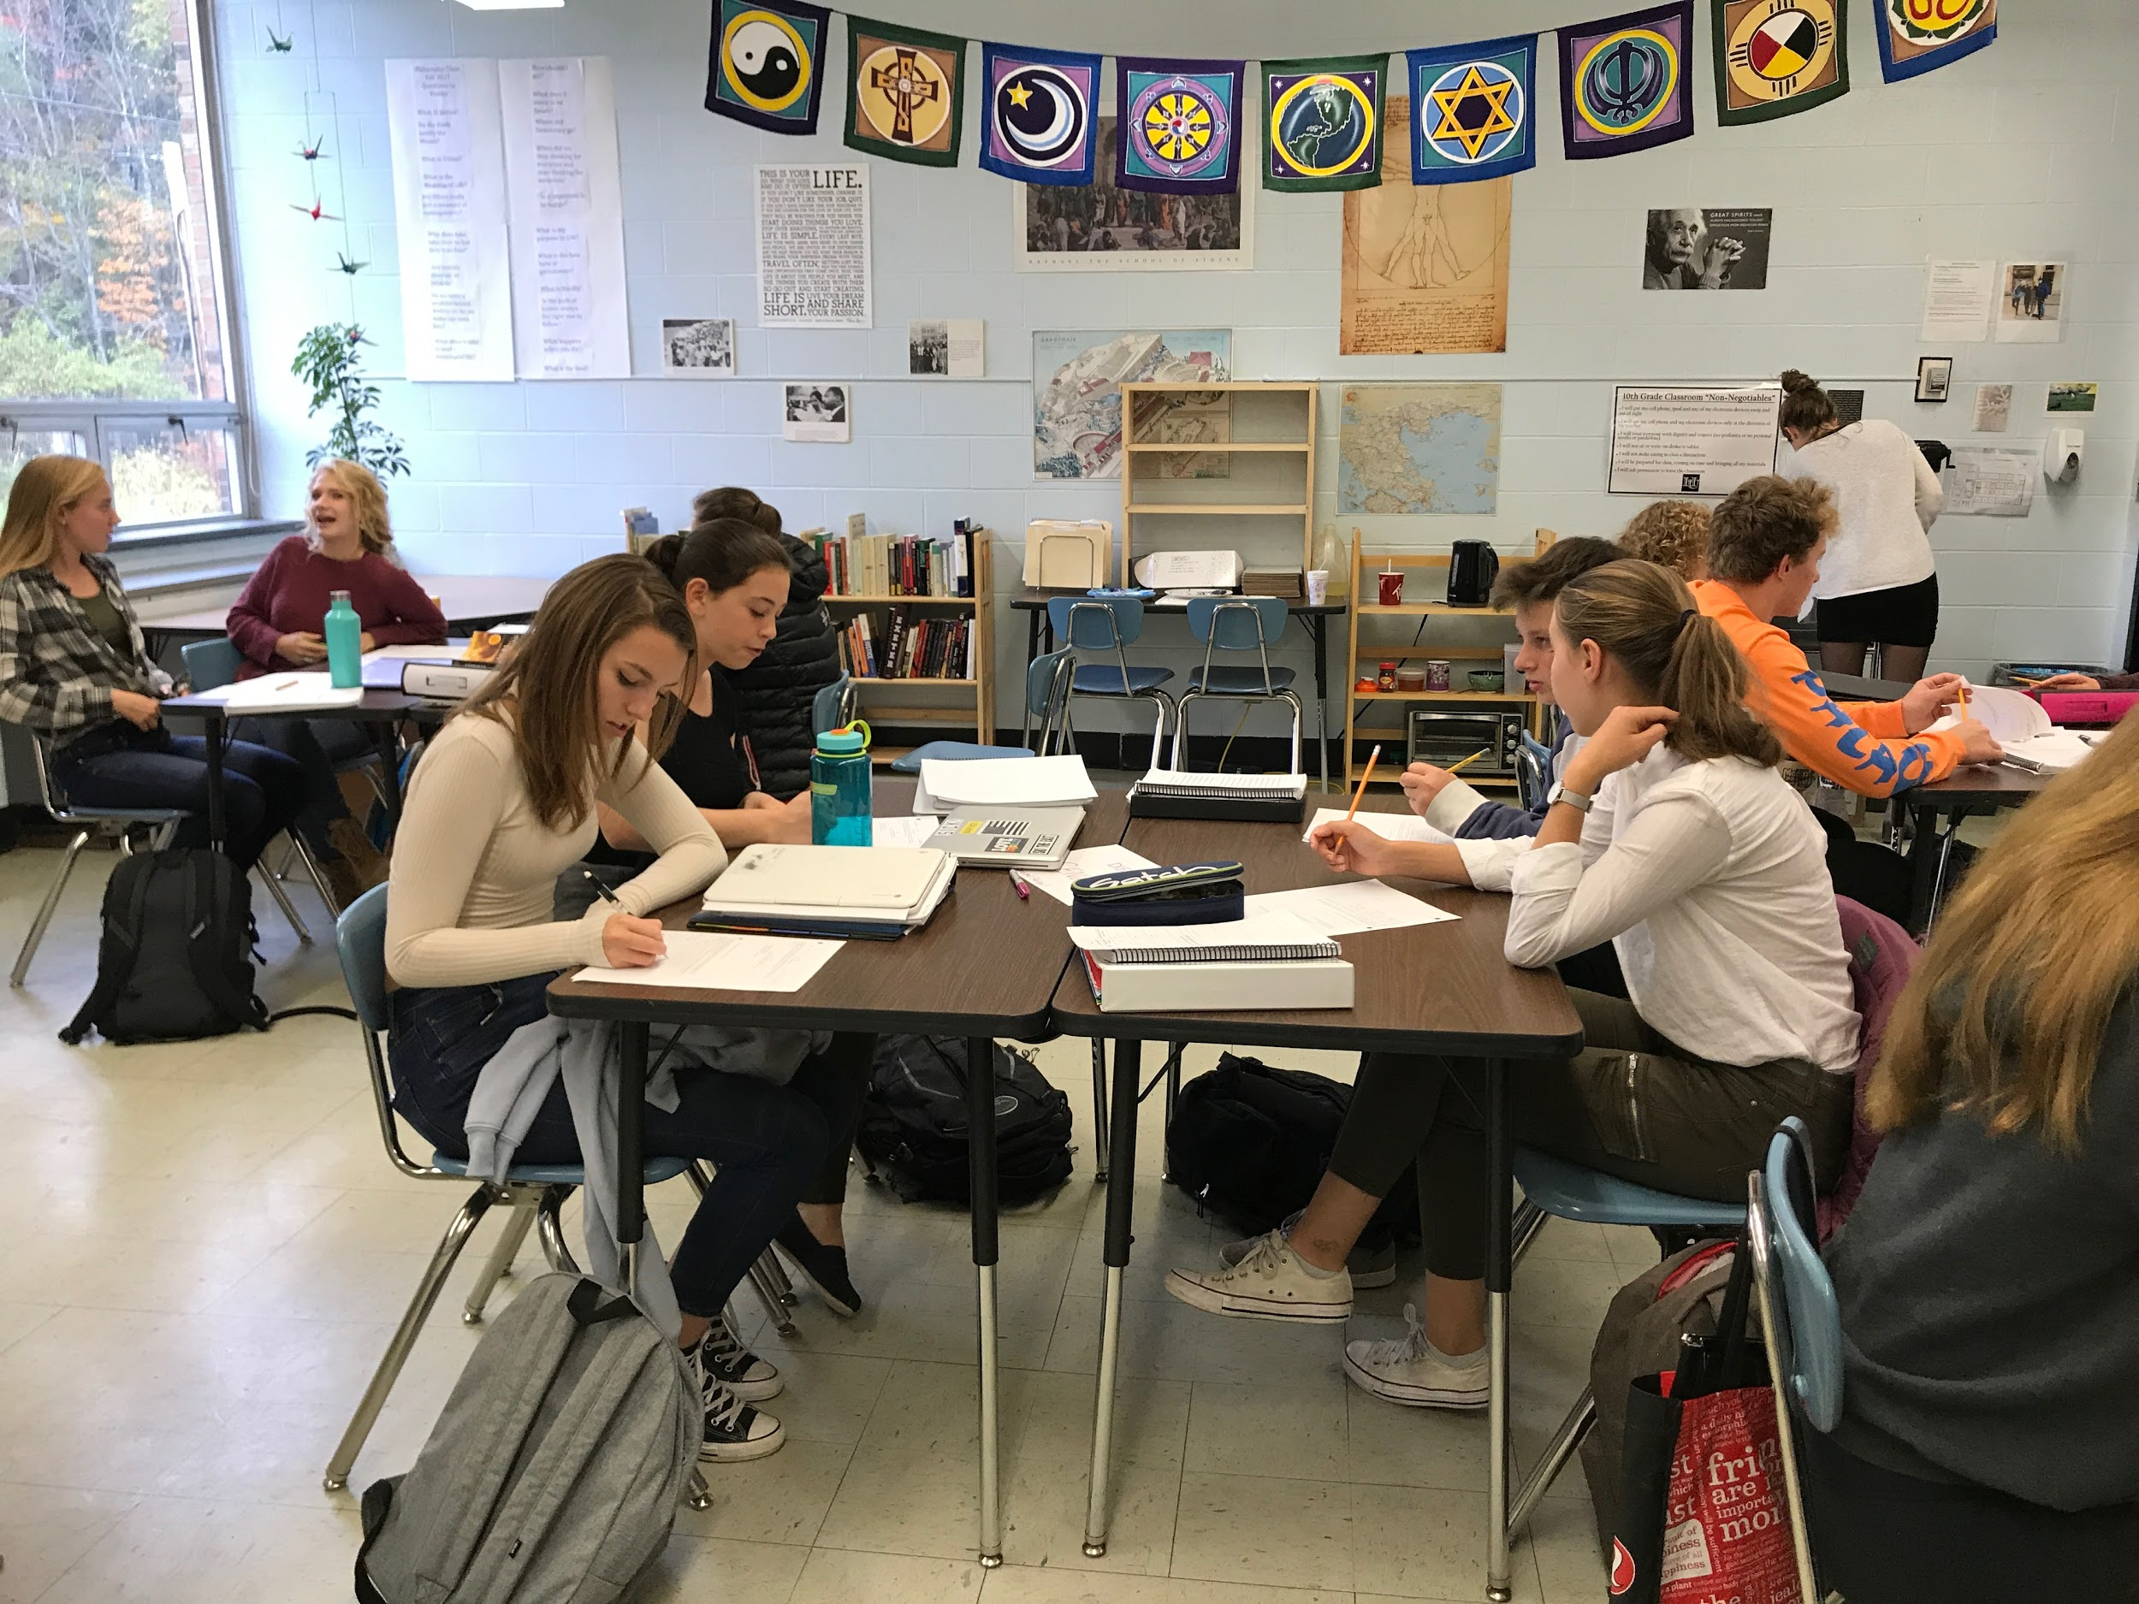
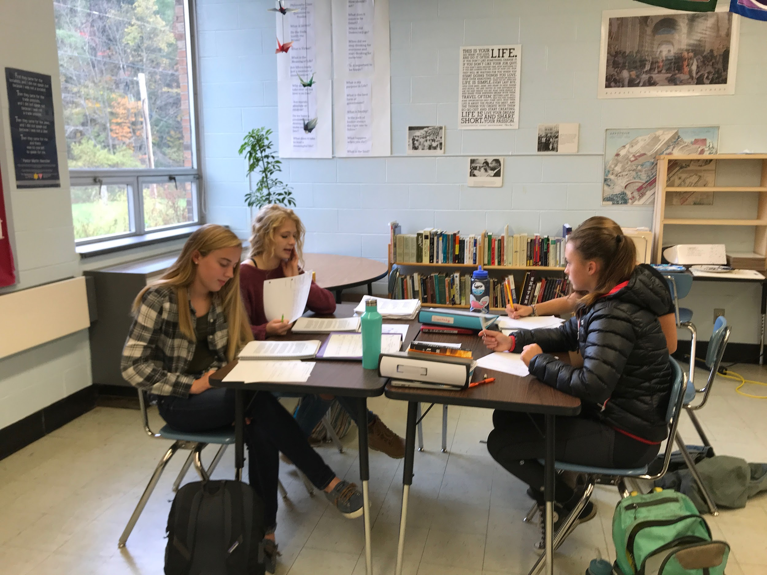
Students Practice Academic and Soft Skills in Teams of Four
The focus is on Self-Assessment and Metacognition

Slide 23
The Final Step: “Coming to the Table”
How Can We Move from Teacher-Centered to Teacher-Facilitated to Student-Driven classrooms?
“En Francais Aussi! Notre Premier Harkness”

Slide 24
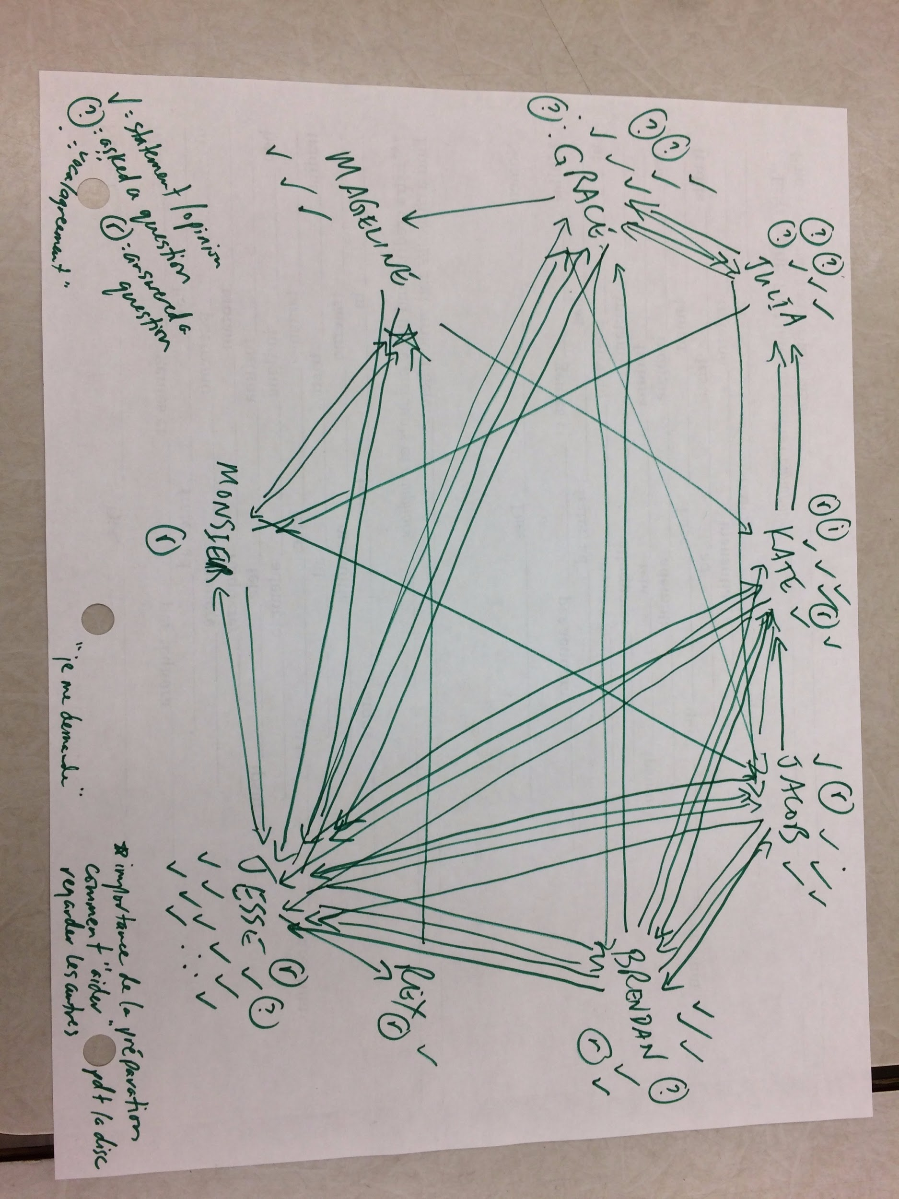
Assessing Harkness:
Teacher and Student Reflection and Metacognition

Slide 25
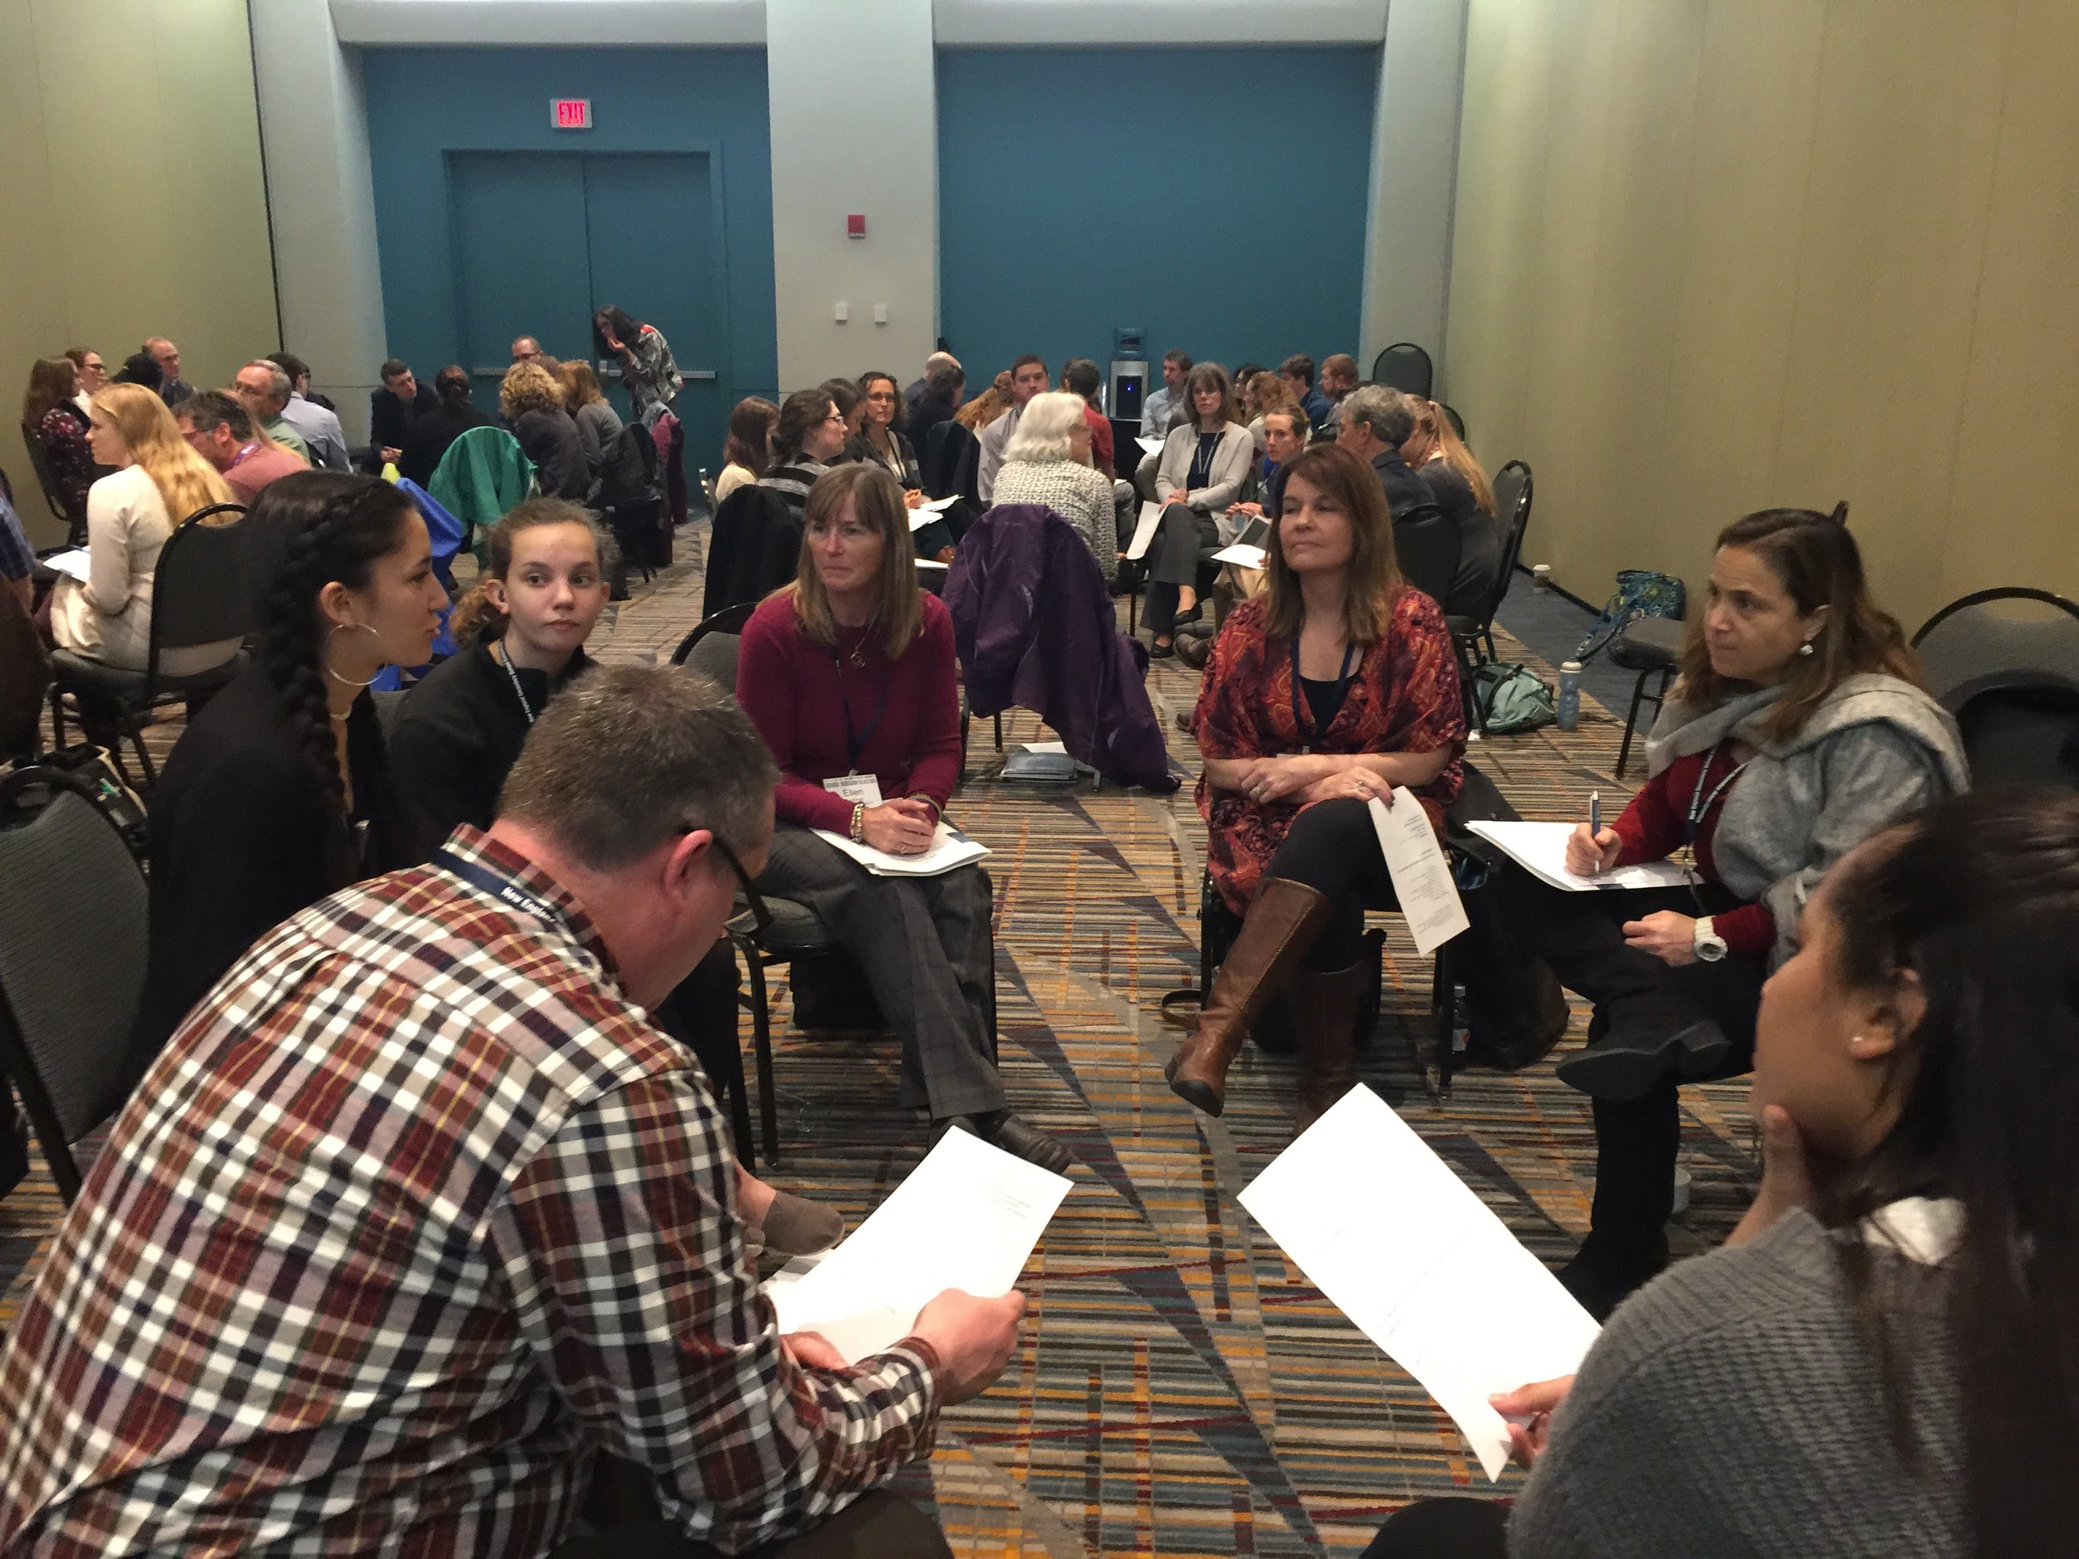
The Socrates Cafe!
A School-Community Partnership for Inquiry

Slide 26
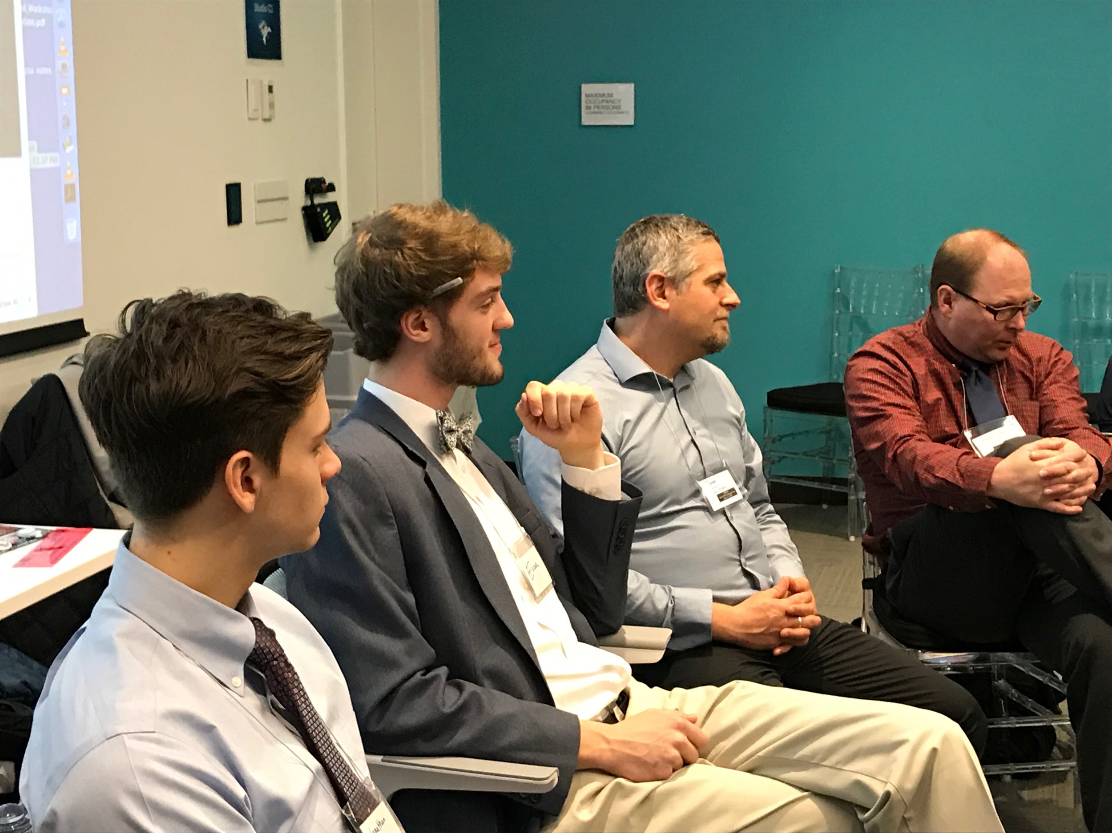
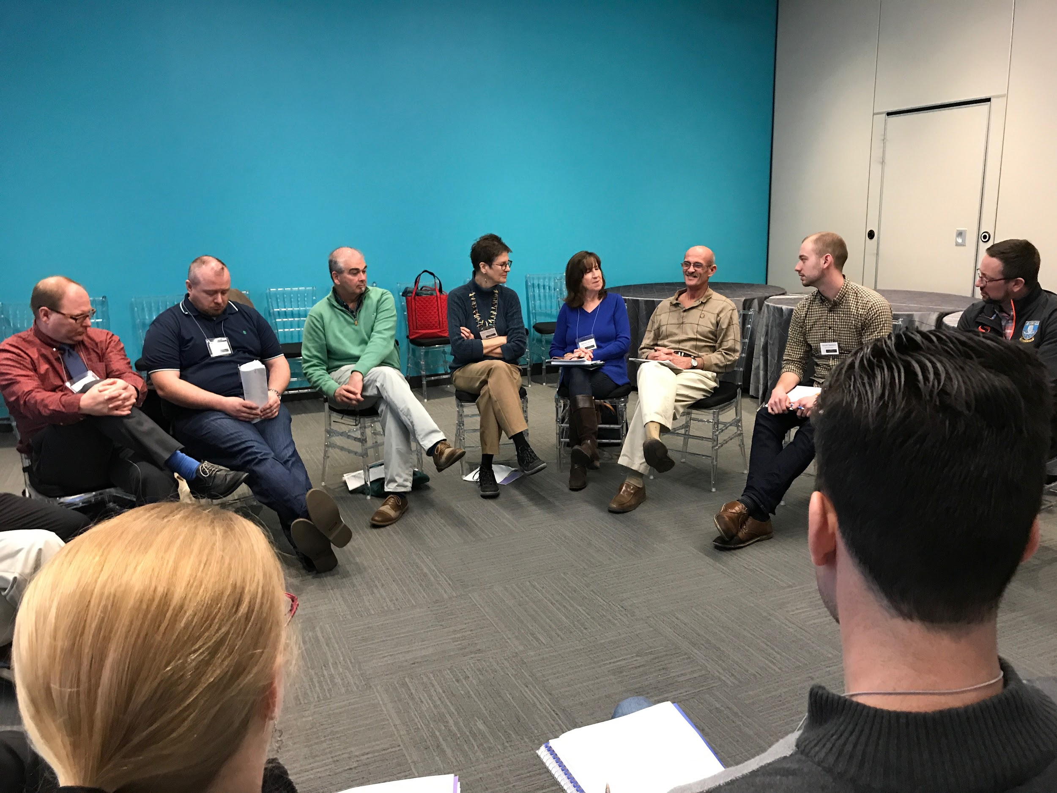
Student Leadership, Learning in Community, Modeling Civil Discourse

Slide 27
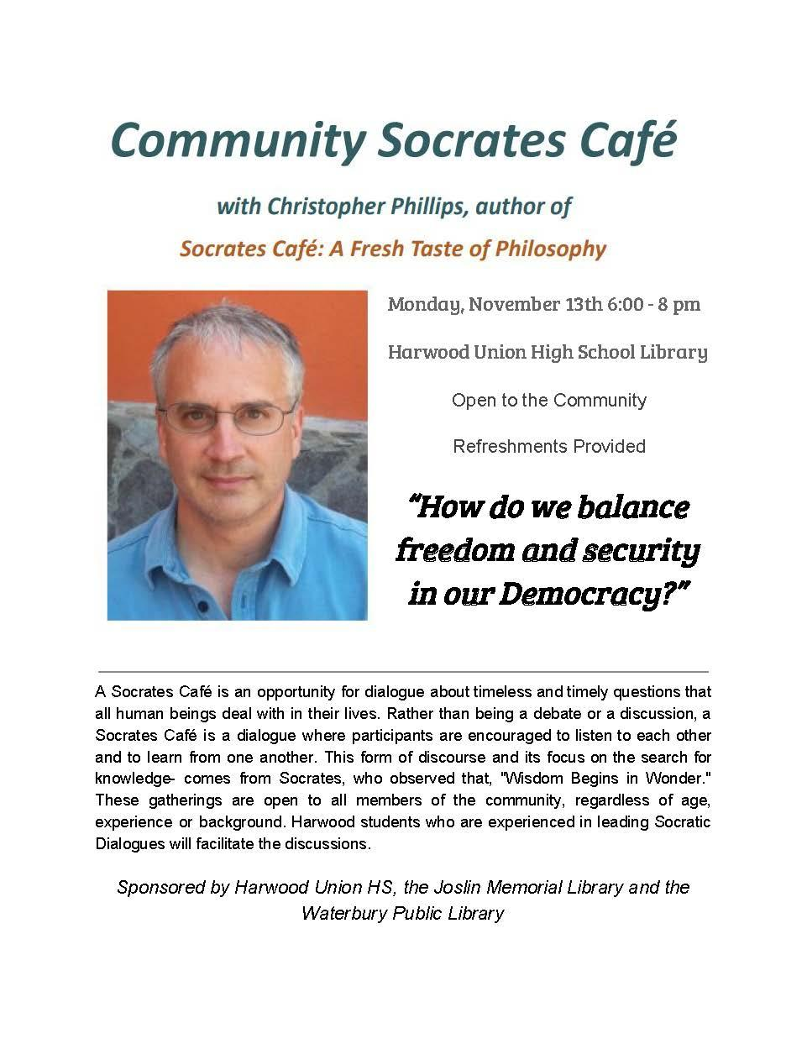
OUR NEXT CAFE!
Featuring Christopher Phillips
Monday, November 13
6:00-8:00 PM HUHS Library

Slide 28
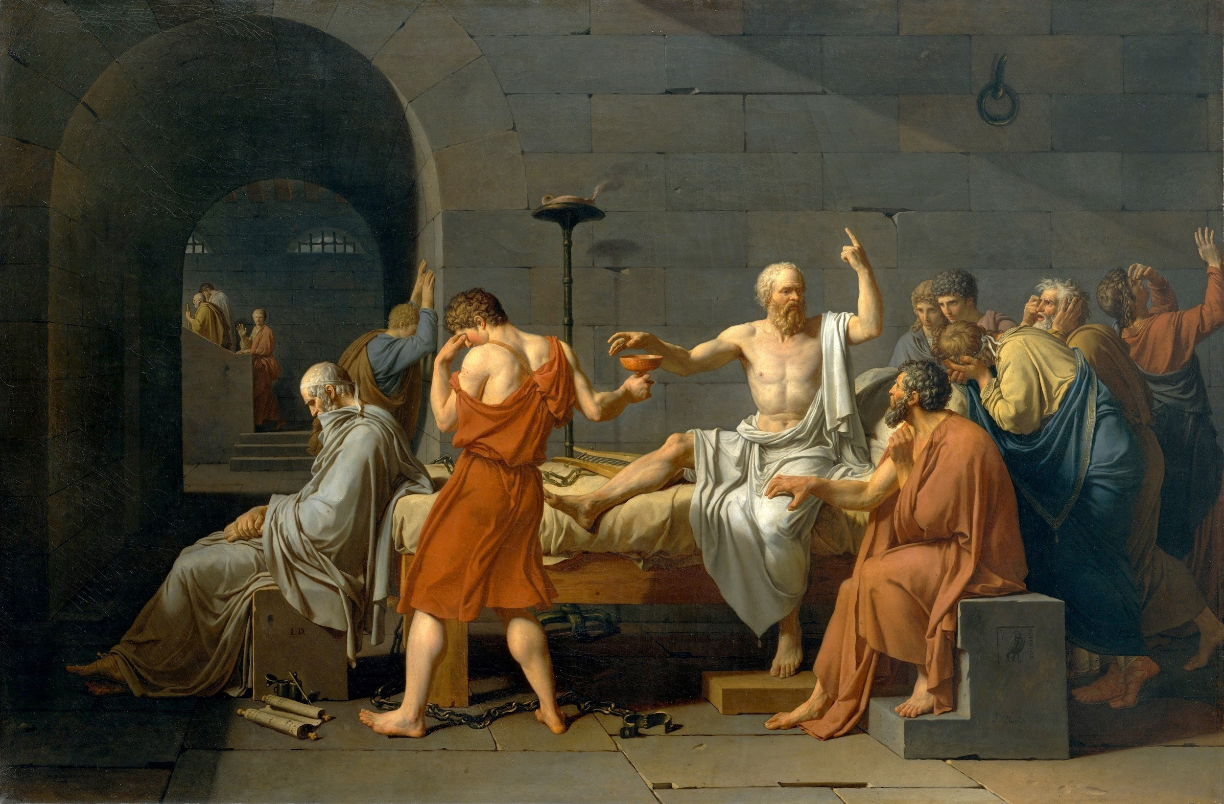
Learning Targets for Socrates Cafe Facilitation
Kate Toland has done some great work to create Learning Targets for Facilitating Socrates’ Cafes!

Slide 29
Let’s Do a Socrates Cafe!
Our Question:
“How Can Actively Teaching Empathy, Transform Teaching and Learning?”

Slide 30
Join Our Great Experiment!
For more information contact:
Strategies for Classroom Dialogue ( https://katherinecadwell.com/)
Katherine Cadwell, HUHS: kcadwell@wwsu.org or katherinewcadwell@gmail.com
For more information about our class, see About Strategies in Classroom Dialogue (https://classroom.google.com/u/1/c/NTQ3NDMxNDAxNFpa- write to me for permission to log on to the site)
With Gratitude to Aida Conroy, Noble Academy, our Harwood students and The Rowland Foundation

